Slide 1
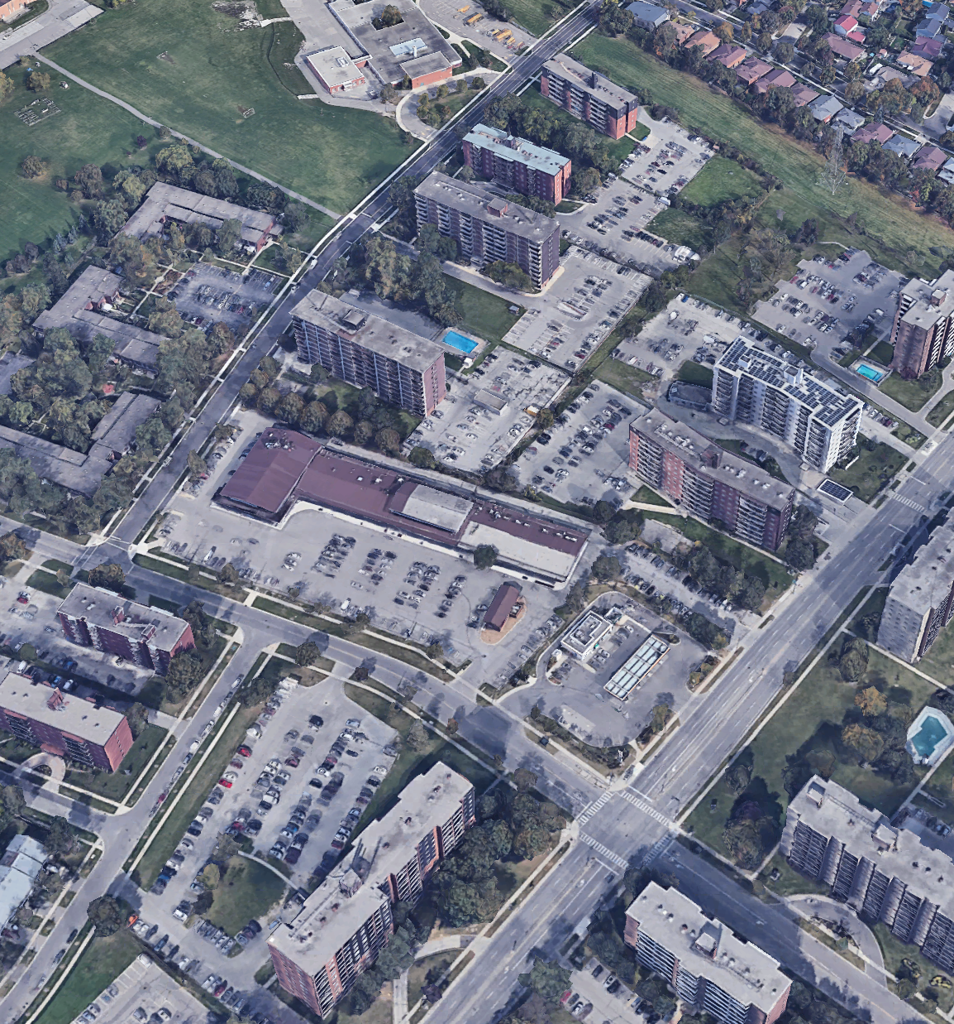

Community Meeting Presentation
3403-3445 Fieldgate Drive (Fieldgate Plaza)
November 26th, 2024

Slide 2
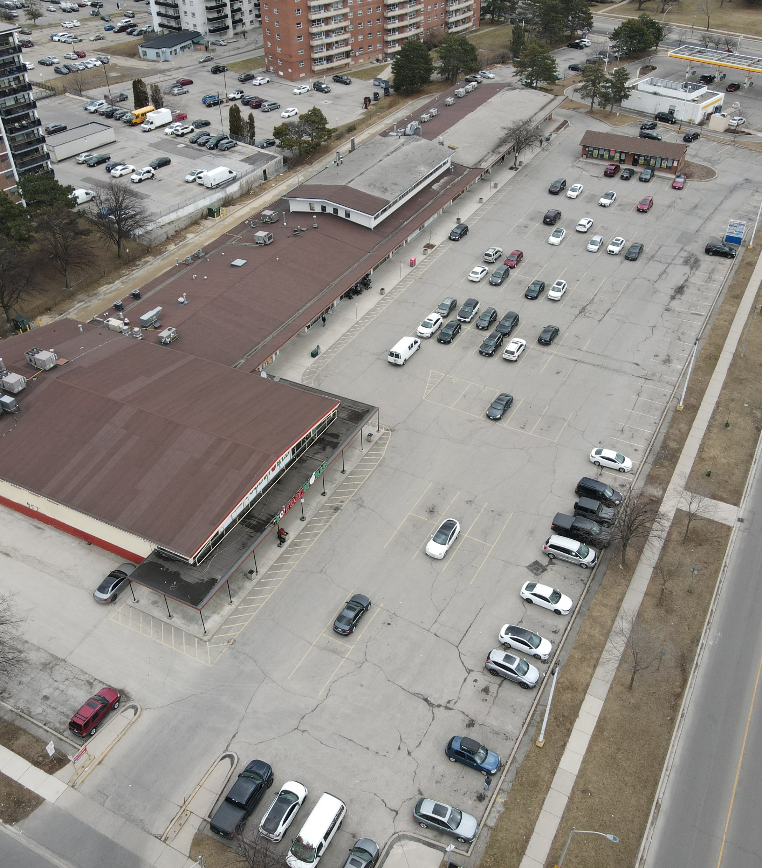
Agenda
Existing Site Context
Planning Policy Context
Overall Planning Process
Proposal
Comments/Questions

Slide 3

1
Existing and
Proposed Context

Slide 4
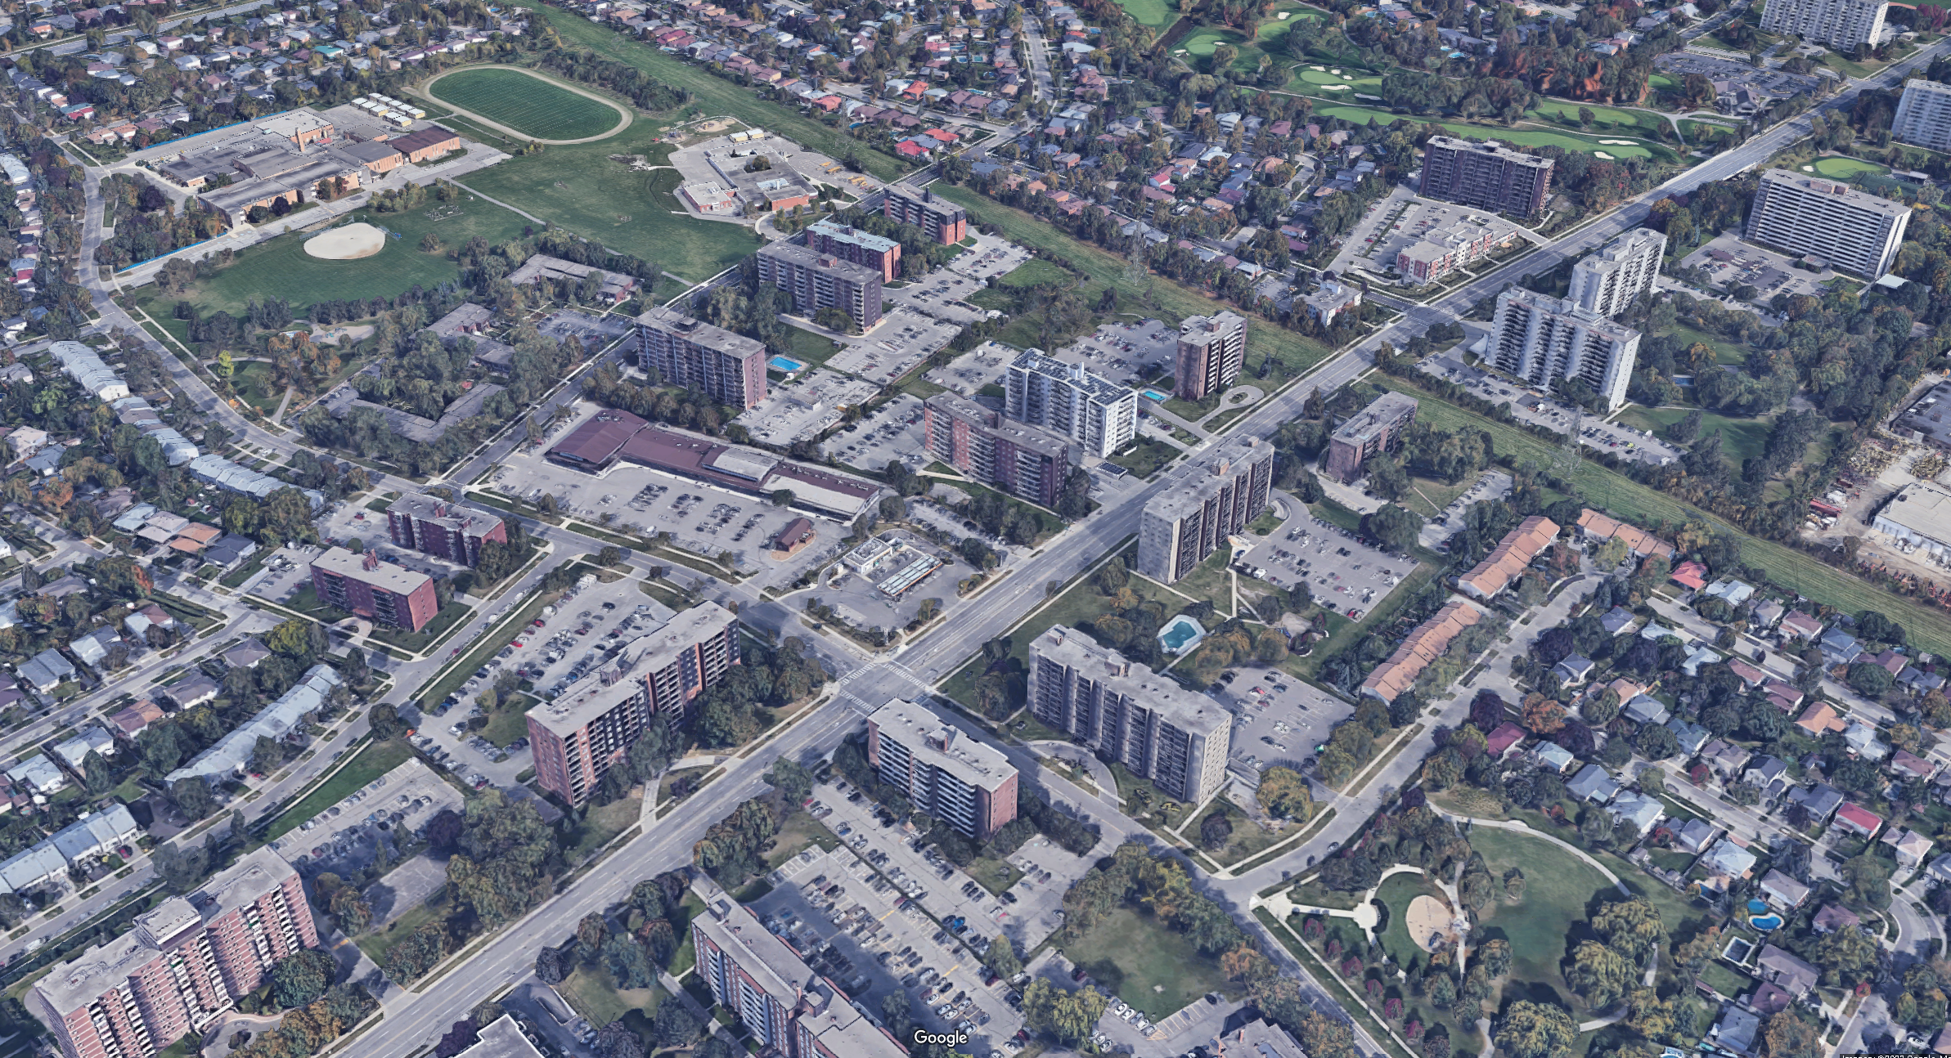

Site Context
Glenforest Secondary School
Forest Glen Public School
11-storeys
6-storeys
14-storeys
Forest Glen Park
6-storeys
14-storeys
11-storeys
11-storeys
14-storeys
10-storeys
14-storeys
18-storeys
Russet Homes Co-op Corporation
9-storeys
18-storeys
Property Address | 3403-3445 Fieldgate Drive, Mississauga, ON
Area (m²) | 15,842 m²
Existing Conditions on Site | A Commercial Plaza with separate commercial building and surface parking.
Land Use Designation | Mixed Use
Zoning (IZBL) | C2
Ponytrail Dr
9-storeys
11-storeys
Hydro Corridor
6-storeys
6-storeys
Fieldgate Drive
Bloor Street
15-storeys
11-storeys
11-storeys
8-storeys
12-storeys
Bethesda Common
8-storeys
#-Storeys Approved
#-Storeys Existing
#-Storeys Proposed

Slide 5
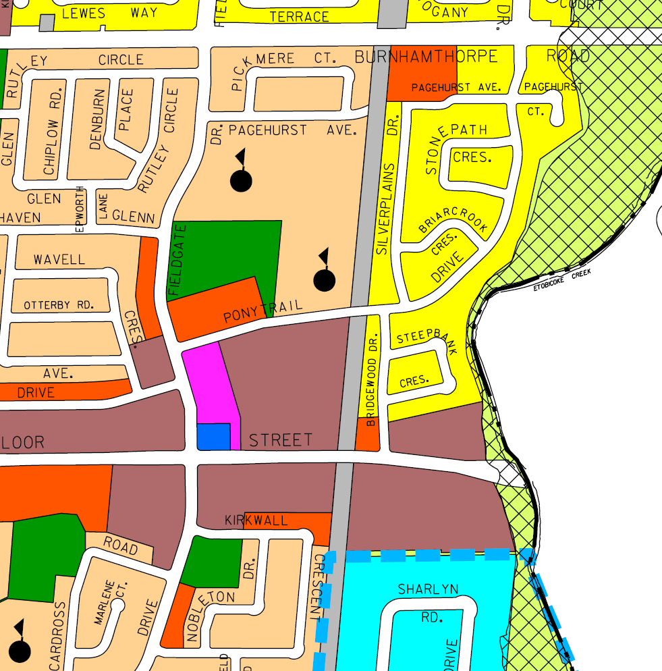
2
Planning Policy
Context

Slide 6



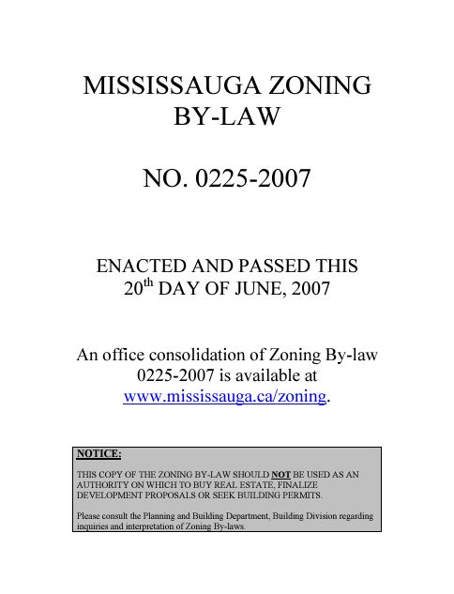
Relevant Land Use Policy Documents

Slide 7
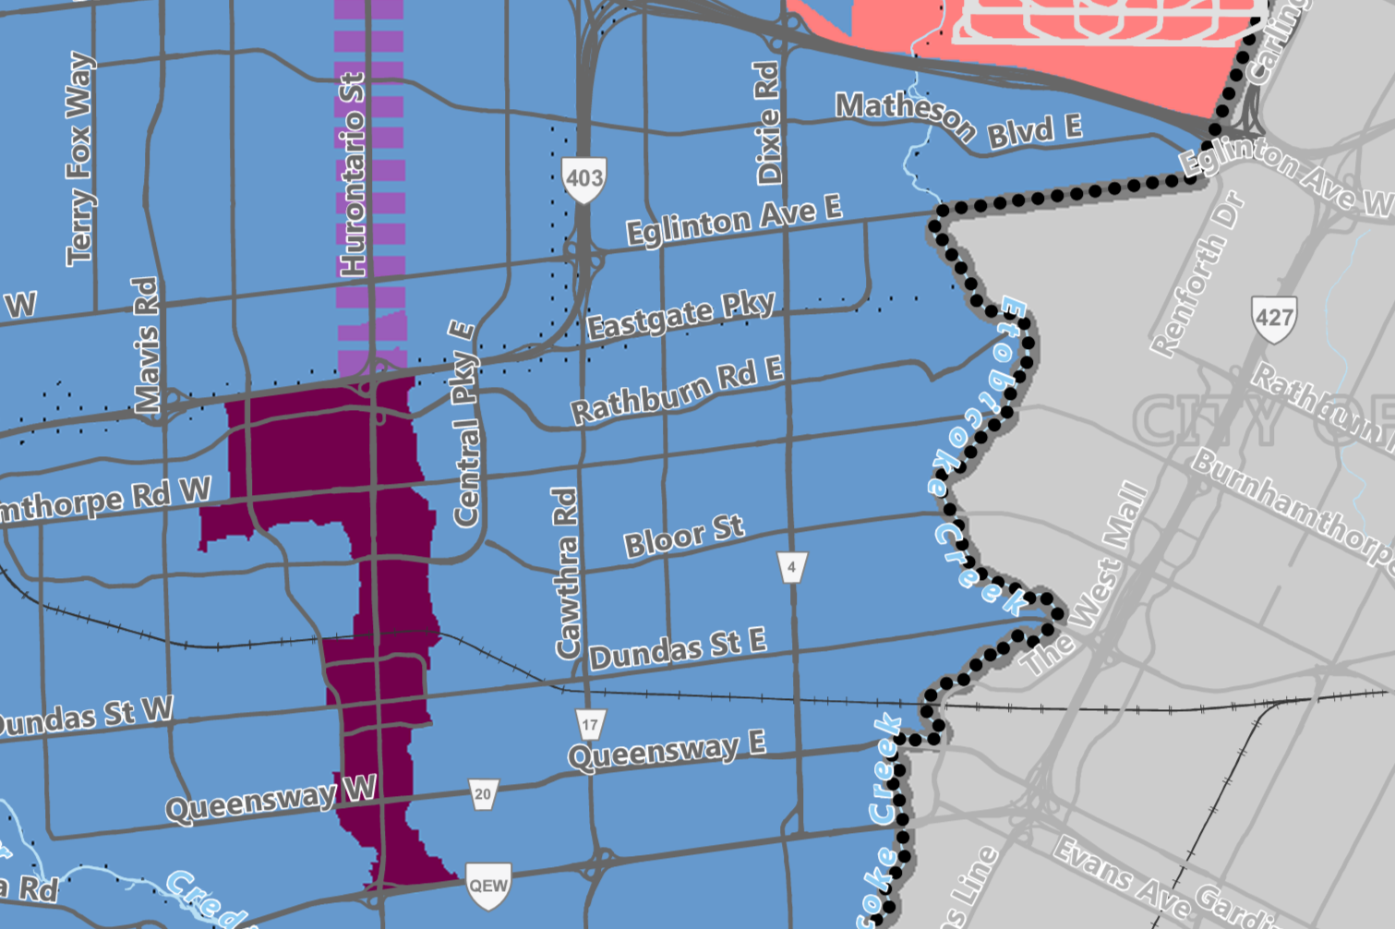
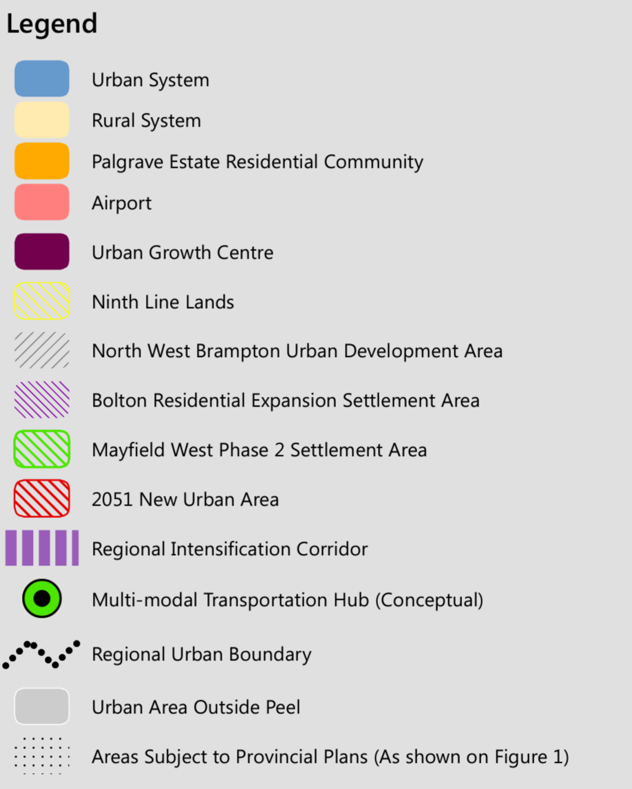
Policy Context
Region of Peel Official Plan (2022)
Schedule E-1
Regional Structure
Subject Site

Slide 8
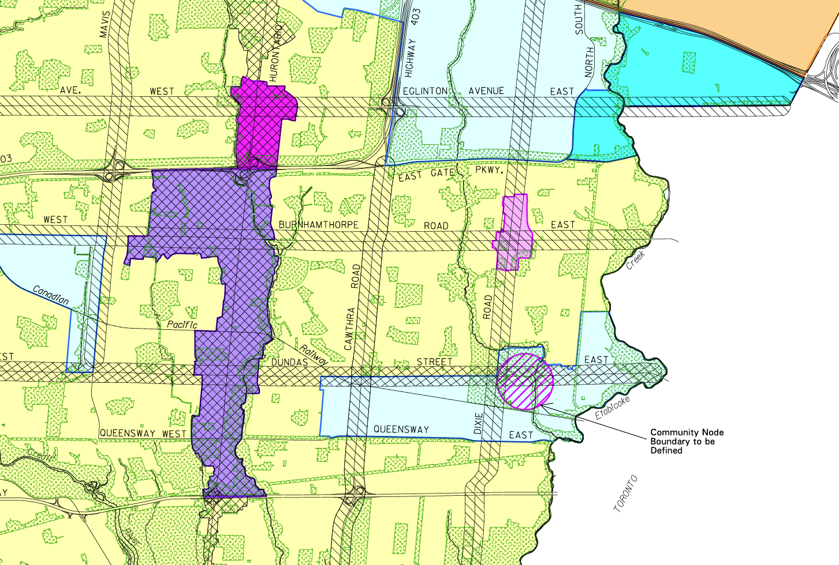
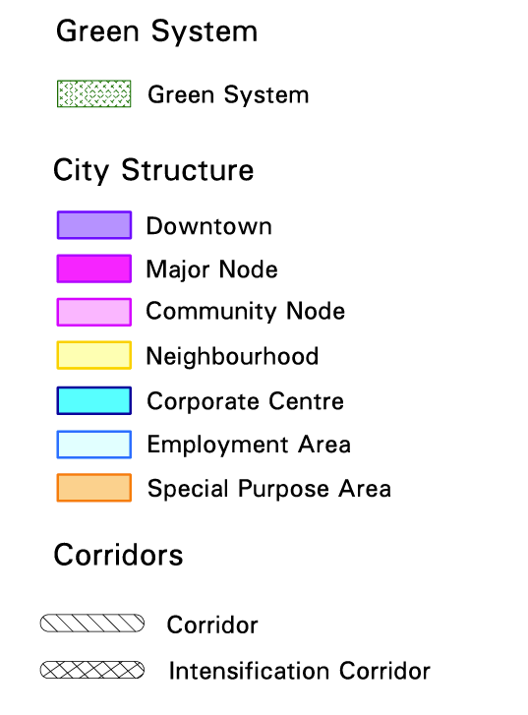
Policy Context
City of Mississauga Official Plan August 7th, 2024 Consolidation
Schedule 1
Urban System
Subject Site
Policy 5.3.5.2 states:
"Residential intensification within Neighbourhoods will generally occur through infilling and the development of existing commercial sites as mixed use areas."

Slide 9
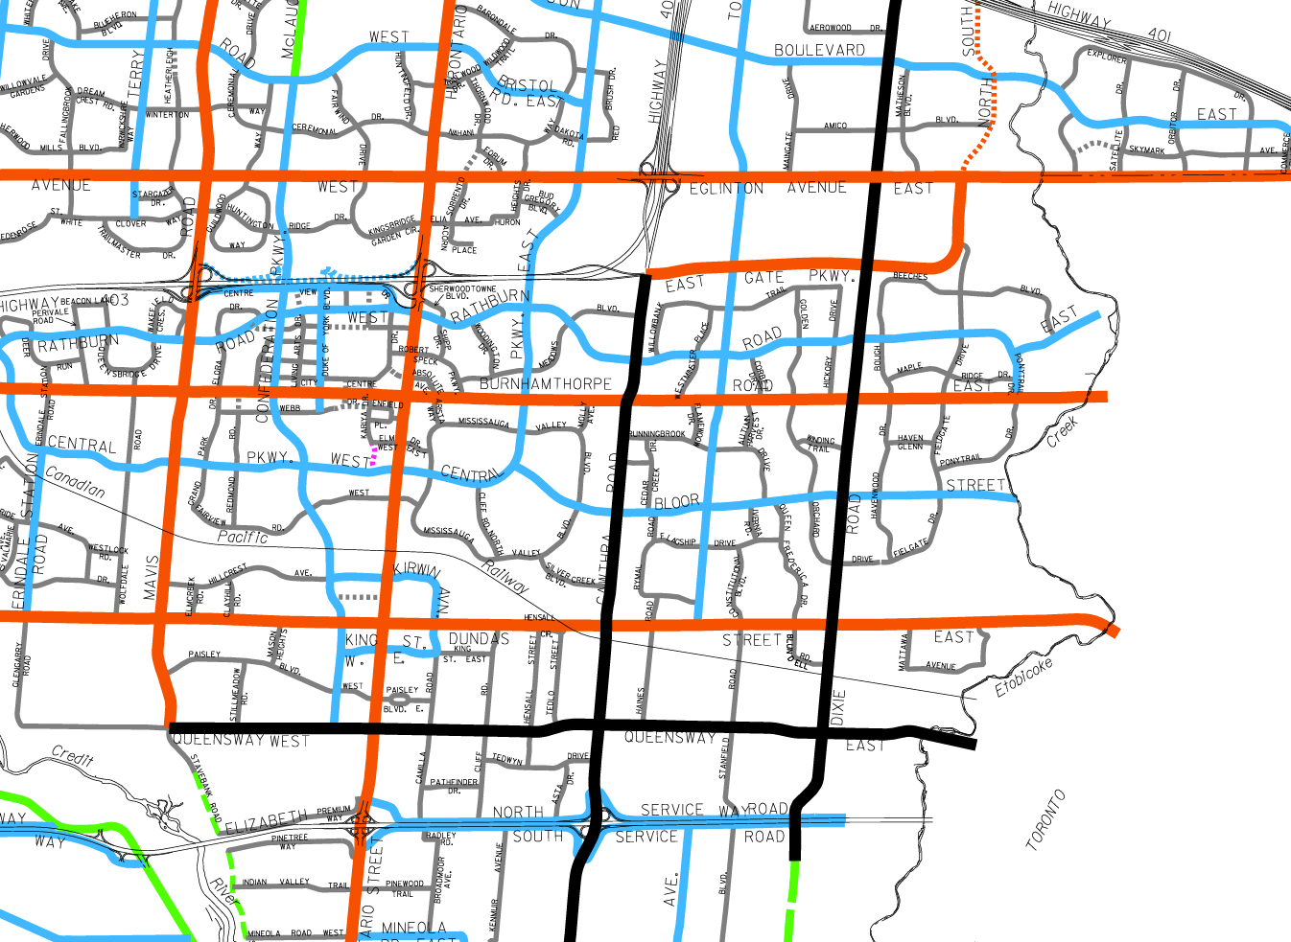
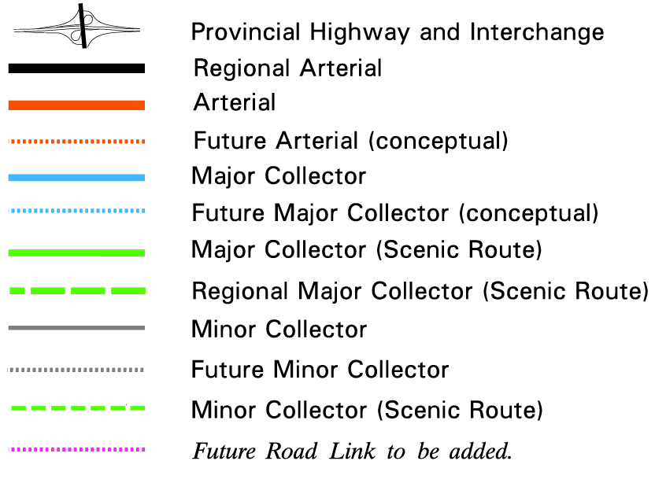
Policy Context
City of Mississauga Official Plan August 7th, 2024 Consolidation
Schedule 5
Long Term Road Network
Subject Site

Slide 10
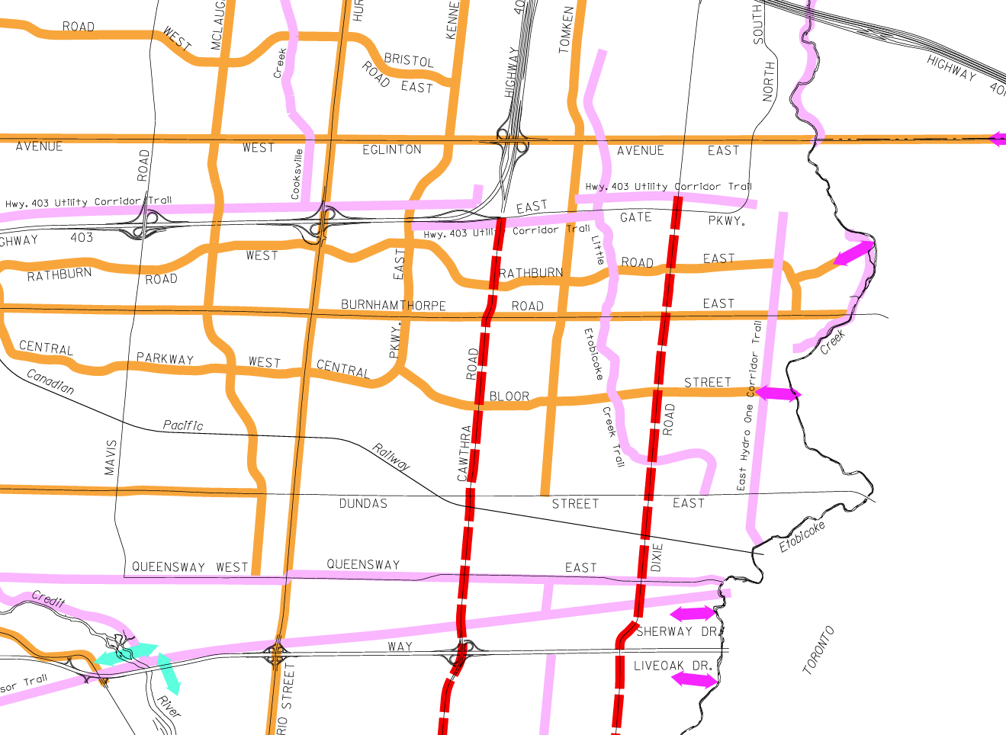
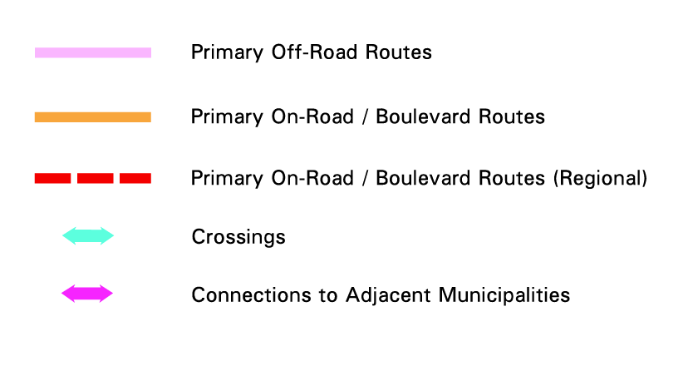
Policy Context
City of Mississauga Official Plan August 7th, 2024 Consolidation
Schedule 7
Long Term Cycling Routes
Subject Site

Slide 11
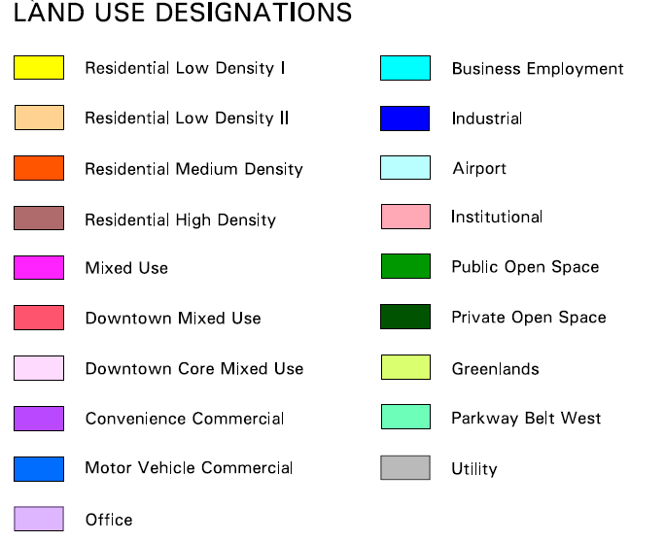
Policy Context
City of Mississauga Official Plan August 7th, 2024 Consolidation
Schedule 10
Land Use Designations
Subject Site

Slide 12
Policy Context
City of Mississauga Official Plan August 7th, 2024 Consolidation
Subject Site
Map 16-2 Applewood Neighbourhood Character Neighbourhood

Slide 13
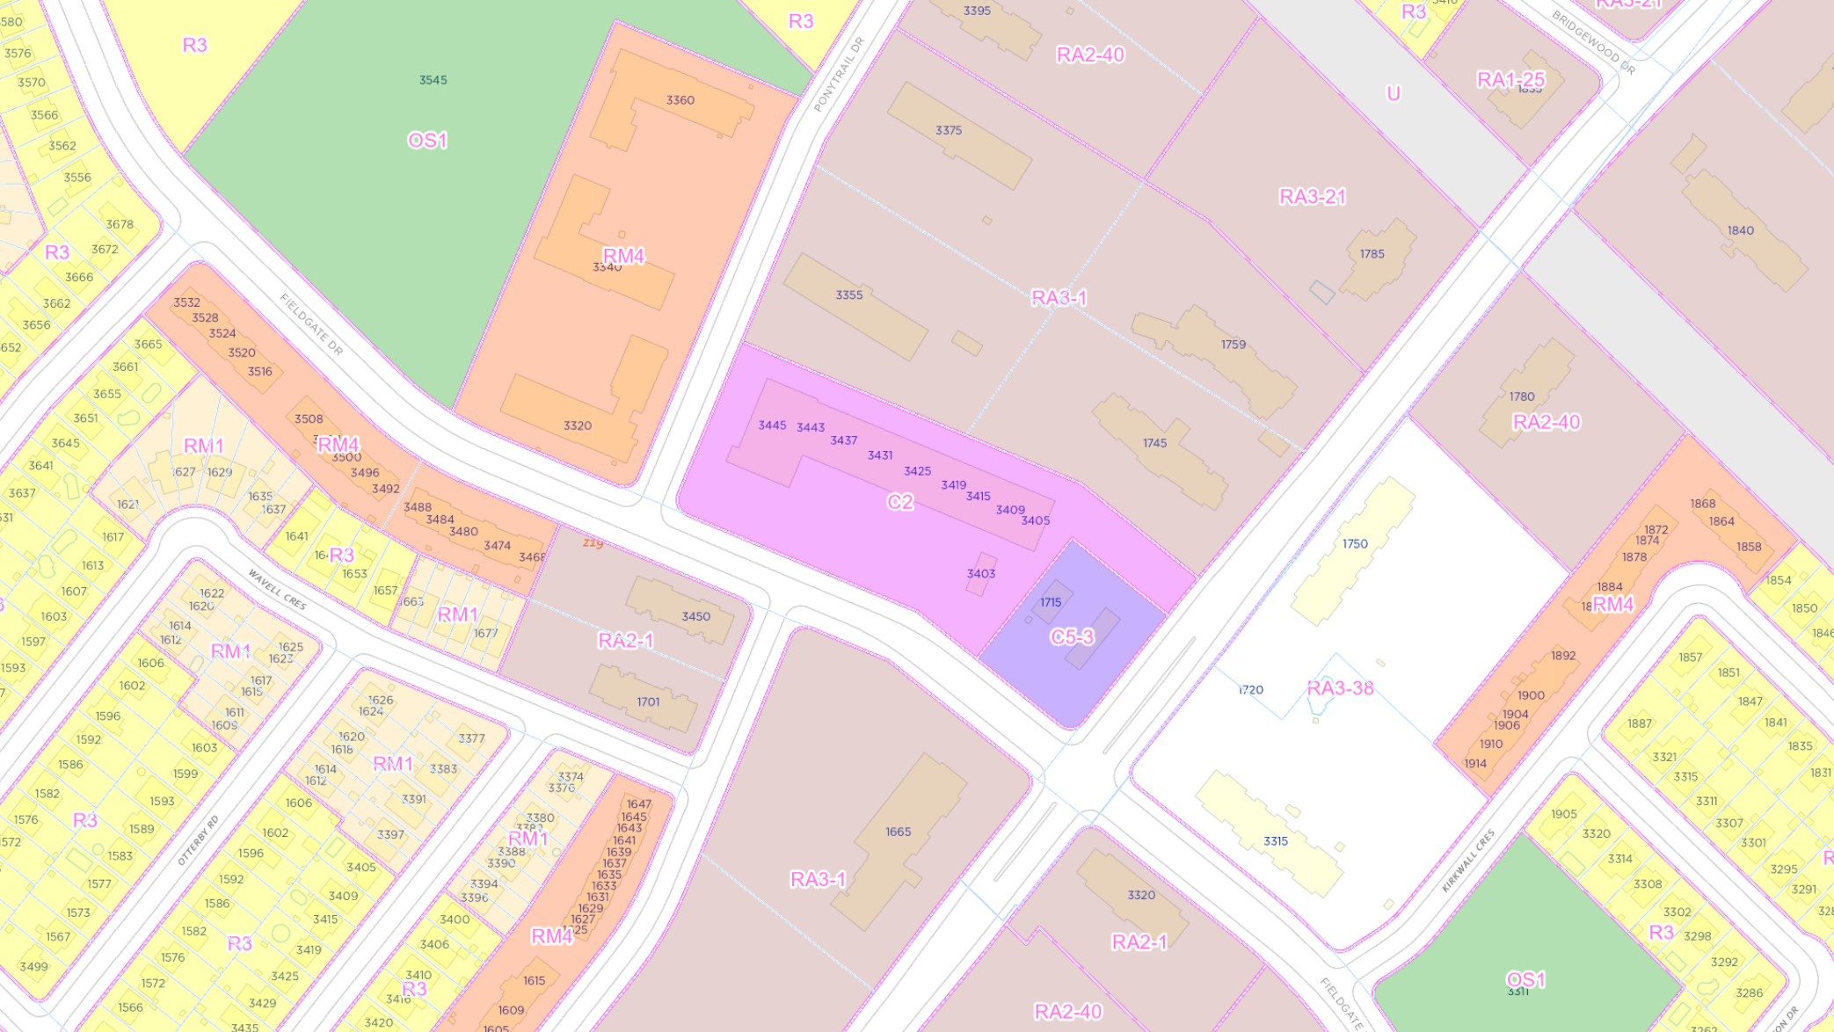
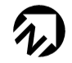
City of Mississauga By-law 25-2007
Subject Site

Slide 14
3
Planning Process
Process Completed
Process to Come
DARC Meeting 1
March 12th, 2024
Meeting with Dixie-Bloor Centre
October 28th, 2024
We are here!
Information Report
To Council
Final Report to Council
DARC Submission Made
February 2024
Preparation of Formal
Submission Materials
April-October 2024
Community Meeting
November 26th, 2024
Submission of
Formal Application
Q4 2024
Statutory Public Meeting
at Planning Committee
DARC: Development Application Review Committee

Slide 15
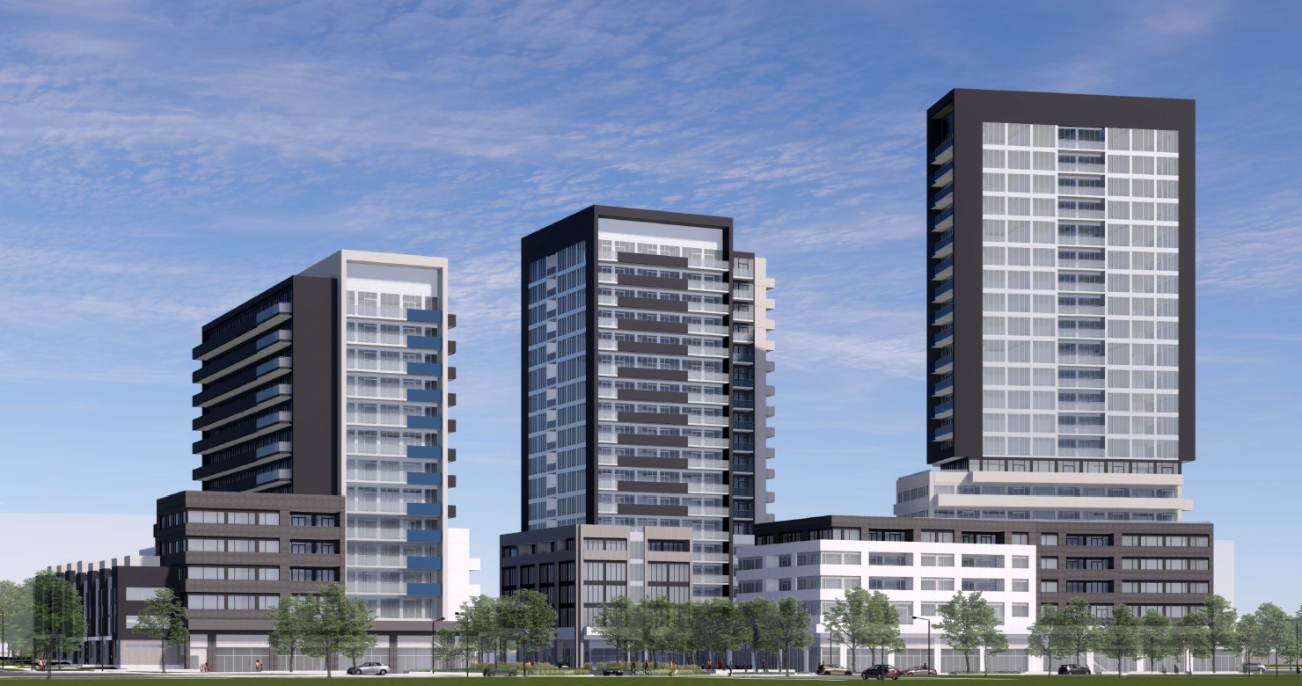
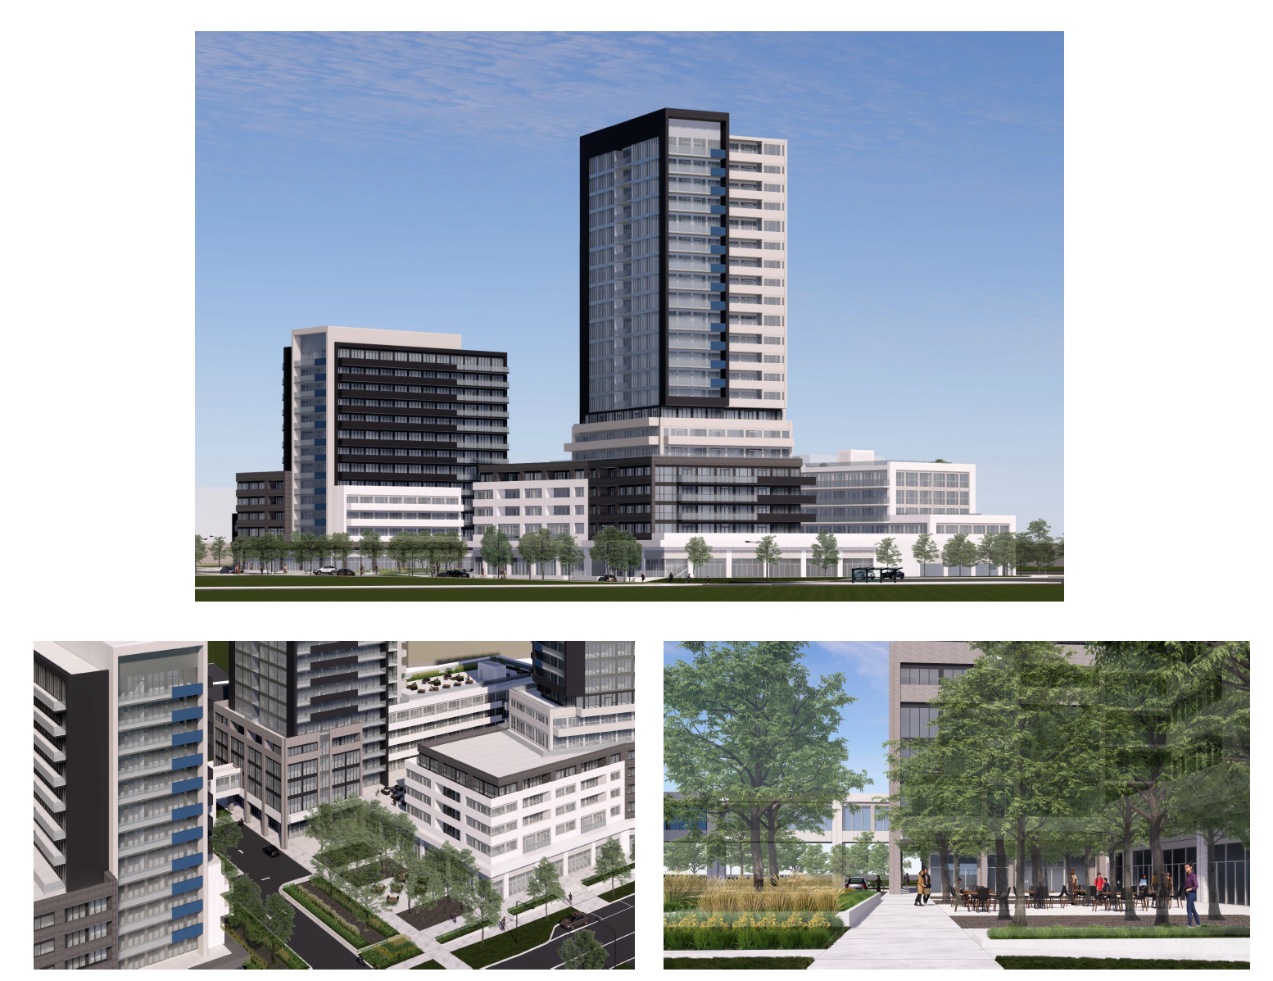

4
Proposal

Slide 16

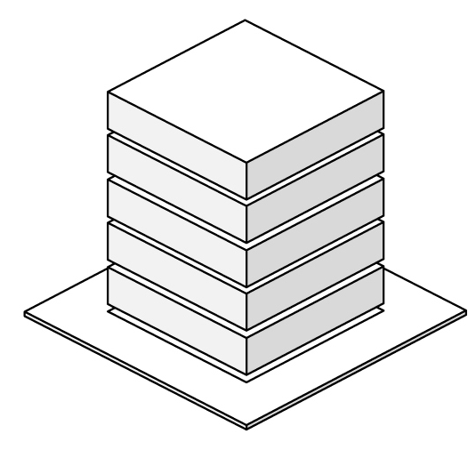







Project Statistics
Height
13-storeys (43.40 m)
18-storeys (58.90 m)
22-storeys (71.40 m)
Site Area
15,840 m² (170,500.34 ft²)
Floor Space Index (FSI)
2.91
592 Dwelling Units
13 townhouses
30 Studios (6%)
319 one-bedrooms (53%)
211 two-bedrooms (35%)
32 three-bedrooms (6%)
Residential
Retail
597 parking spaces
454 resident
143 visitor/retail
401 Bicycle
parking spaces
361 Long-term
40 Short-term
Amenity Space
Indoor: 1,433.10 m² (15,425 ft²)
Outdoor: 1,906.91 m² (20,525 ft²)
Total: 3,340.01m ² (35,951 ft ²)
Collective 5.64/unit
43,140.38 m² (464,359.18 ft²)
2,884.31 m²
(31,046.45 ft ²)
Total Gross Floor Area
46,024.69m ²
(495,409.75 ft ²)
Notes:
Existing retail

Slide 17
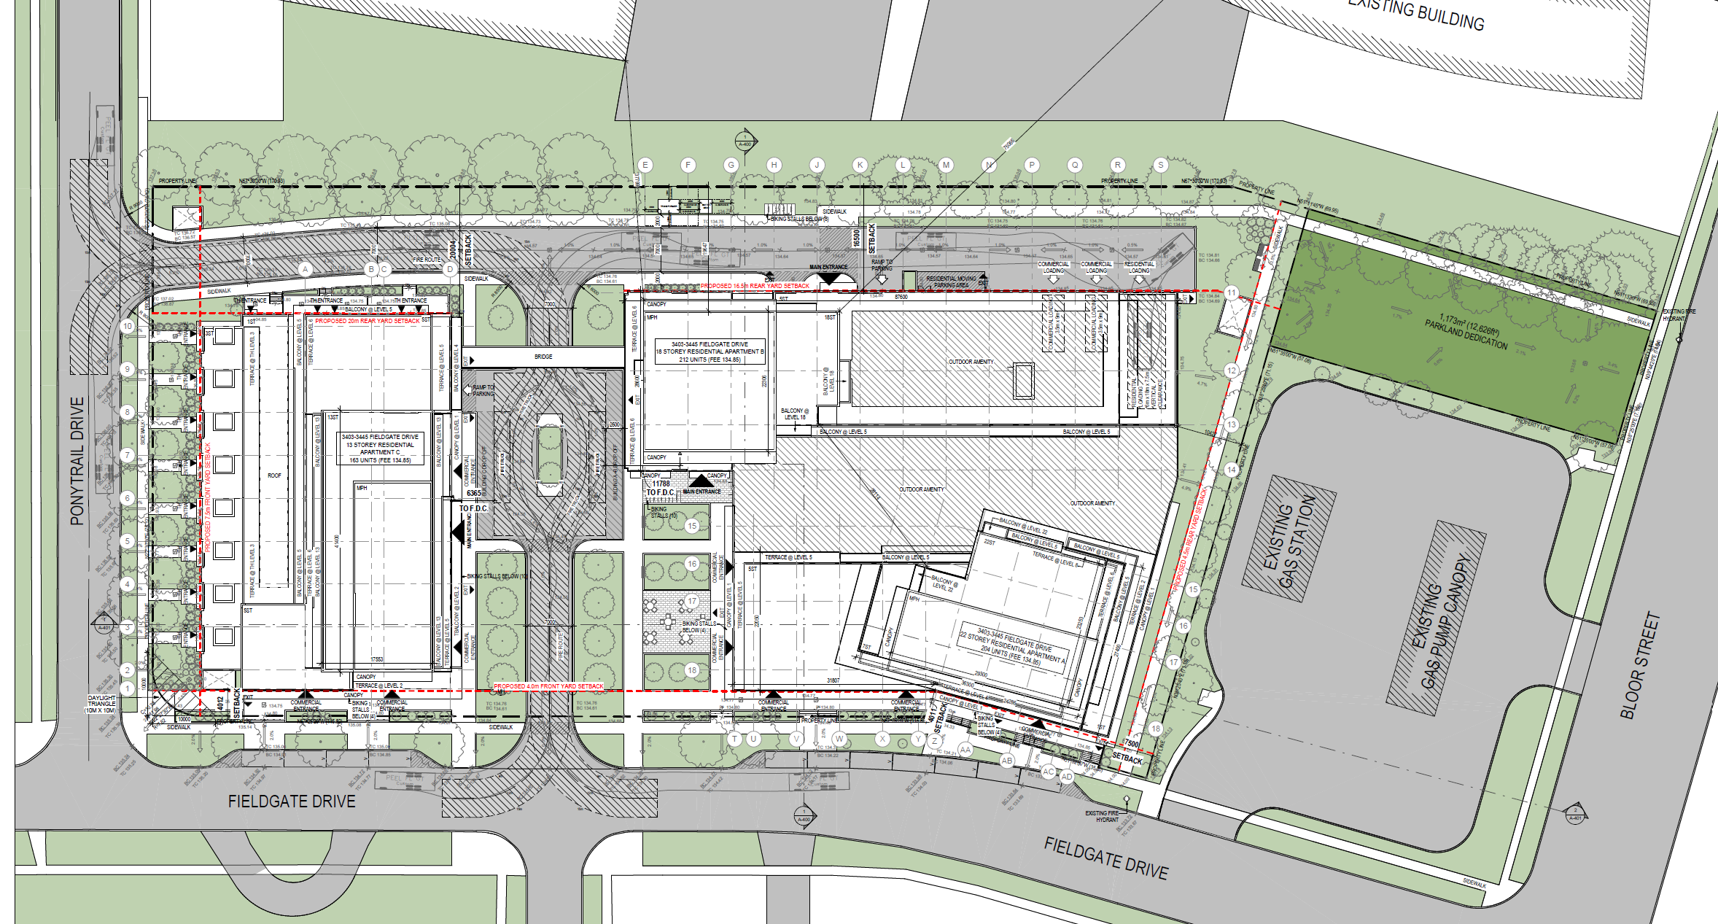
Site Plan

Slide 18
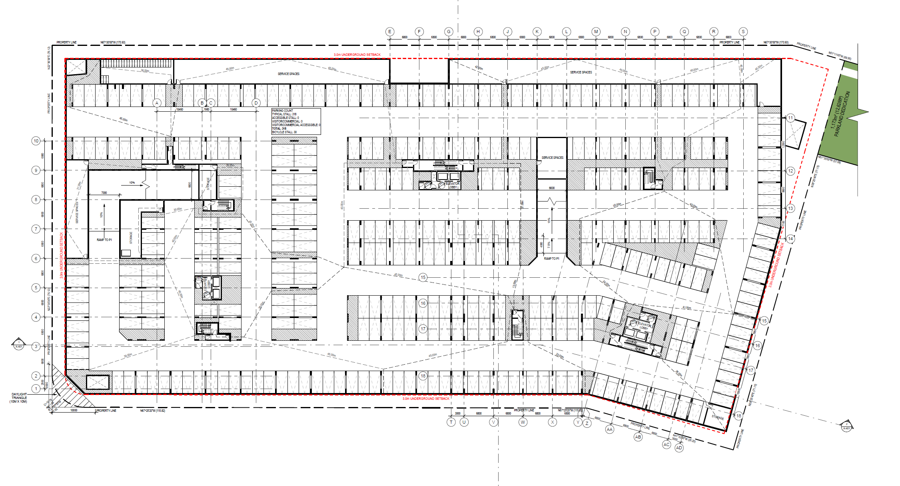
P2 Level Plan

Slide 19
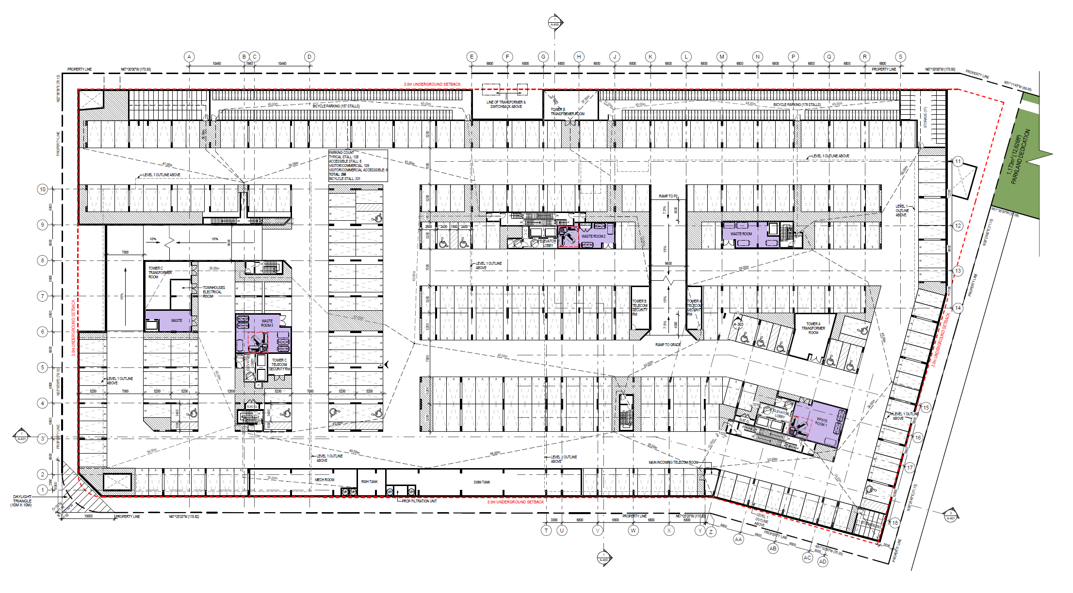
P1 Level Plan

Slide 20
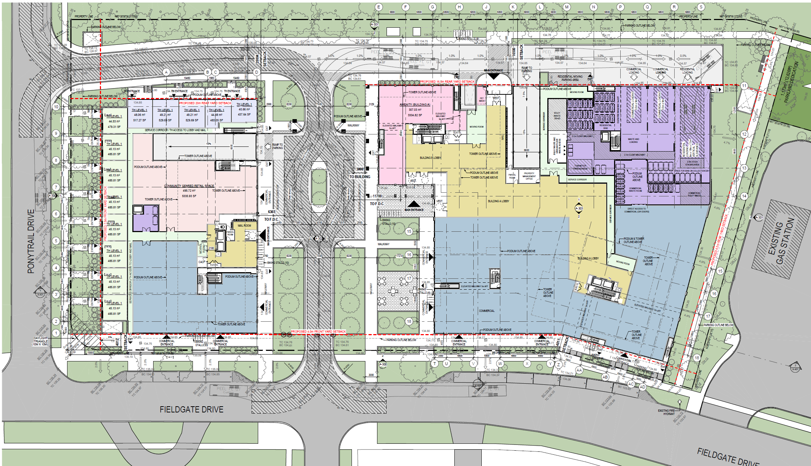
Ground Floor Plan

Slide 21
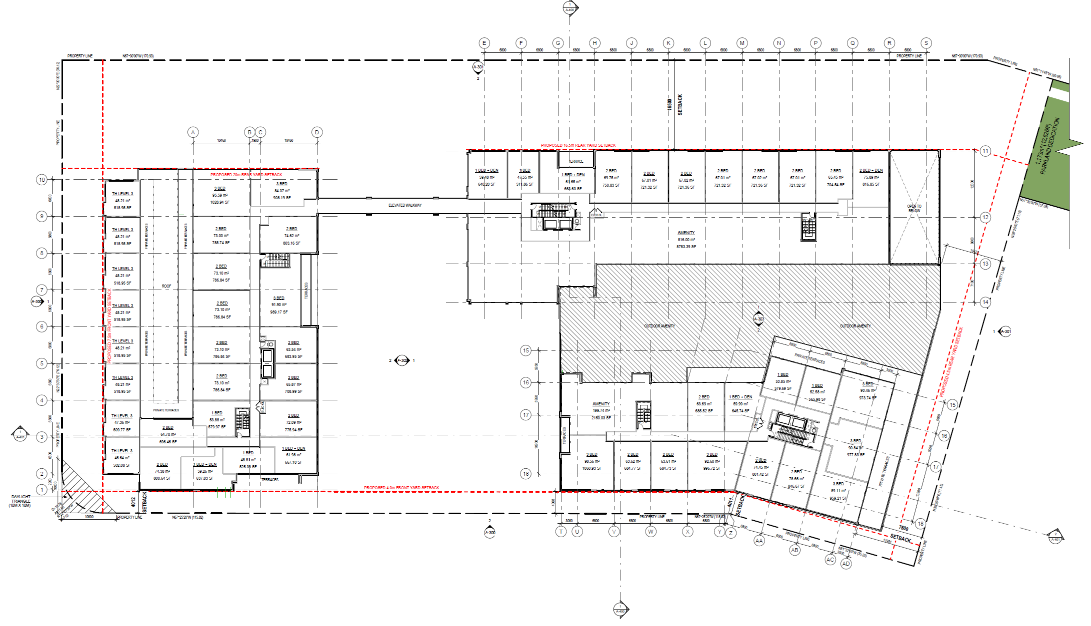
Second Floor Plan

Slide 22
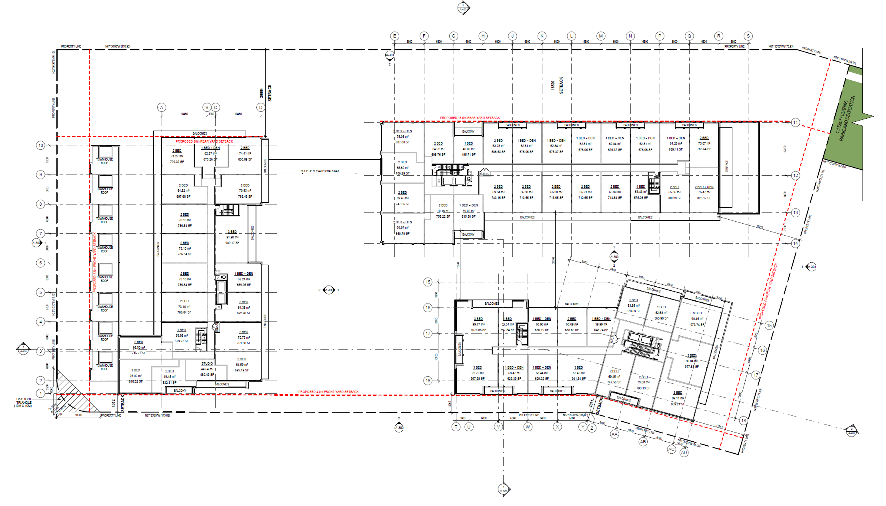
3rd & 4th Floor Plan

Slide 23
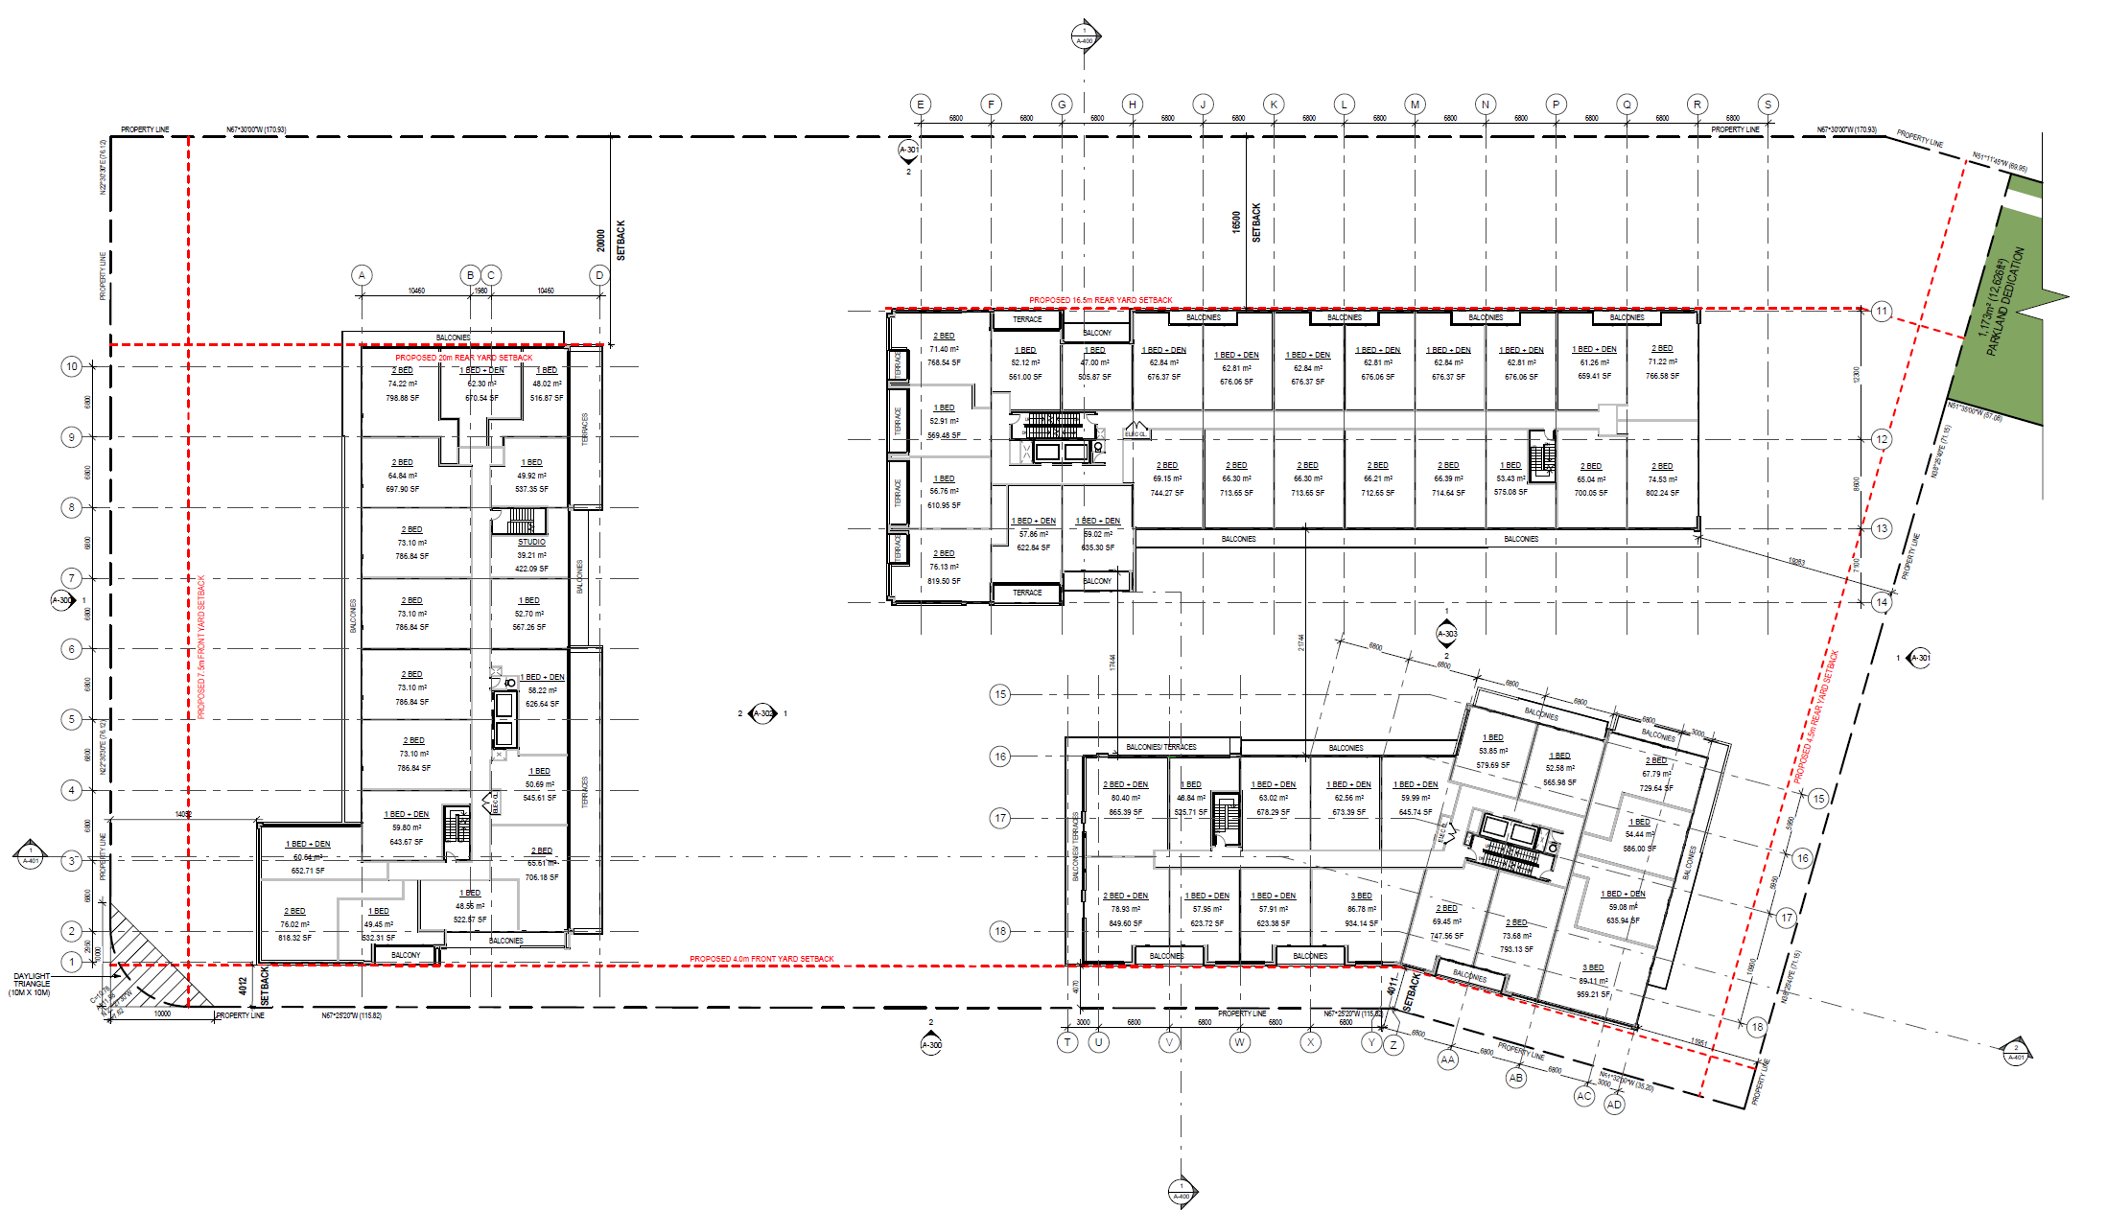
5th Floor Plan

Slide 24
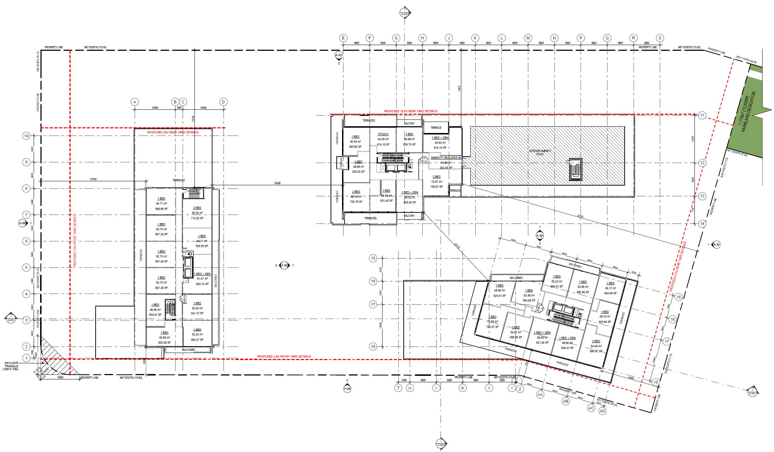
6th Floor Plan

Slide 25
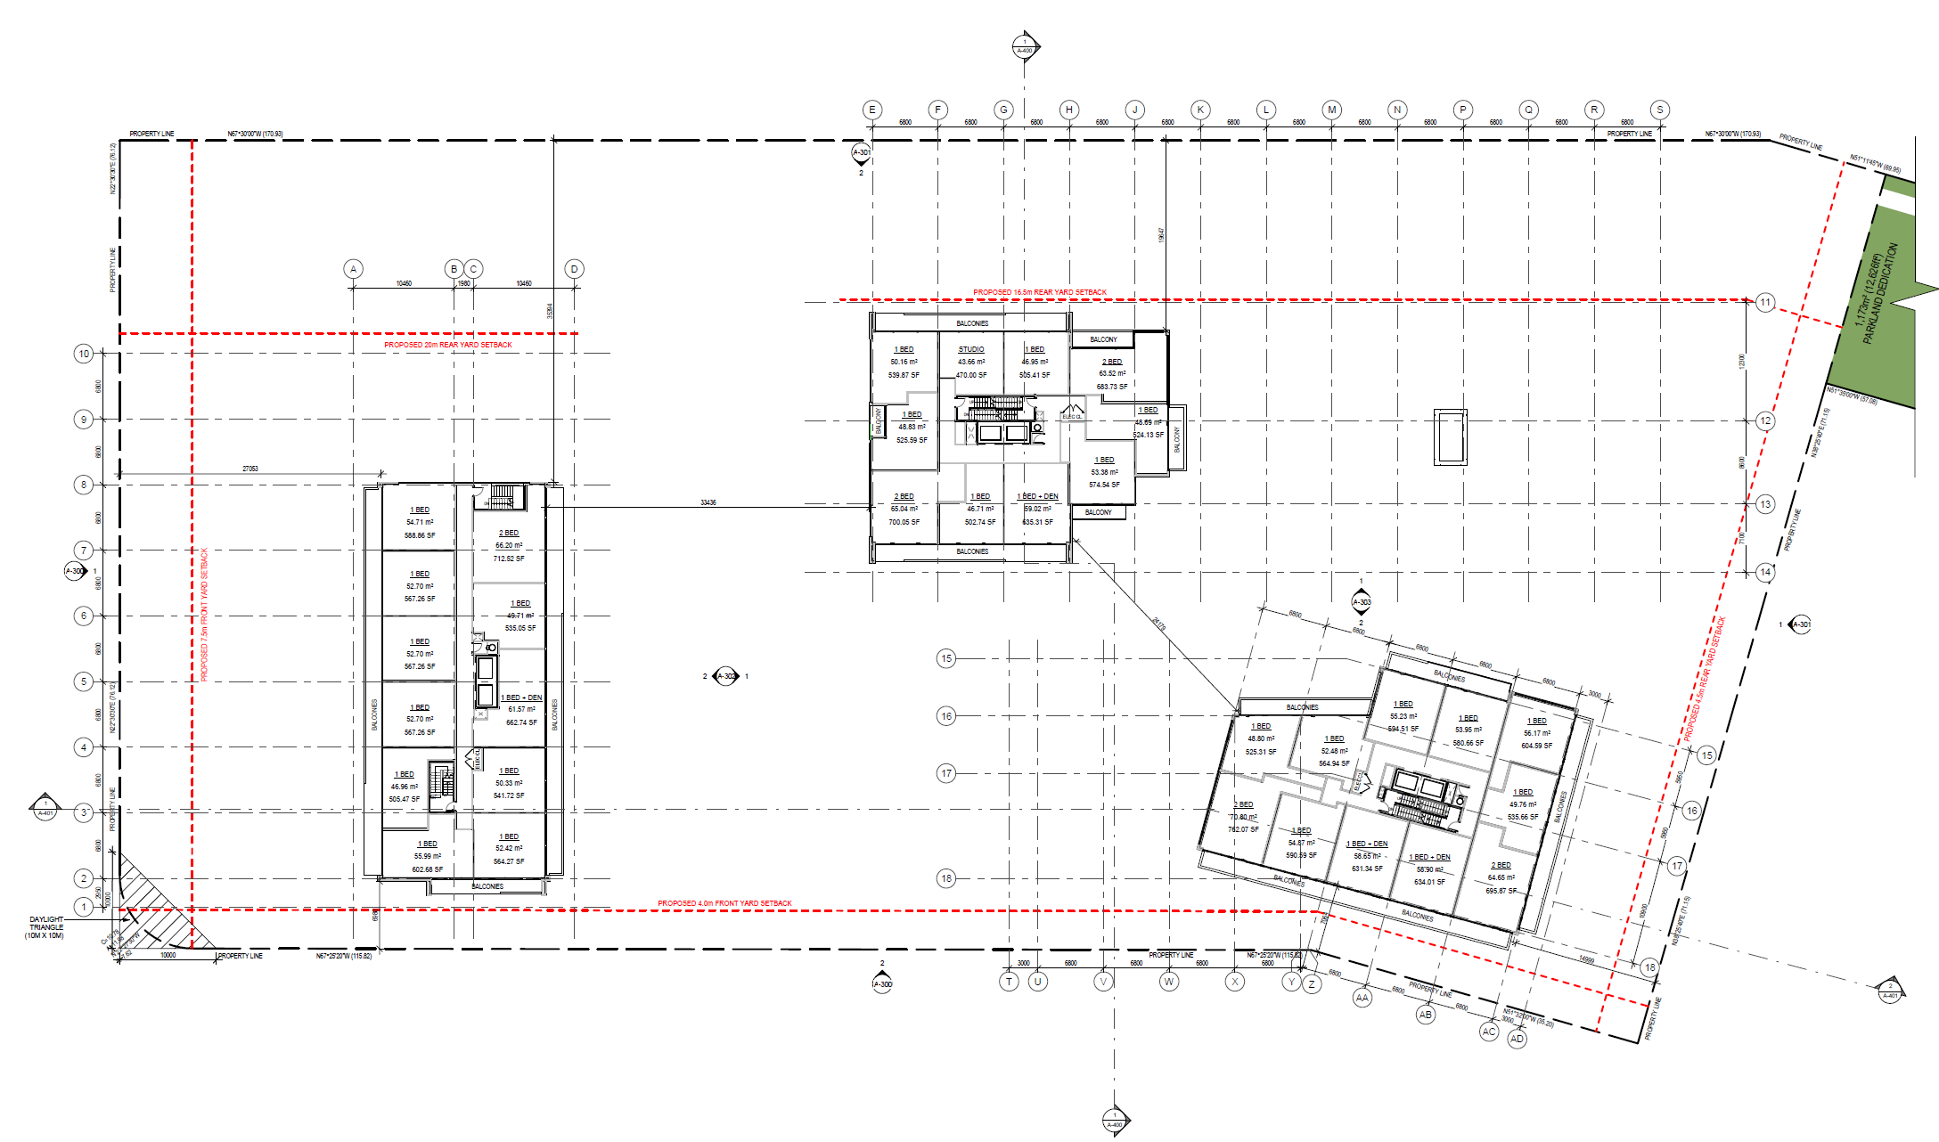
Typical Floor Plans (Floors 7 to 22)

Slide 26
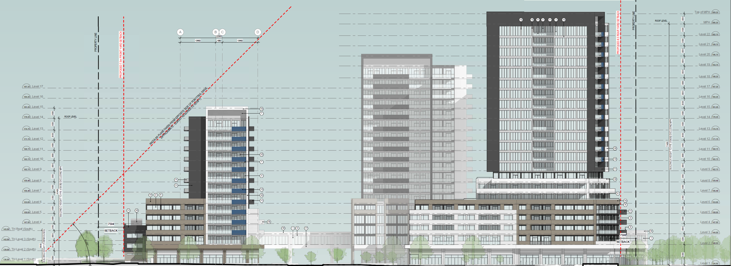
Elevations
71.40 m
58.90 m
43.30 m
South Elevation

Slide 27
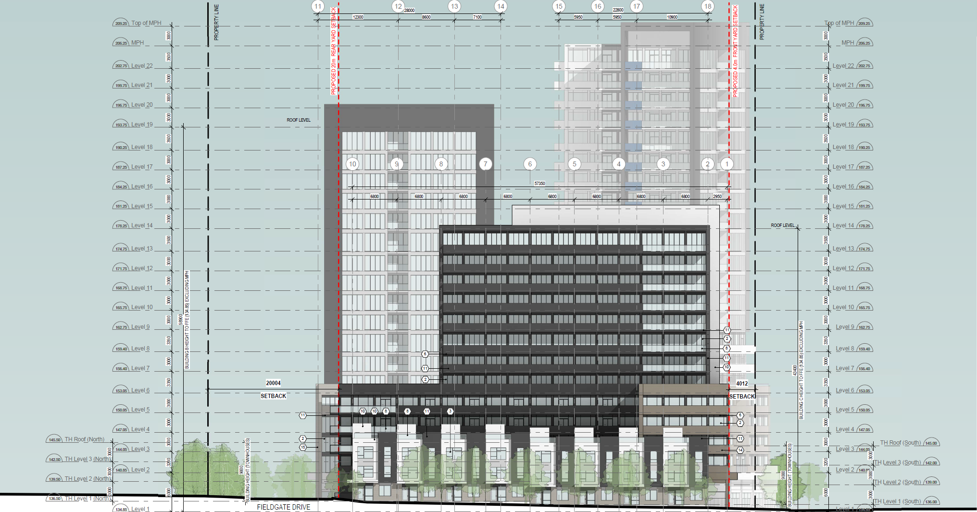
Elevations
West Elevation

Slide 28
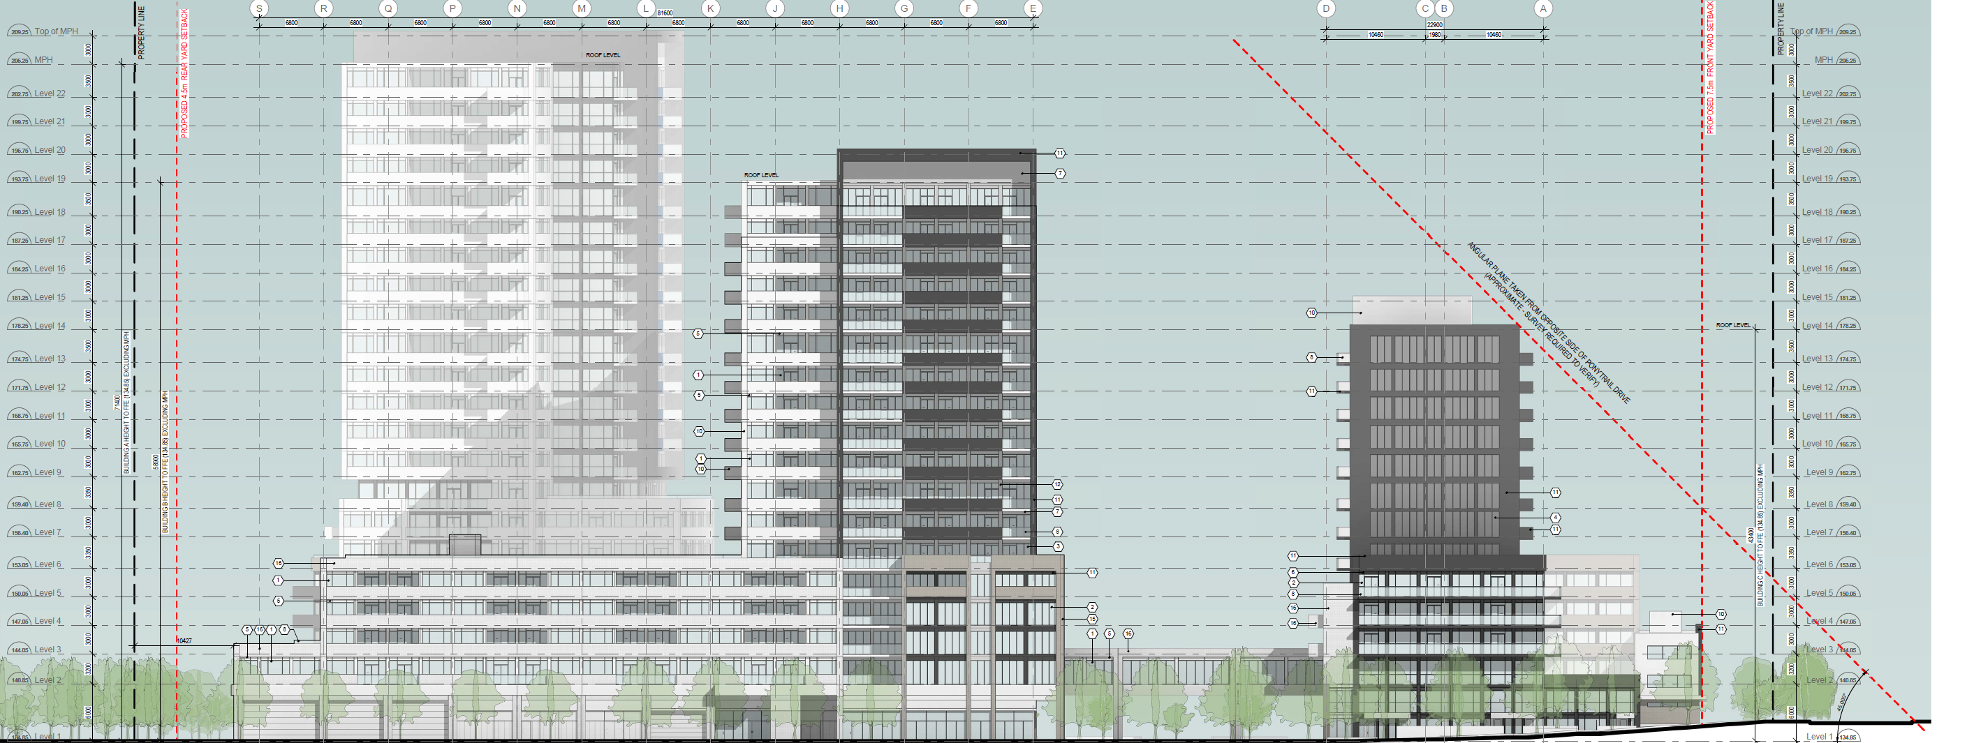
Elevations
North Elevation

Slide 29
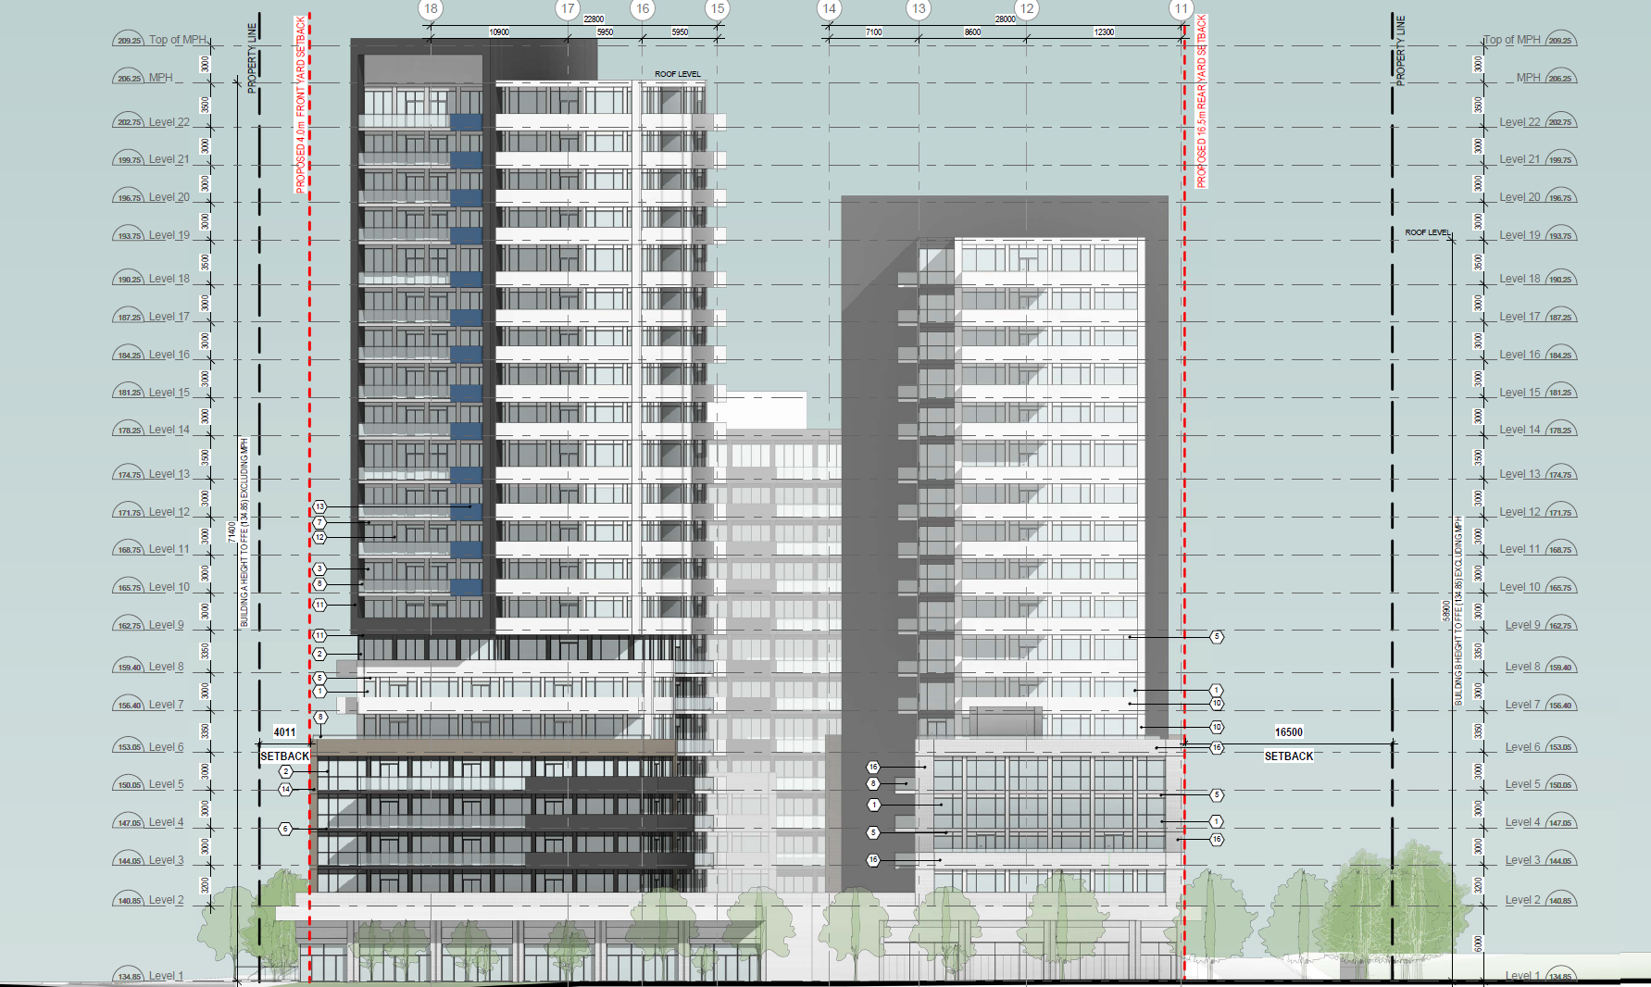
Elevations
East Elevation

Slide 30
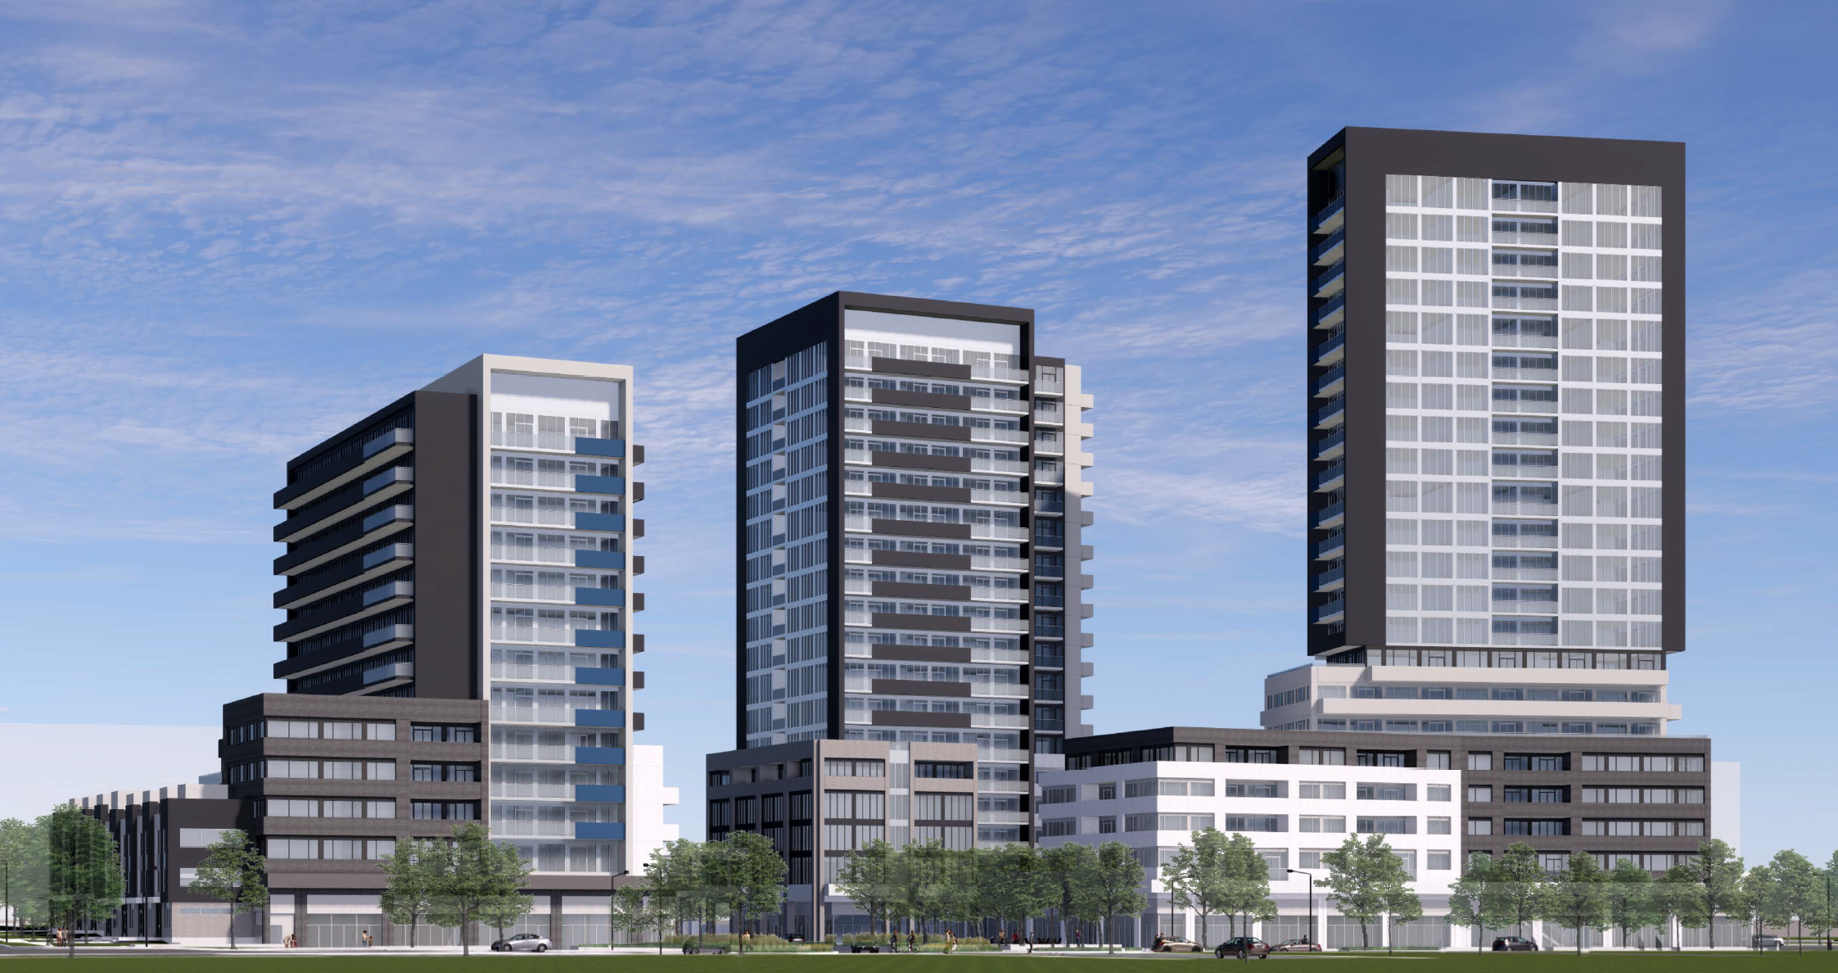
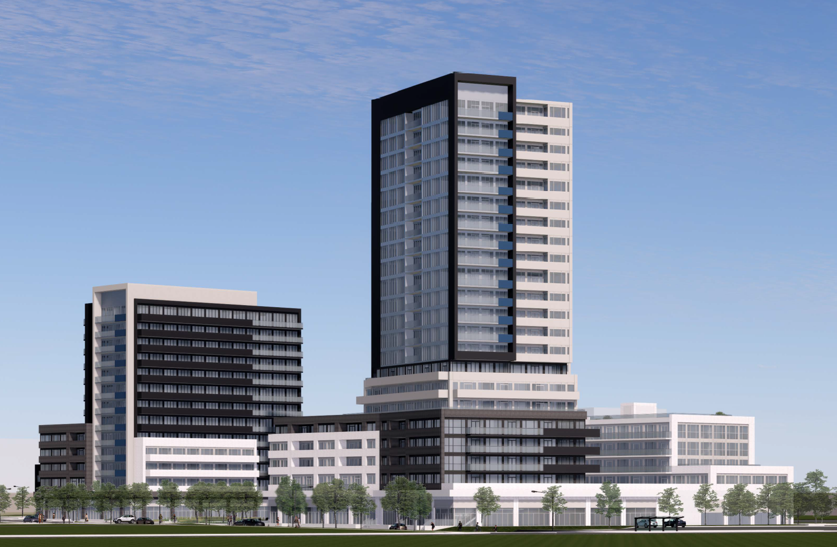
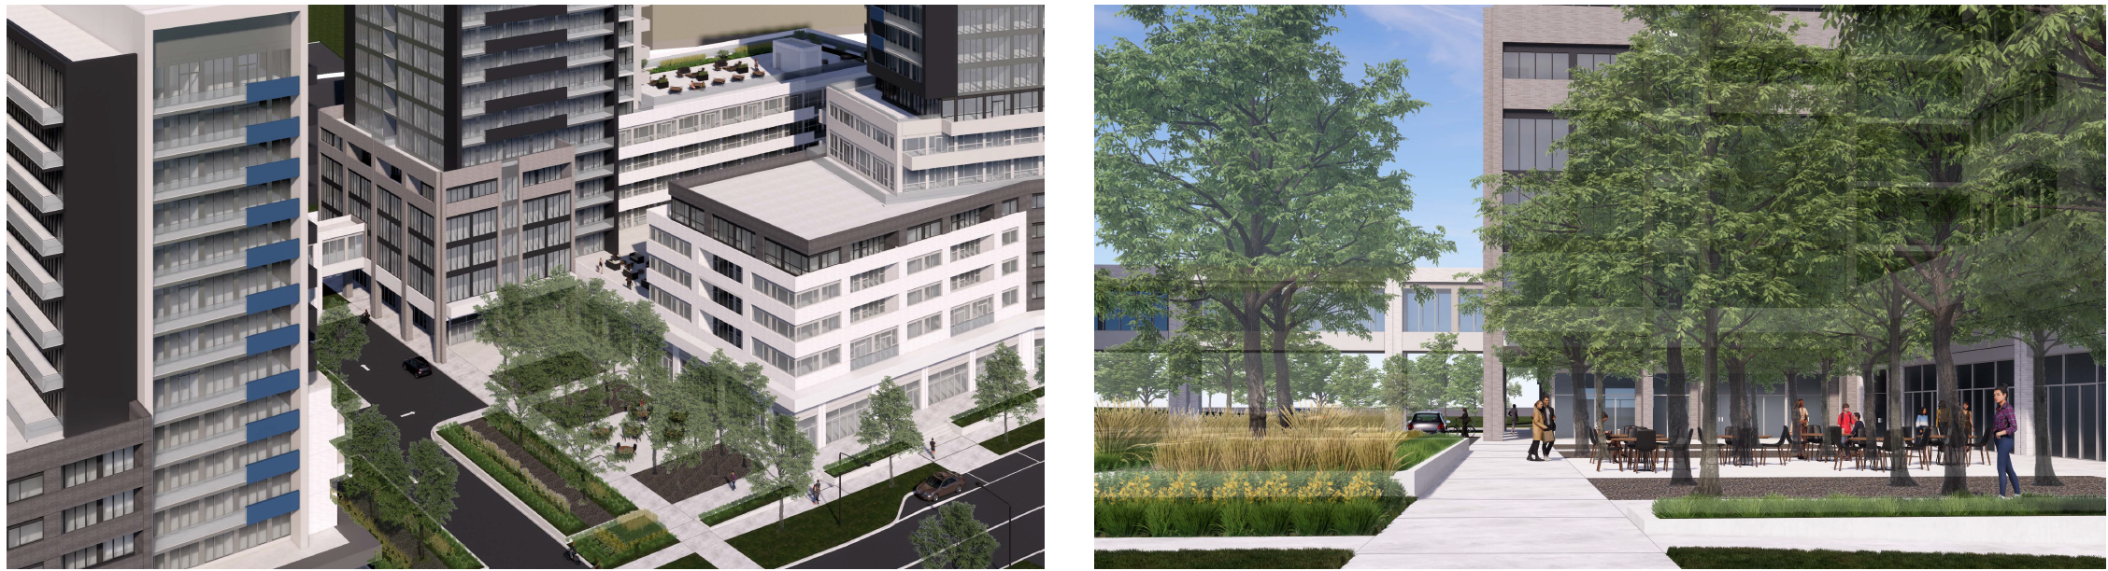
Renderings
View looking northeast
View looking northwest
Views of central internal courtyard

Slide 31
Thank you for your time!

