Slide 1
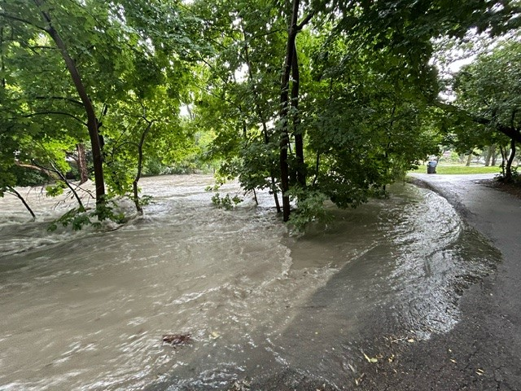
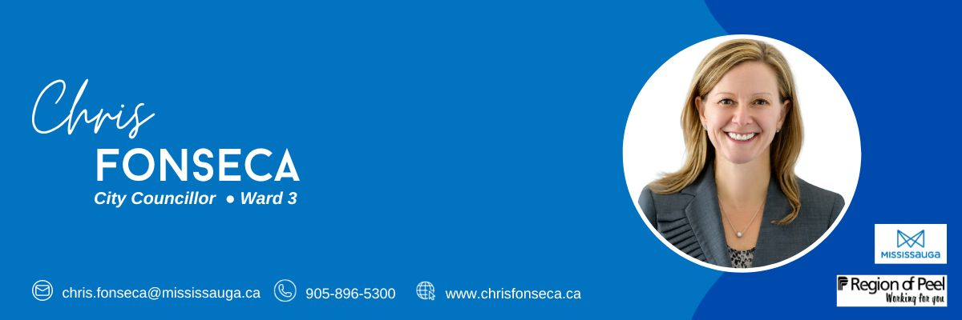
Welcome To The Ward 3
Flooding Community Meeting

Slide 2
AGENDA
Welcome Remarks and Housekeeping Reminders
Opening Remarks and Review of Agenda by Councillor Fonseca
City of Mississauga Team Presentation
Region of Peel Presentation
a. Public Works
b. Transportation and Works
c. Housing
5. Toronto and Region Conservation Authority (TRCA) Presentation
6. Tyndall Seniors Village Presentation
7. Q & A

Slide 3
My Advocacy & Action for the Flooding in 2024
Motion Brought Forward on July 31st, 2024 – In my motion, I acknowledged that while the city has invested significantly in climate change mitigation through the capital plan—such as the Little Etobicoke Creek Strategy Plan, Dixie Dundas flood mitigation projects, and Lisgar and Cooks initiatives—more needs to be done to address the immediate needs of residents and businesses. My motion requested that staff provide a corporate report proposing immediate, short-term, mid-term, and long-term solutions, as well as collaborate with other stakeholders.
Outcome of the Corporate Report and Presentation on September 25th, 2024.
Residential Compassionate Flood Relief Grant (City-wide) one time grant up to $1,000 for residential homeowners or tenants.
Basement Flooding Prevention Rebate Program (City-wide) rebate of up to $6,800 for residents to install flood protection devices
Seconded a motion by Councillor McFadden to establish a Flood Resilience Rebate Program valued at 50% of the invoiced cost up to a maximum of 3,000 to cover costs
As a Council, we passed subsidies at the Region.
Sanitary Backwater Preventer Valve Rebate Program (was $700, now $1500 for eligible homeowners).
TRCA report be brought back on early warning notifications in October/November 2024.
Advocacy Card – Urging the Premier to take immediate action on the severe flooding in Mississauga, as the City is underfunded, and we need support for flood prevention.

Slide 4
Ward 3 Community Meeting October 17th, 2024 Burnhamthorpe Community Centre
Infrastructure Planning & Engineering Services

Slide 5
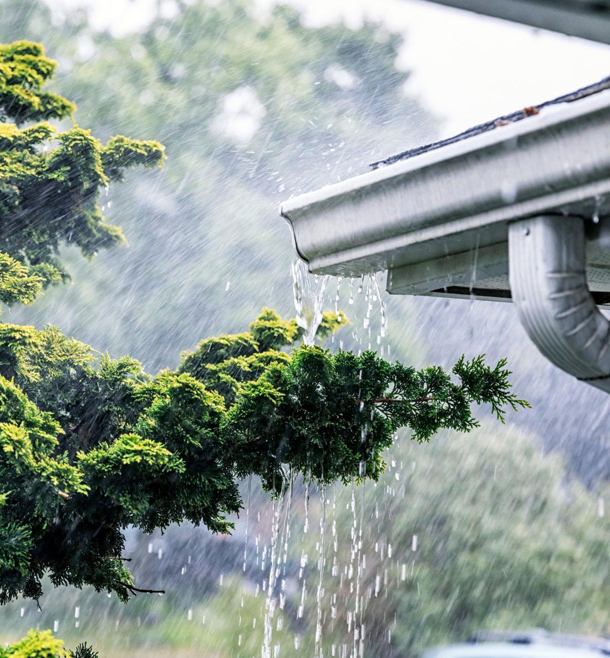
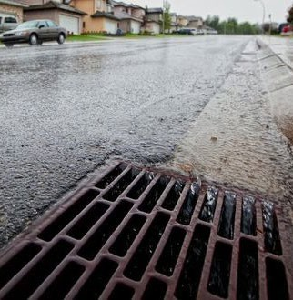

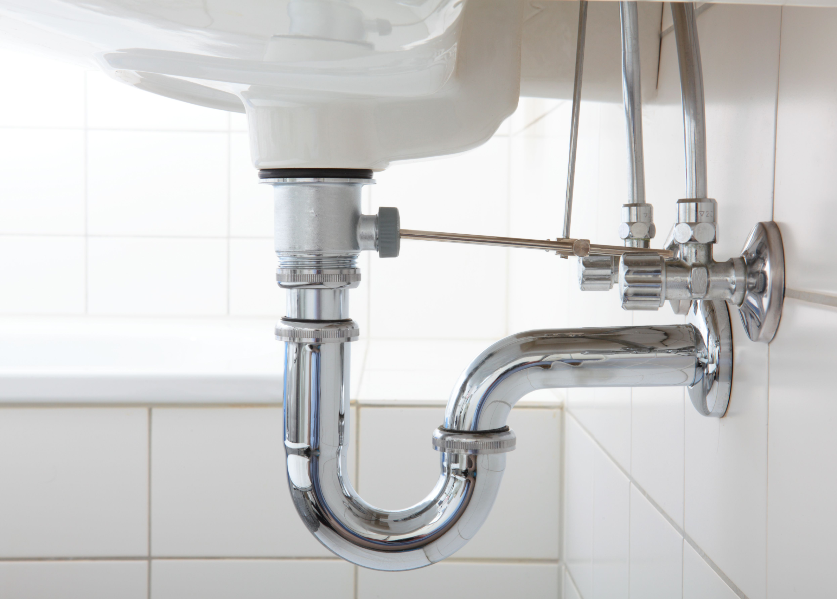
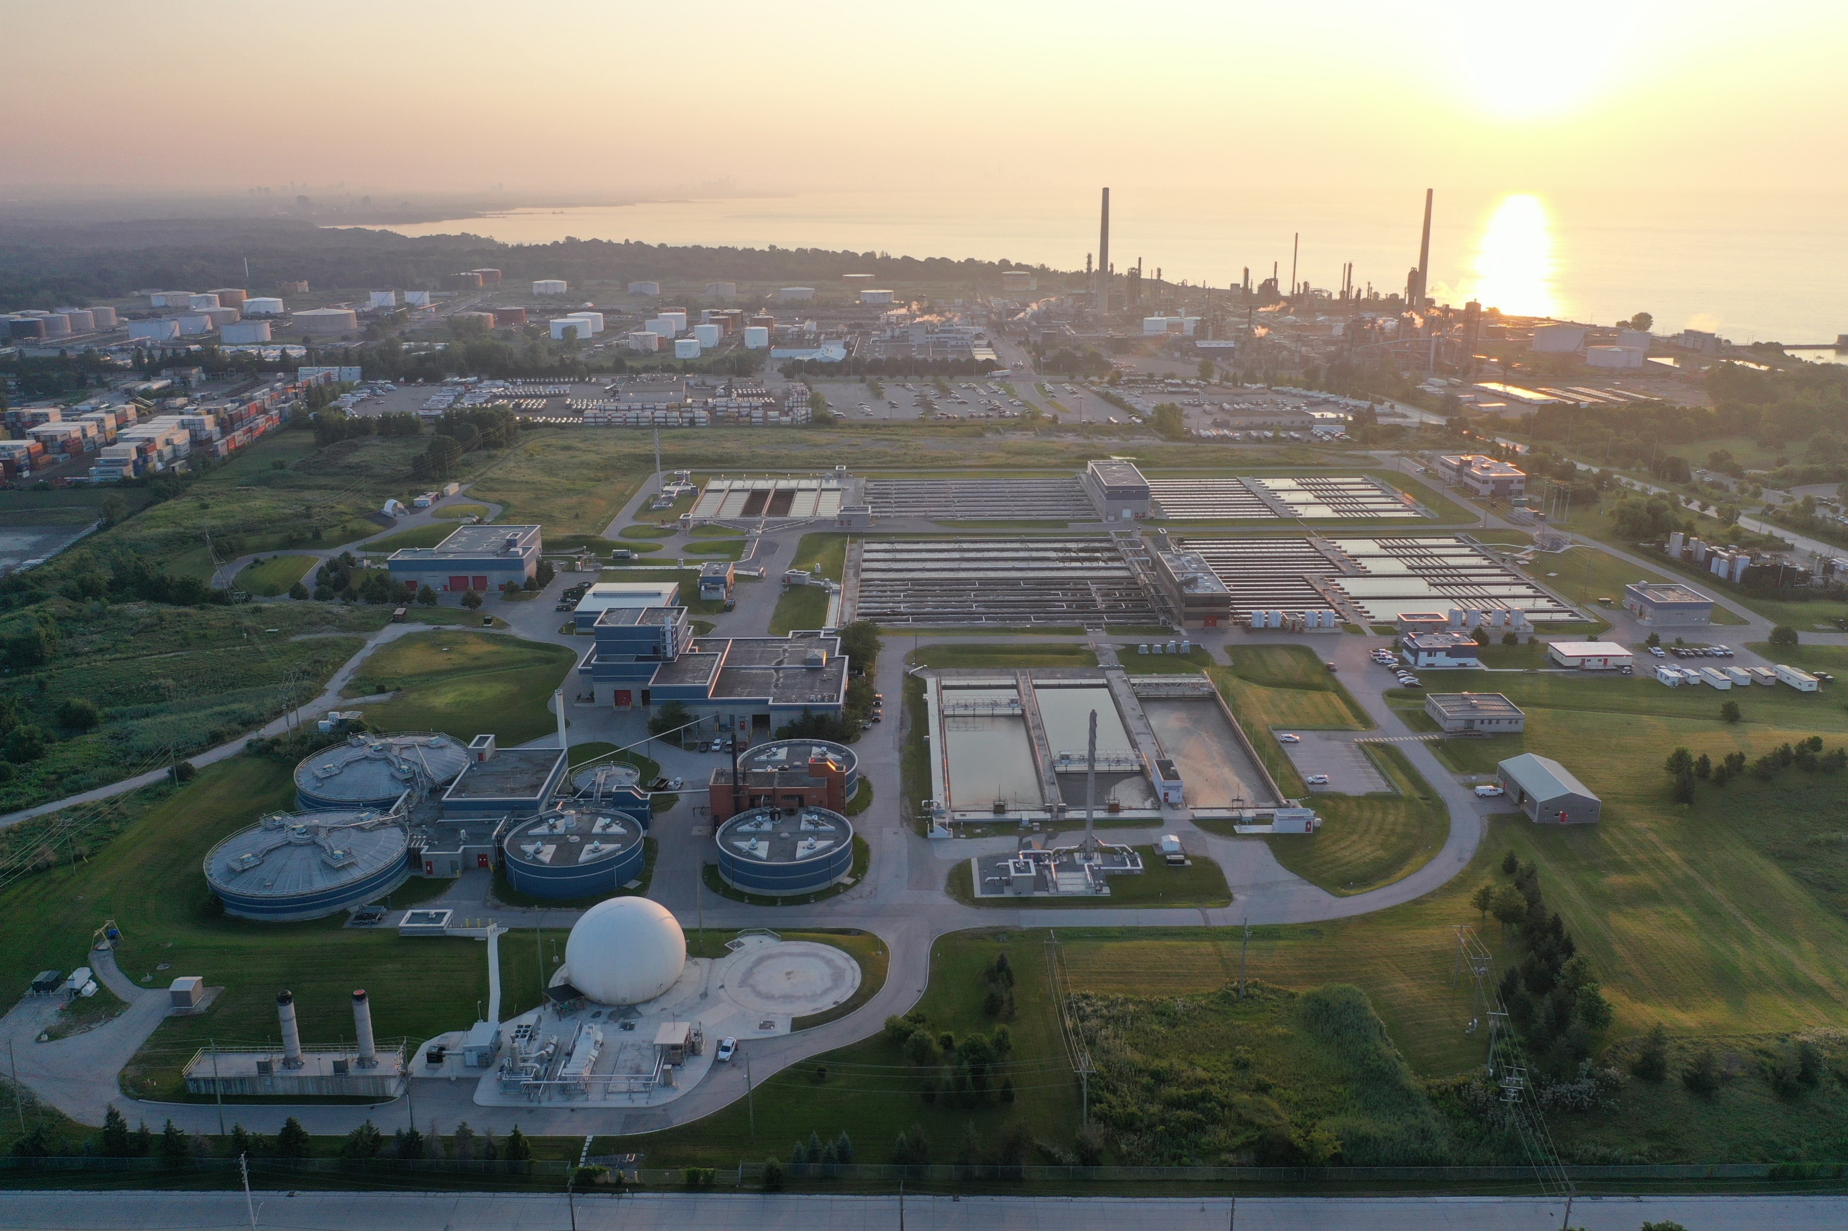
Managing stormwater is a shared responsibility
Your home
City of Mississauga
Conservation Authorities
Direct the rain to the City’s stormwater system
Local Stormwater Sewers & Stormwater Ponds
Monitor rivers, set flood management criteria, provide flood forecasting.
Wastewater system is distinct
Wastewater from your home/business
Water Resource Recovery Facility (for treatment)
Region of Peel
Sewage System

Slide 6
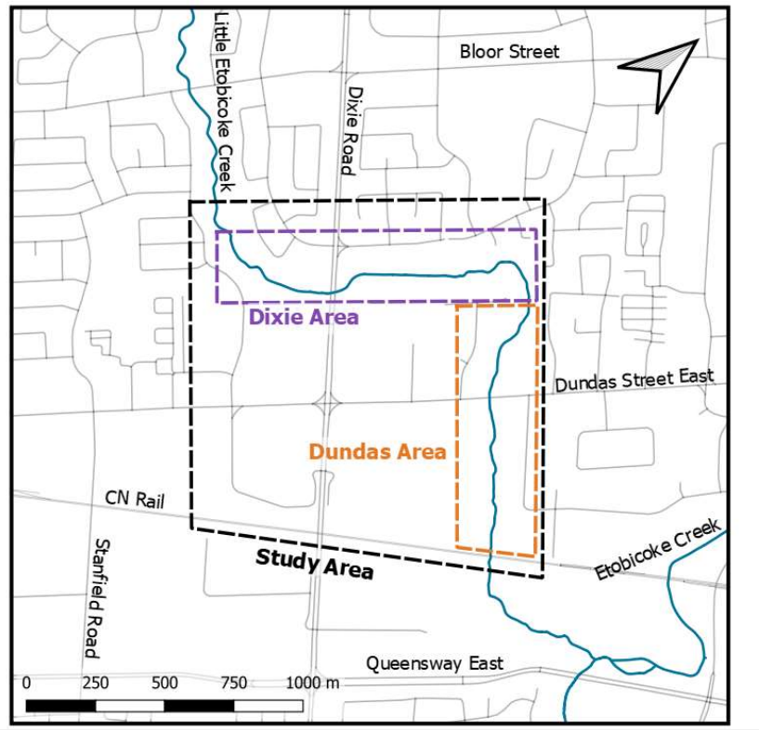
Dixie-Dundas Flood Project
Project Overview
• City-led study that identified solutions to address flooding from Little Etobicoke Creek to protect existing residences and businesses as well as enable future growth
• Followed a Schedule ‘C’ Environmental Assessment (EA) process that included public consultation and Public Information Centre’s
• In spring 2024, the City completed the study which identified several improvements for future design and implementation as part of a comprehensive flood mitigation solution
• These improvements, once implemented, are expected to contain the spill and reduce or eliminate flooding

Slide 7
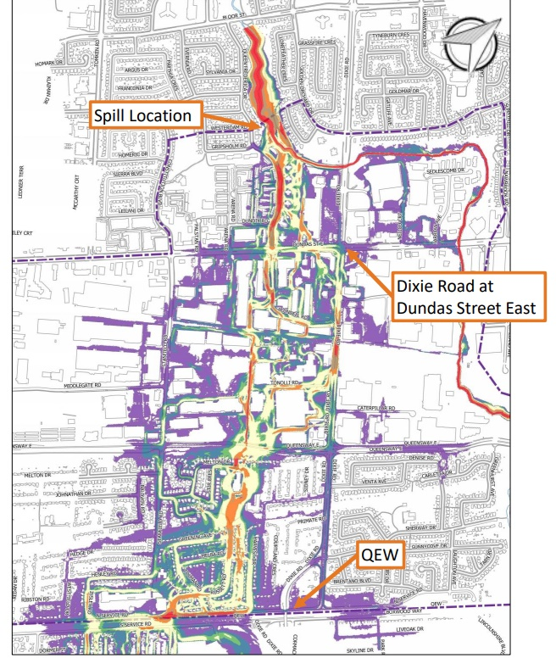
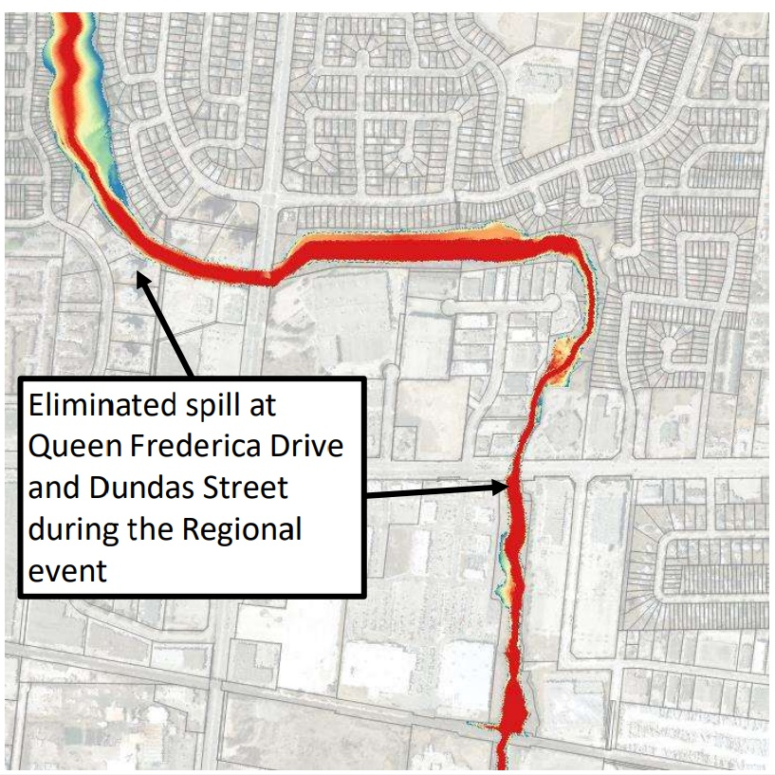
Dixie-Dundas Flood Project
Existing Flooding and Proposed Solution
• Approximately 130 m³/s of the total 200 m³/s Regional (Hurricane Hazel) storm event flow currently spills at Queen Frederica Drive and exits the creek valley corridor
• Over 1,000 residential, commercial, and industrial properties between the creek and the QEW are at risk of flooding
• The risk of flooding is expected to be reduced or eliminated by the preferred solution
Existing
Proposed

Slide 8
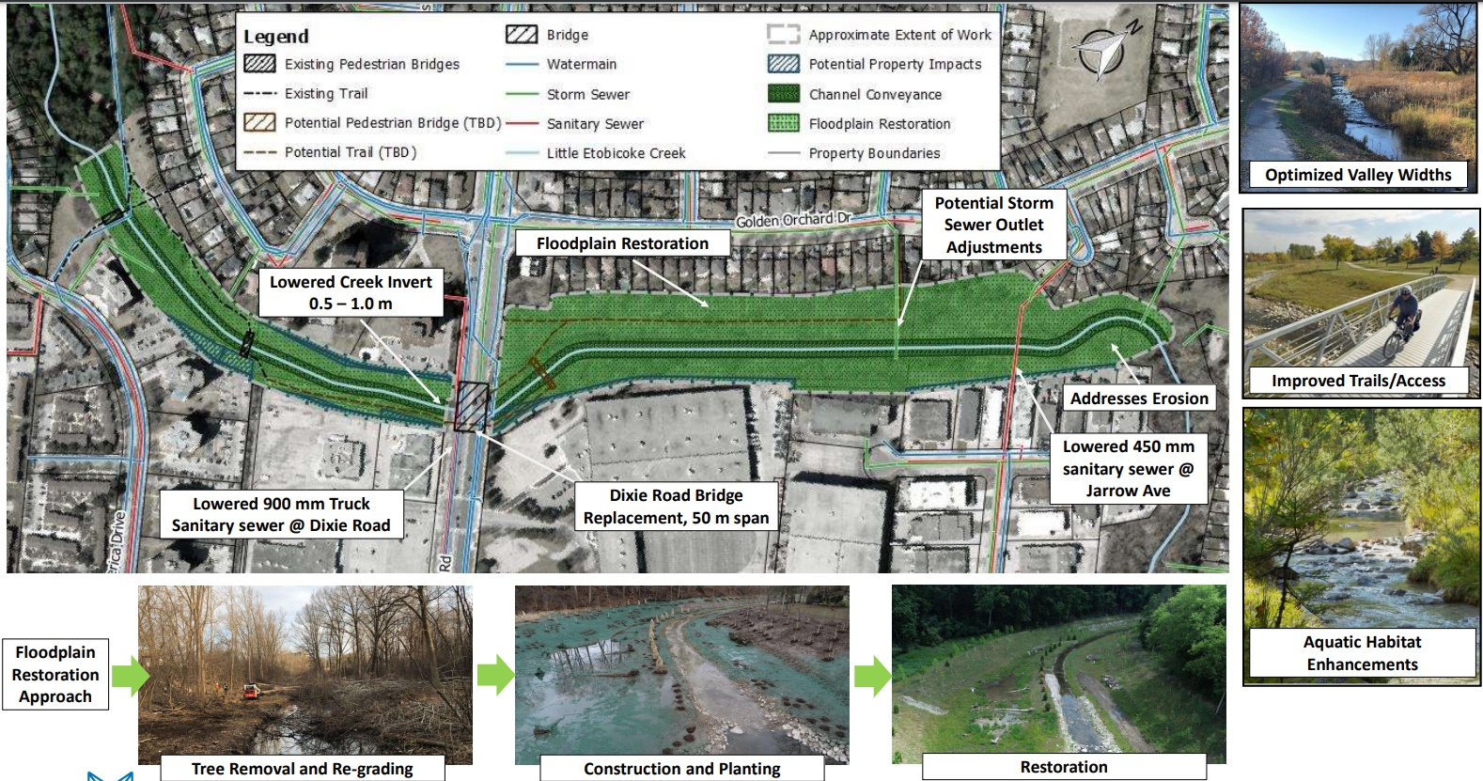
Dixie-Dundas Flood Project
Preferred Solution – Dixie Area
.

Slide 9
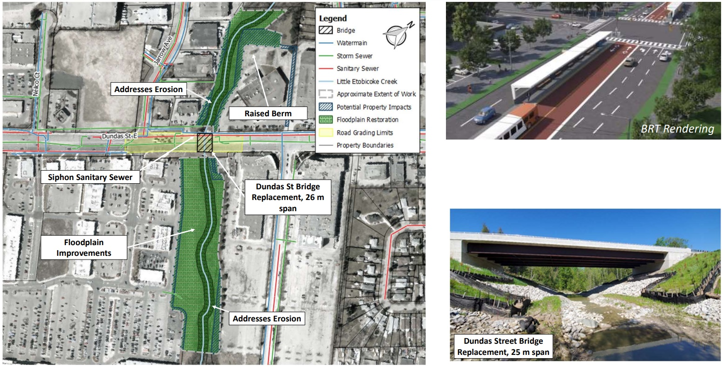
Dixie-Dundas Flood Project
Preferred Solution – Dundas Area

Slide 10

ACTION – Expediting Dixie-Dundas
Fast-tracking design
Leaning on partnerships
Single proponent management
Advancing land acquisition
Streamlining utility relocation
The implementation of this updated approach projects a completion date of 2028 (6-year acceleration)

Slide 11
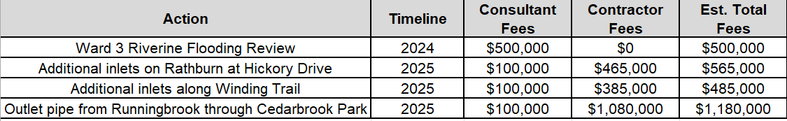
ACTION – Undertakings (2024/2025)
Through the remainder of 2024 and into 2025, several undertakings will be initiated to expand and expedite capital projects in areas of the City where large clusters of impacts were identified – Little Etobicoke Creek, Lisgar, Malton, Applewood and Streetsville

Slide 12
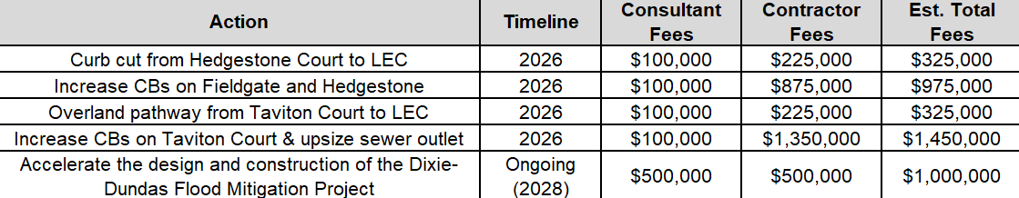
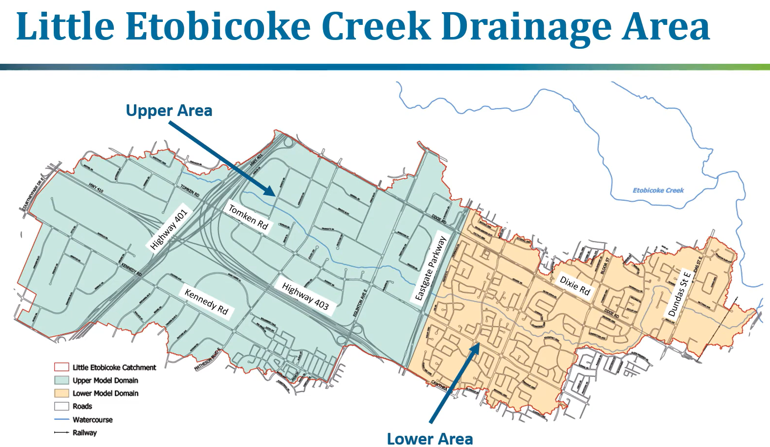
ACTION – Undertakings (2026)
2026 will see a continuation of the undertakings, including further accelerating the recommendations from the Little Etobicoke Creek Flood Evaluation Study.

Slide 13
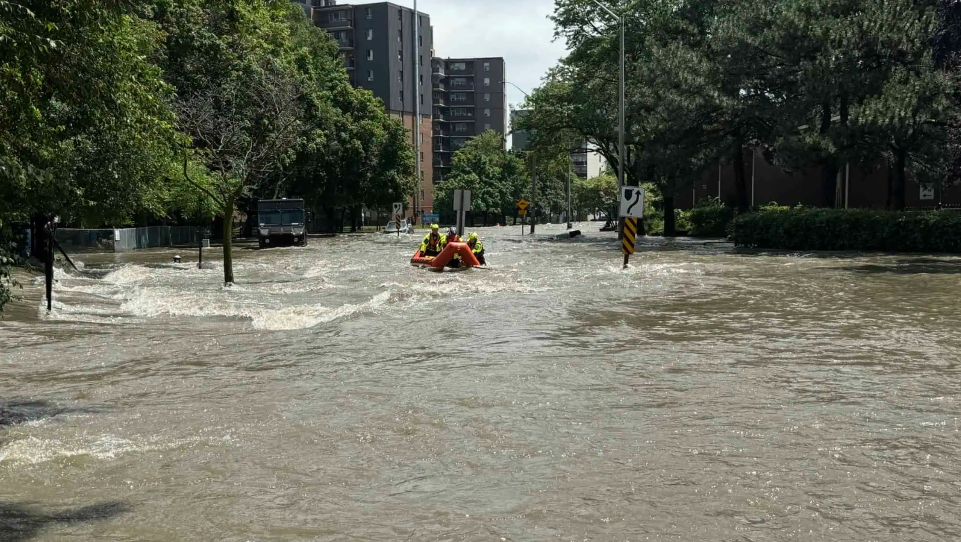

16 July 2024 Storm Event
Anthony Parente – General Manager Water and Wastewater
October 2024

Slide 14

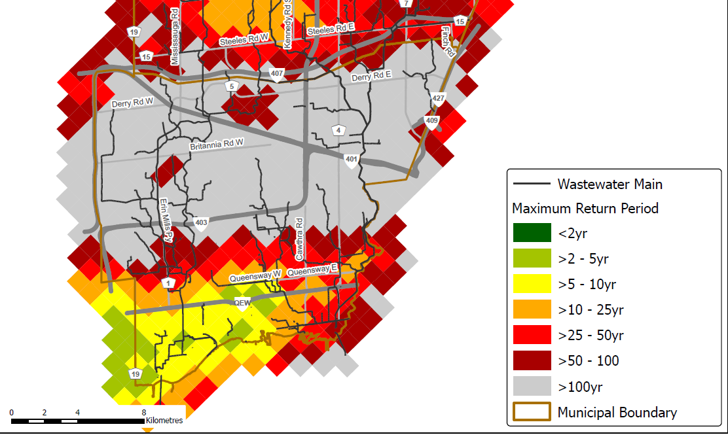
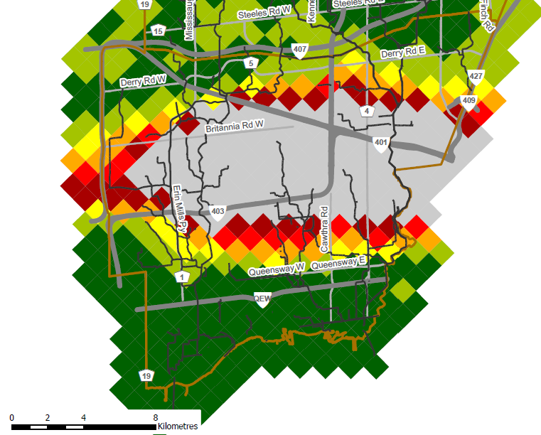
100-Year Storms
Average Monthly July Rainfall 75mm to 85mm
Max 24-hour Rainfall on July 8, 2023 101mm
Max 24-hour Rainfall on July 16, 2024 143mm
Max 24-hour Rainfall on August 17, 2024 143mm
July 2024 Storm
August 2024 Storm

Slide 15
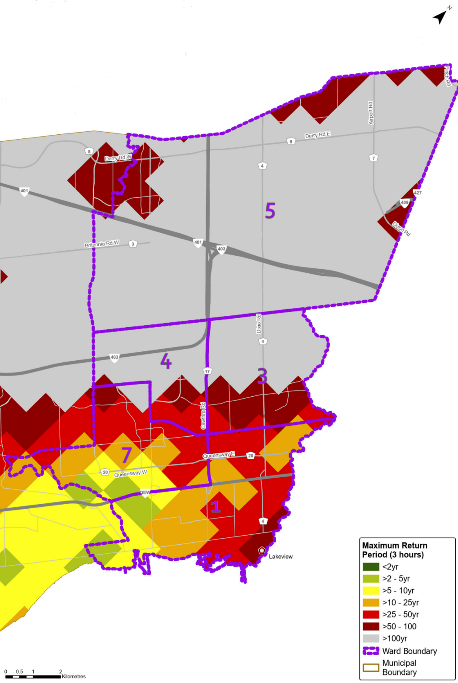
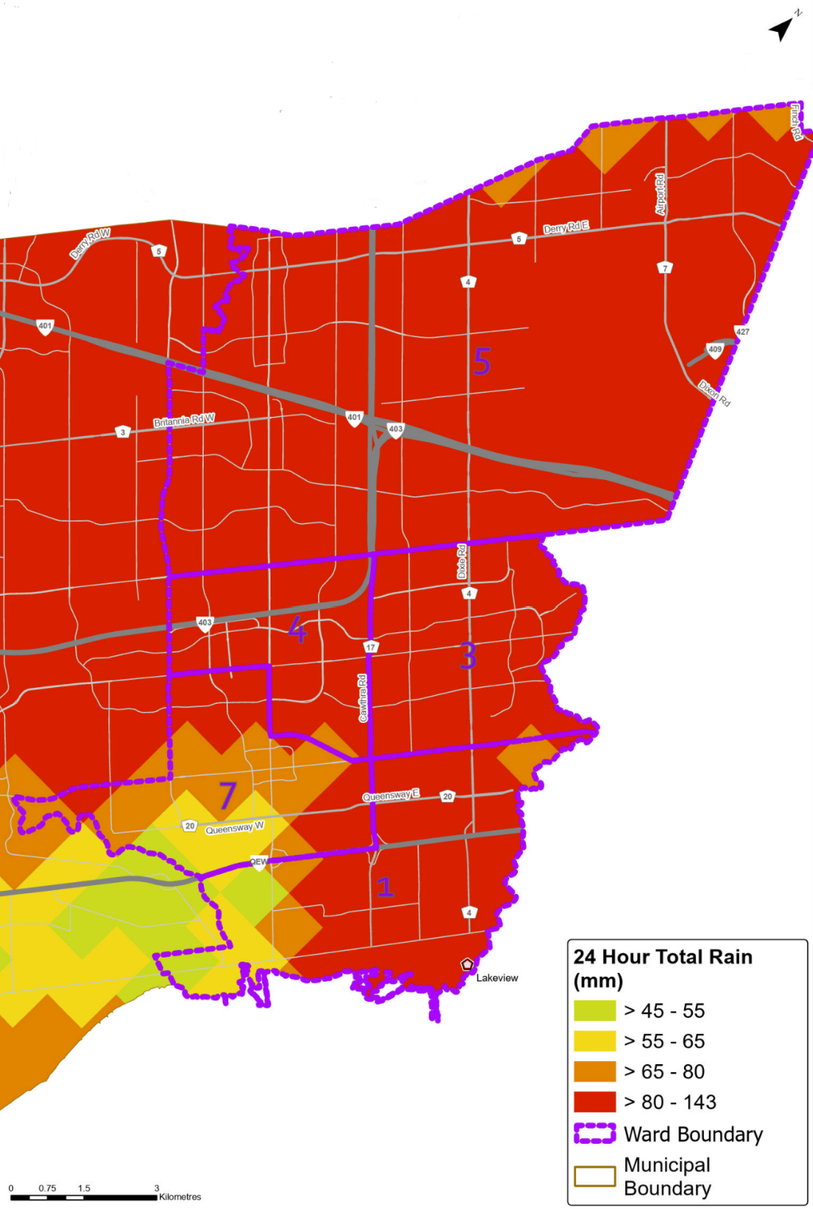
July 15, 2024 Storm

Slide 16
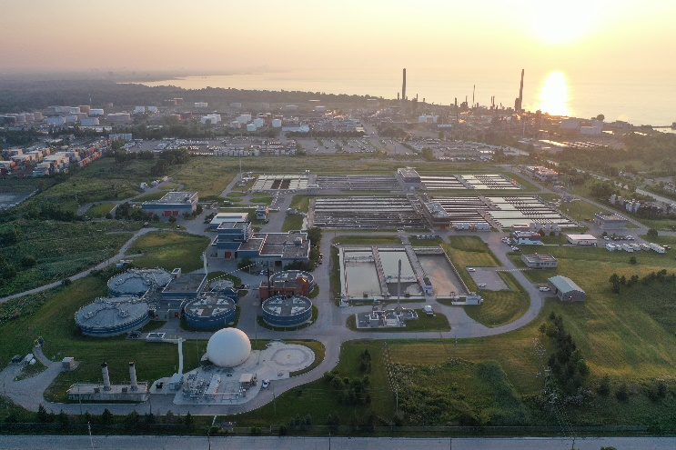
Managing stormwater is a shared responsibility
Your home
City of Mississauga
Conservation Authorities
Direct the rain to the City’s stormwater system
Local Stormwater Sewers & Stormwater Ponds
Monitors rivers, sets flood management criteria, provides flood forecasting
Wastewater system is distinct
Wastewater from your home/business
Water Resource Recovery Facility (for treatment)
Region of Peel
Sewage System

Slide 17
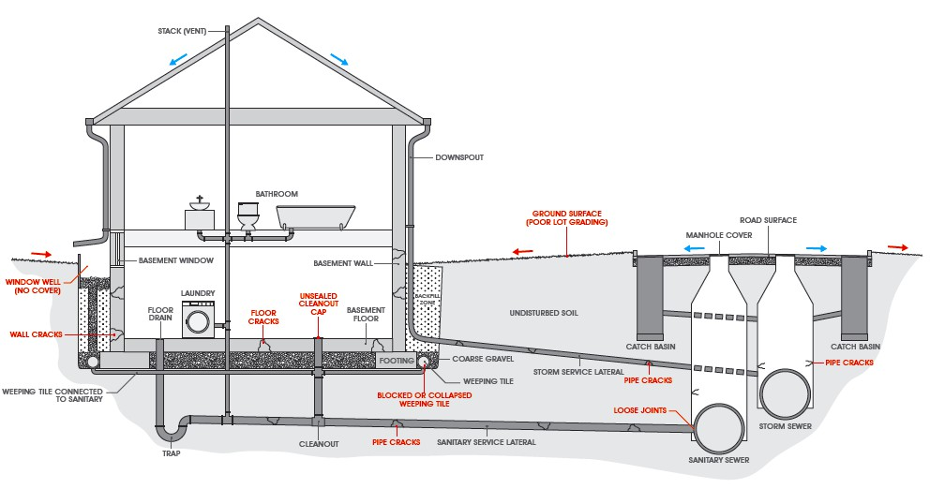
Sanitary vs. Storm Infrastructure – Normal State
Typical flows have distinct connections to both wastewater and stormwater systems
Under normal operations there is no connection between each
4
Graphic courtesy of ICLR
4

Slide 18
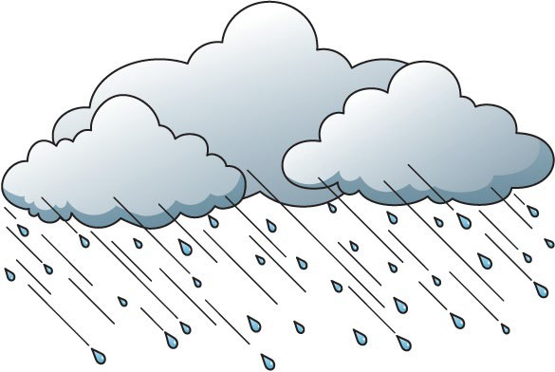
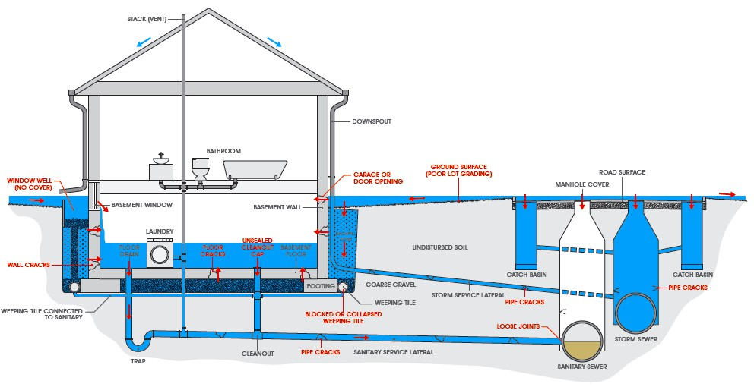
During Major Storms (Flooding)
Overland flooding results in surcharging of the storm system
Often results in flows into basements
Flow into basement floor drains begins to overwhelm the sanitary system
Graphic courtesy of ICLR
18

Slide 19
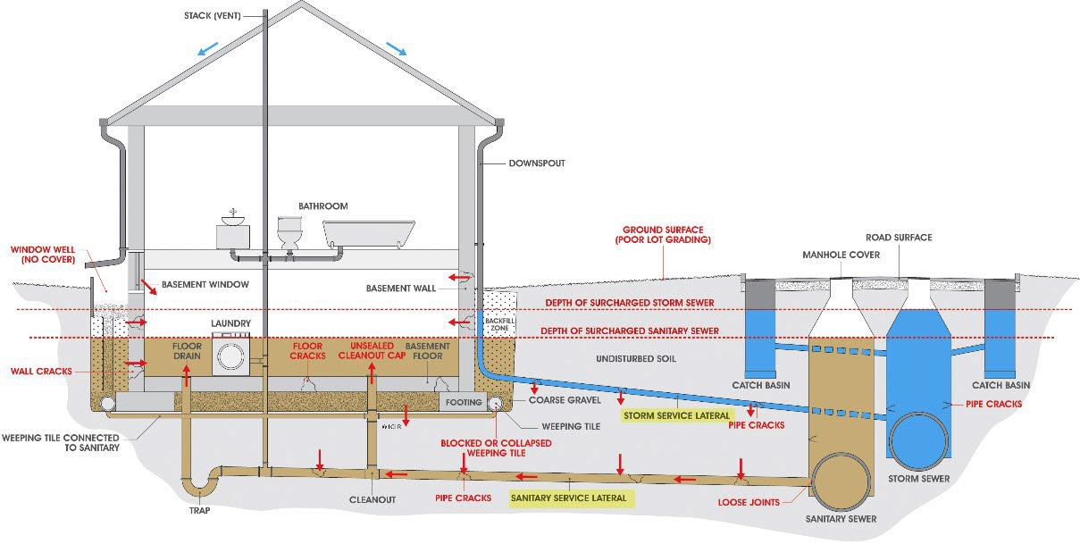
Surcharged Condition (Sanitary)
Eventually the sanitary system may become overwhelmed with storm water
Sanitary backflow into basements may occur
Graphic courtesy of ICLR
19

Slide 20
What is the Region doing to address impacts?
19

Slide 21
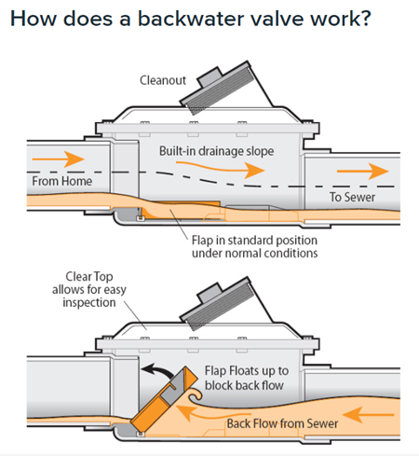
Peel Region Sanitary Backwater Valve Rebate
www.peelregion.ca/wastewater/backwater-valve-rebate
Contact the Region 905-791-7800 #4409
Check with Peel for eligibility: Flood insurance claim or property is in a Region of Peel priority flood vulnerable area.
Obtain a building permit from the City.
Installation inspection by the City.
Submit a rebate application to the Region of Peel.
The rebate recently increased by Regional Council to 60% of the invoiced cost up to a maximum of $1500
Homeowners who have previously received a rebate from Peel Region program eligible for a further rebate after 10 years.
Recent program changes are in effect retroactively to July 16, 2024.

Slide 22

Sanitary Backwater Valve Considerations
Challenges
Valves are mechanical devices and need regular maintenance (checked and cleaned)
If the backwater valve is closed during a storm, DO NOT use water (shower, washing, flushing) because this will result in flooding your own basement.
Prevent Sewer Mainline Back-ups
Avoid flushing disposable wipes, diapers, paper towel, fats, oil, and grease.
Get Professional Advice
Retain a certified plumber to ensure you employ appropriate flood prevention methods for your home.

Slide 23

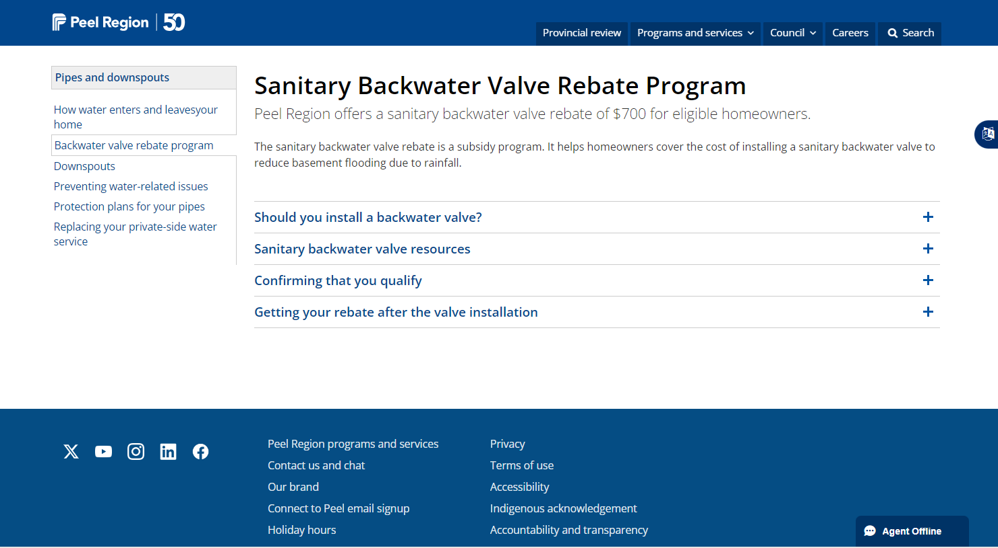
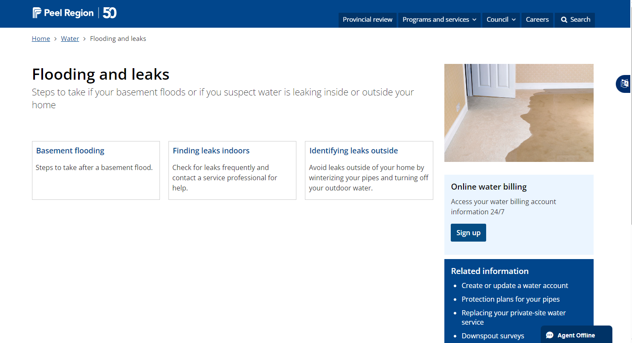
Homeowner Resources
A Residential Guide to
Flood Prevention and Recovery
www.peelregion.ca/water/-media/basement-flood-prevention-guide
Region of Peel Sanitary Backwater Valve
Rebate Program
www.peelregion.ca/wastewater/backwater-valve-rebate.asp
Region of Peel Guidance
www.peelregion.ca/water/flooding-leaks/

Slide 24
How are we improving Peel’s Wastewater System?
19

Slide 25
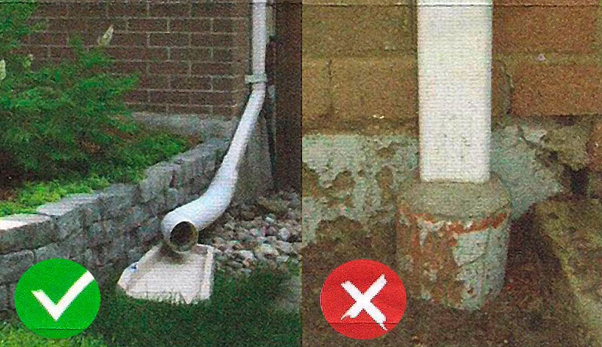



Downspout Disconnection
Eliminating direct connections to the sanitary system – where they exist
Private
Municipal
Downspout Disconnection Opportunity
Cross-connected
Downspout
Catch basin
Foundation Drainage
Storm Sewer (City)
Cross-connections
Sewer Lateral
Sanitary Sewer (Region of Peel)
4
4

Slide 26
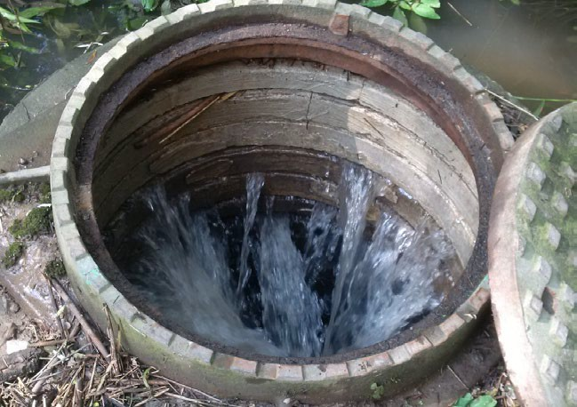
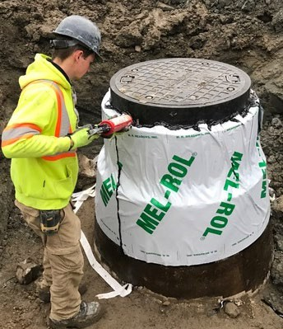

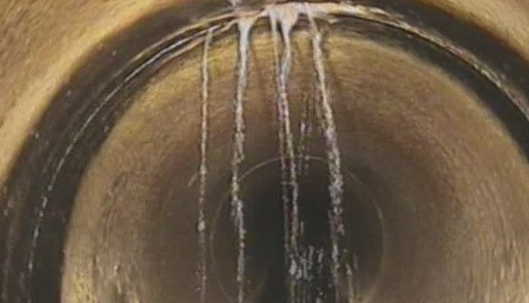
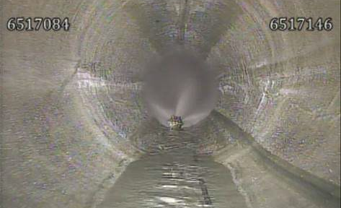
Rehabilitating our system
4
4

Slide 27


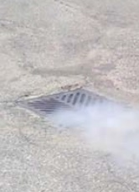
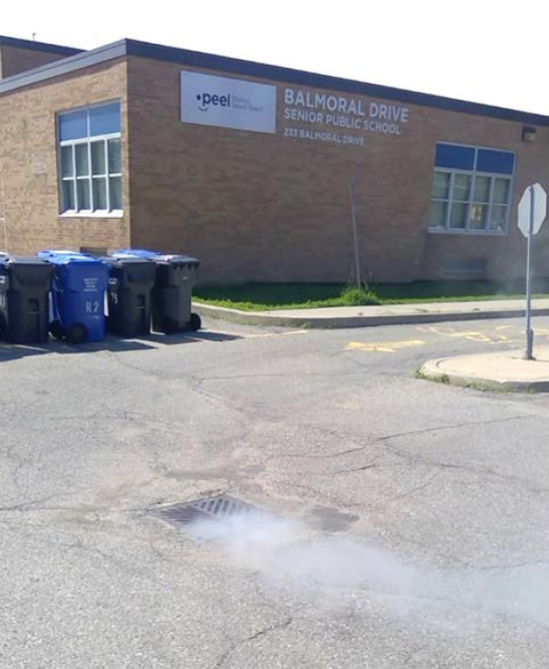
Eliminating Storm/ Sanitary Cross Connections
(parking lot)
Maintenance
Hole Cover
Catch basin
(stormwater)
Sanitary Sewer (Region of Peel)
Cross-connection
Cross-connected
Catch basin
4
4

Slide 28
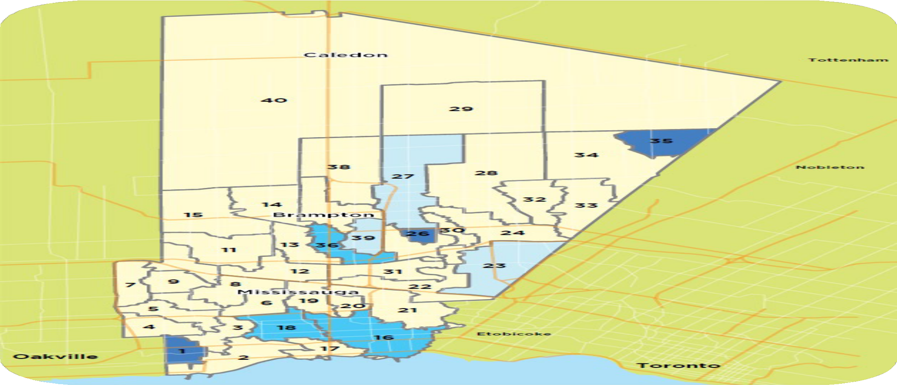
Prioritizing our Work
Prioritizing reviews of the sanitary system most impacted by Inflow and Infiltration of stormwater and groundwater
Where we cannot address solutions directly it is often more economical to develop adaptation solutions
Storage
Treatment expansion

Slide 29

Work Completed to reduce basement flooding Since 2013 – Ward 3
Ward 3 – Inflow & Infiltration - COMPLETED
98% of the sanitary sewers have been inspected by CCTV and repaired as required
98% of the sanitary sewers have been smoke tested to find leaks and cross-connections
All but 92 downspouts have been disconnected
12 Flow meters installed to track flows in real time
Ward 3 Projects COMPLETED
Ponytrail Bypass – COMPLETED 2019
Bloor Street, Bridgewood Drive improvements – COMPLETED 2017
Cawthra Road Relief Sewer – Phase 1 and 2 COMPLETED 2021
Maintenance hole “candy canes” – COMPLETED
State of Good repair sewer relining – Numerous areas completed
.

Slide 30
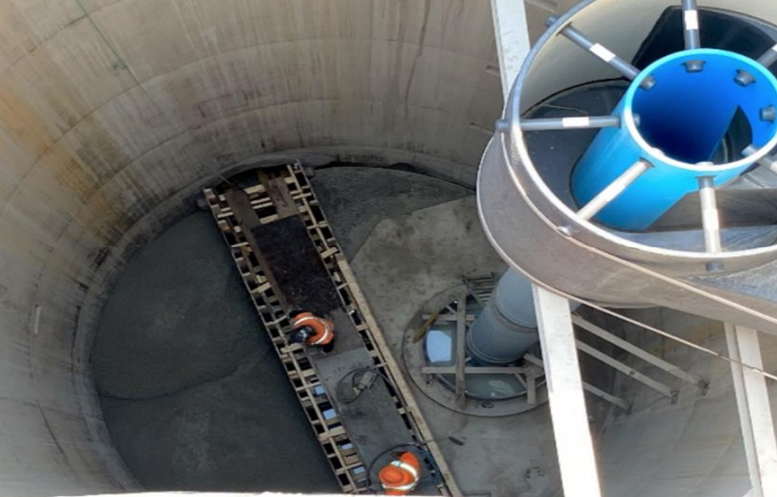
Work UNDERWAY – Ward 3/ Vicinity
Ward 3 & Vicinity
Cawthra Relief Sewer – Phase 3 - Extension to Queensway to provide capacity for growth and relief during high rainfall events
Little Etobicoke Relief Sewer – new relief sewer from Etobicoke Creek to Cawthra along Burnhamthorpe – in design
Queensway Relief Sewer & Capacity Expansion – For growth and relief – Hurontario to Etobicoke Creek
Entire System
2600 km of CCTV Inspection
350 km of testing to find and remove cross connections
400+ flow meters to measure true problem areas
87,000 downspout surveyed
Developed radar system to determine true rainfall that occurs in each area
Developed new standards to reduce inflow and infiltration
.

Slide 31
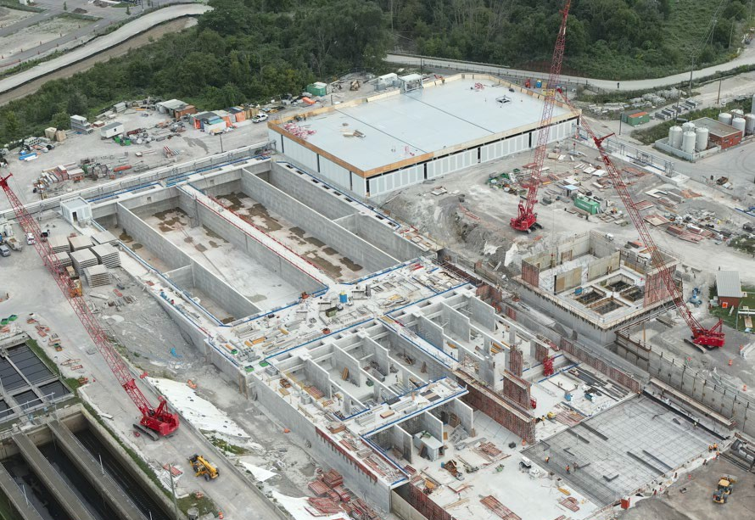
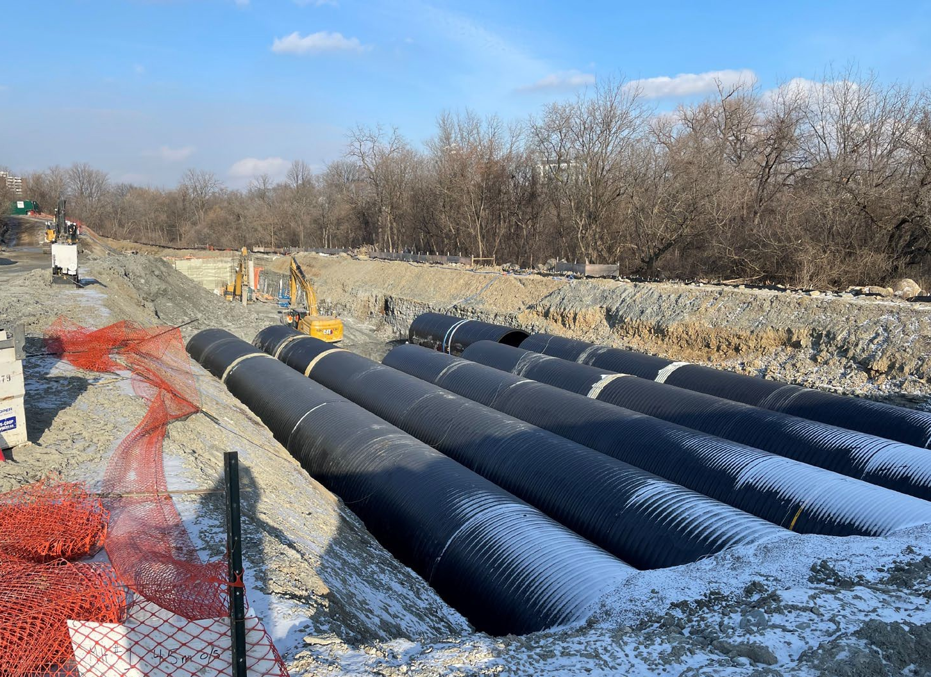
Other Adaptation Projects
Project | Location | Status
Etobicoke Creek Storage Facility | Mississauga | Under construction, in service 2025
Lakeshore Relief Sewer (Phase 1 – Elmwood to Jack Darling Park) | Mississauga/ Port Credit | Construction commencing 2024
GE Booth Water Resource Recovery Facility | Mississauga/ Lakeview | Under construction. Expansion commencing in 2025
Queensway Relief Sewer | Mississauga | 2026-2030
Cawthra Road Relief Sewer Phase 3 | Mississauga | 2026-2028
Lakeshore Relief Sewer (Future Phases – Elmwood to G.E. Booth and Jack Darling Park to Southdown) | Mississauga - Lakeview/ Port Credit/ Clarkson | TBD
17

Slide 32


Continuous
Improvement
Activity | Description
Region of Peel and City of Mississauga - Cross connection committee | Identifying cross connections between the sanitary and storm systems and correct all occurrences.
Rainfall Monitoring and advance warning system | Using a radar rainfall system to predict and advise storm intensity up to 2 hours in advance.
Sanitary system Real Time Control | Ability to divert sanitary flows, if and where possible to alleviate sanitary system surcharging.
18
West Trunk Sanitary Sewer Erin Mills Parkway

Slide 33
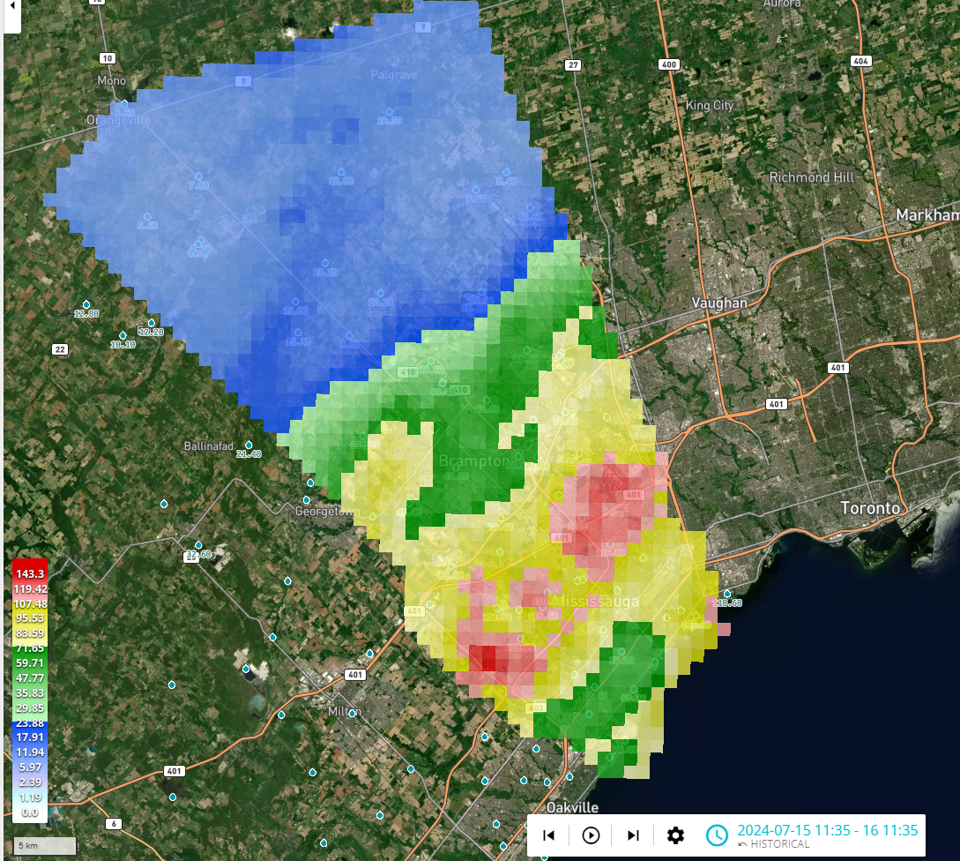
Thank You!
July 16, 2024 GARR Data
19

Slide 34
Peel Region’s Role in Managing Stormwater
Ward 3 Community Meeting
Lauren Crawford, Director, Transportation
October 17, 2024

Slide 35
Two-Tiered Stormwater Management in Peel
Peel Region:
Owns and maintains stormwater infrastructure located on regional roads.
The system is not subject to a stormwater rate.
This system must comply with provincial guidelines.
The City of Mississauga:
Owns and maintains stormwater infrastructure on local streets and private properties.
This system is funded through a municipal stormwater rate.
This system must comply with provincial guidelines.

Slide 36
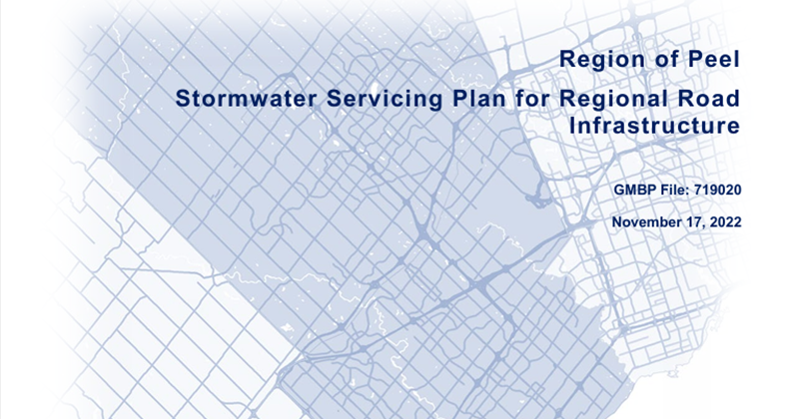
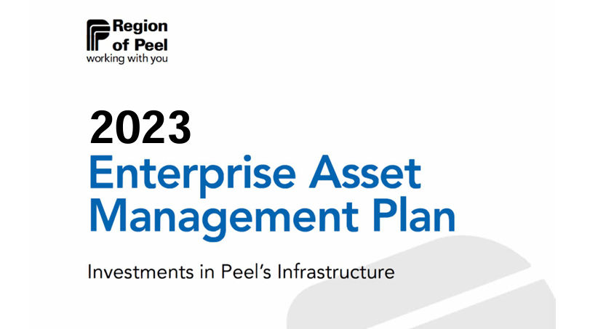
Regional Guidance and Strategy
Peel Region has several plans that guide design and maintenance of the stormwater system to the highest standards, including:
Stormwater Design Criteria and Guidelines for Peel Region
Stormwater Asset Management Plan
Stormwater Operations & Maintenance Manual and Practices
Stormwater Servicing Master Plan for Regional Roads

Slide 37
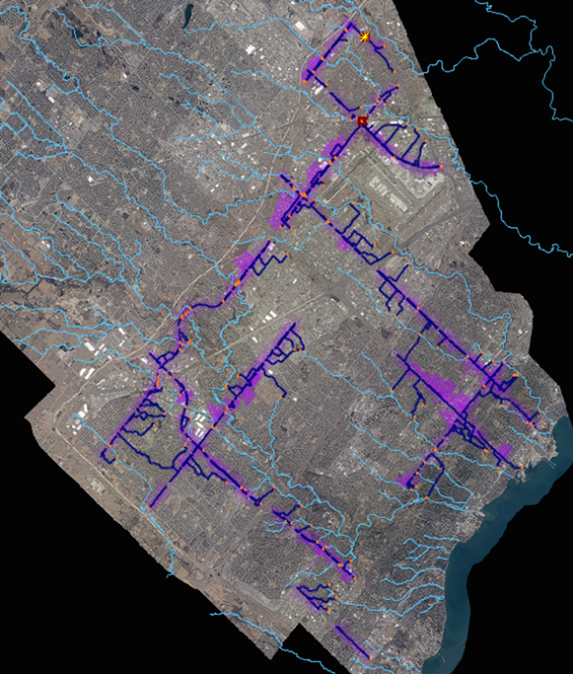
What has the Region done since the 2013 event?
Completed inventory & CCTV condition assessment of entire Peel stormwater system
Partnered with Conservation Authorities for annual inspections & reporting
Developed Peel’s first storm sewer system hydraulic model
Invested $56M for our stormwater assets over the next 10 years

Slide 38
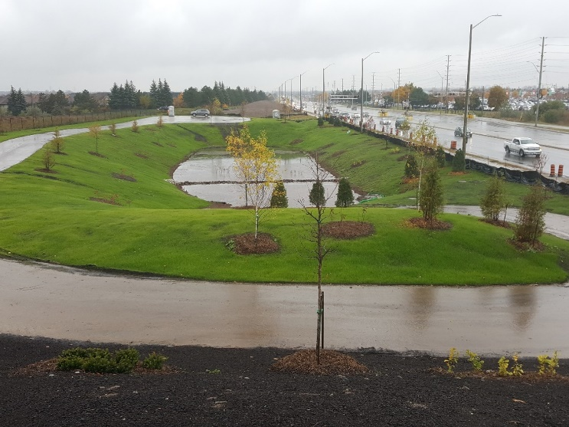
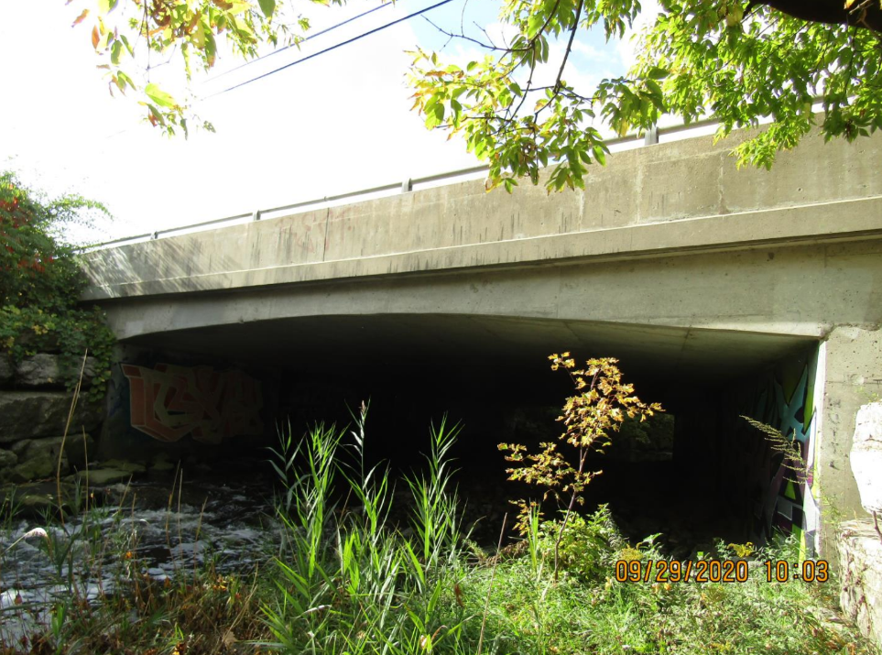
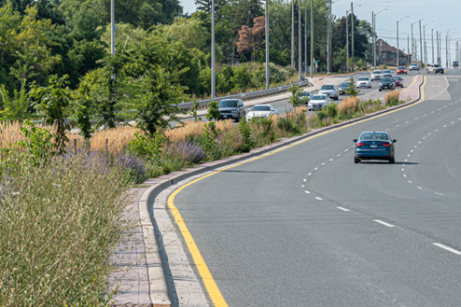
Other climate change and flood mitigation work underway
Installed Low Impact Development (LID) projects to reduce rapid stormwater run-off
Collaborated with the City of Mississauga and Conservation Authorities on studies and projects
Advanced the Climate Change and Infrastructure Risk Assessment project

Slide 39
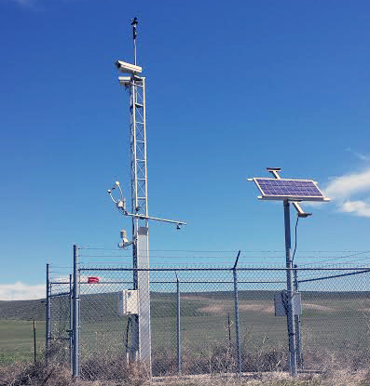
Peel’s Pre- and Post-Storm Approach
Monitored incoming weather events
Deployed additional Road Patrol staff to monitor Region's road network
Deployed additional staff to assist the call centre
Engaged contracted services to clear outfalls and re-establish drainage channels
Regular removal of trash and debris on the roadside and catch basin cleaning
Assessed damage and created work orders for post-storm repairs and clean-up
Assisted police with traffic safety during road closures

Slide 40
Lauren Crawford
Director of Transportation
Lauren.Crawford@peelregion.ca | (905)716-3613

Slide 41

Flood Mitigation Discussion
Flood Emergency Planning and Communication Measures followed by Peel Living:
Developed an Emergency Plan and implemented a Flood Emergency Plan
Developed a mechanism for mass communications directly with tenants before/during/after a flood
Working on measures that could be implemented to reduce flood risk onsite.
24 hour customer contact centre
(905)790-7335

Slide 42
July & August 2024 Storm Events
July 16, August 17-18
Presented By: David Kellershohn – Associate Director, Engineering Services
October 17, 2024

Slide 43
How much rain did we get?

Slide 44
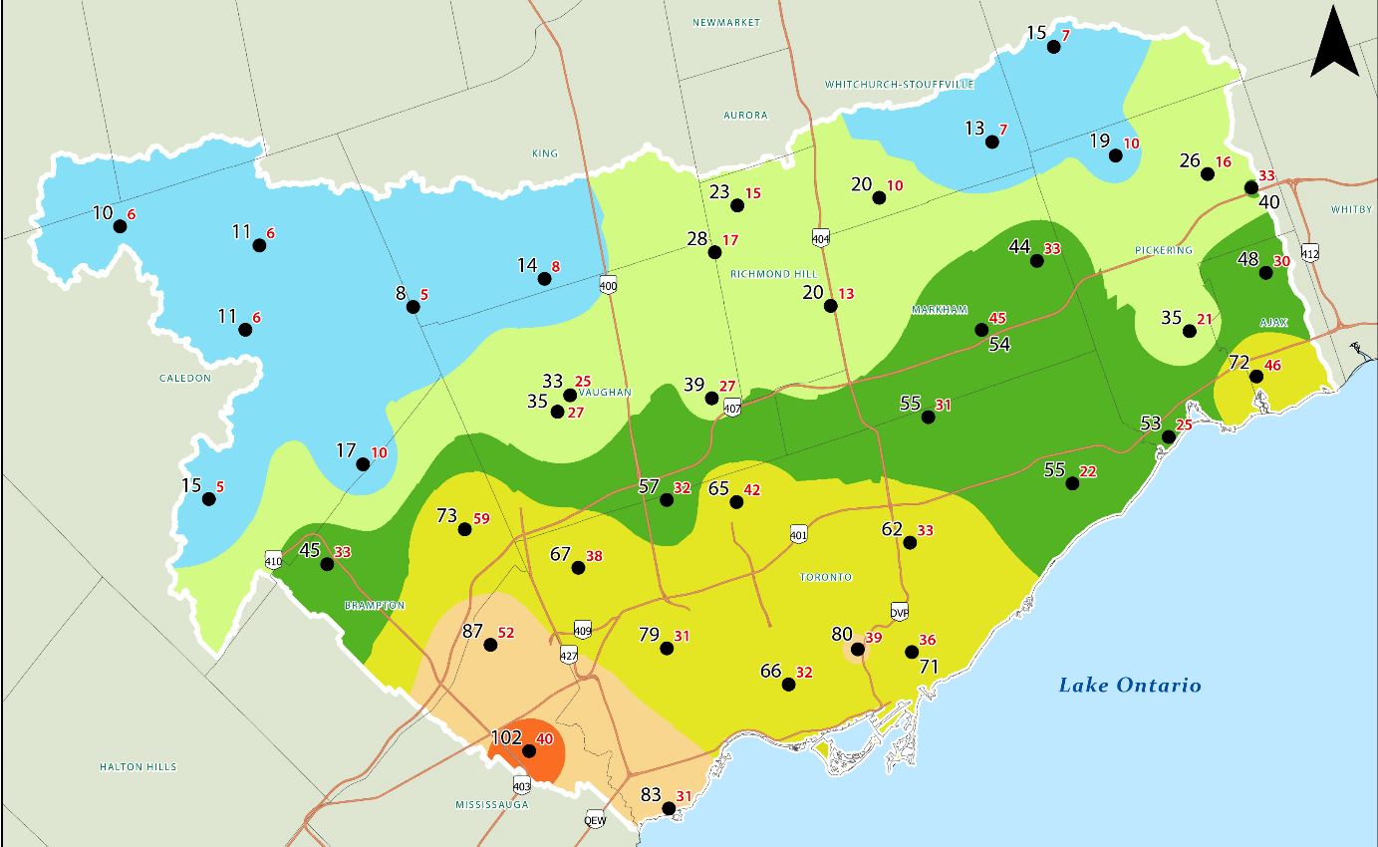
July 16, 2024 Storm event
Highest Rainfall = 102 mm (40 mm/hr)
Notes:
Pearson Airport 97.8 mm

Slide 45
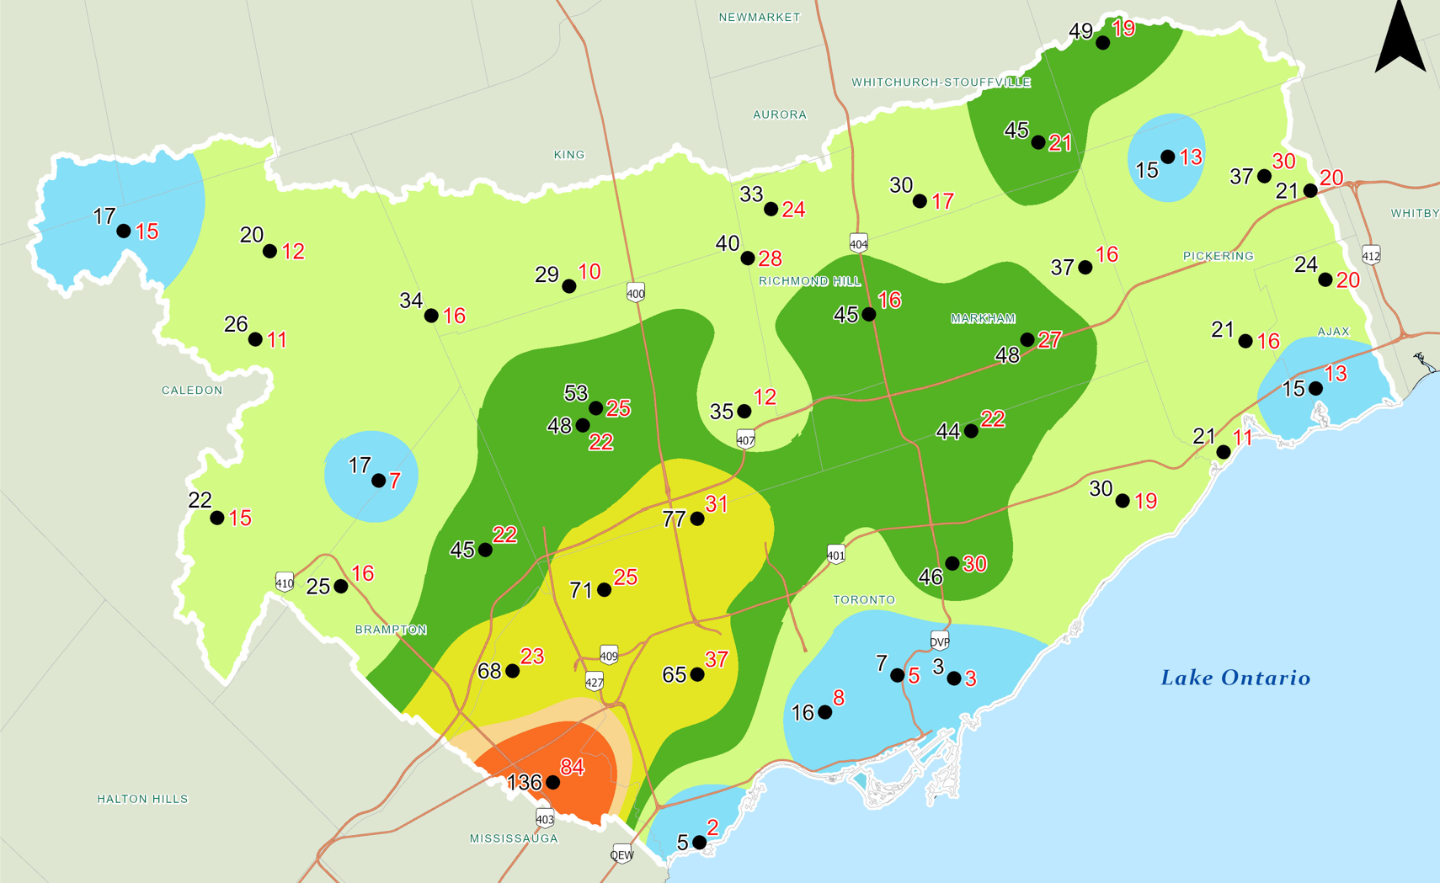
August 17, 2024 Storm Event
Highest Rainfall = 136 mm (84 mm/hr)
Notes:
Pearson Airport recorded 128.3mm
Surpassed previous 1-day rainfall record from July 8, 2013 which was 126mm.

Slide 46
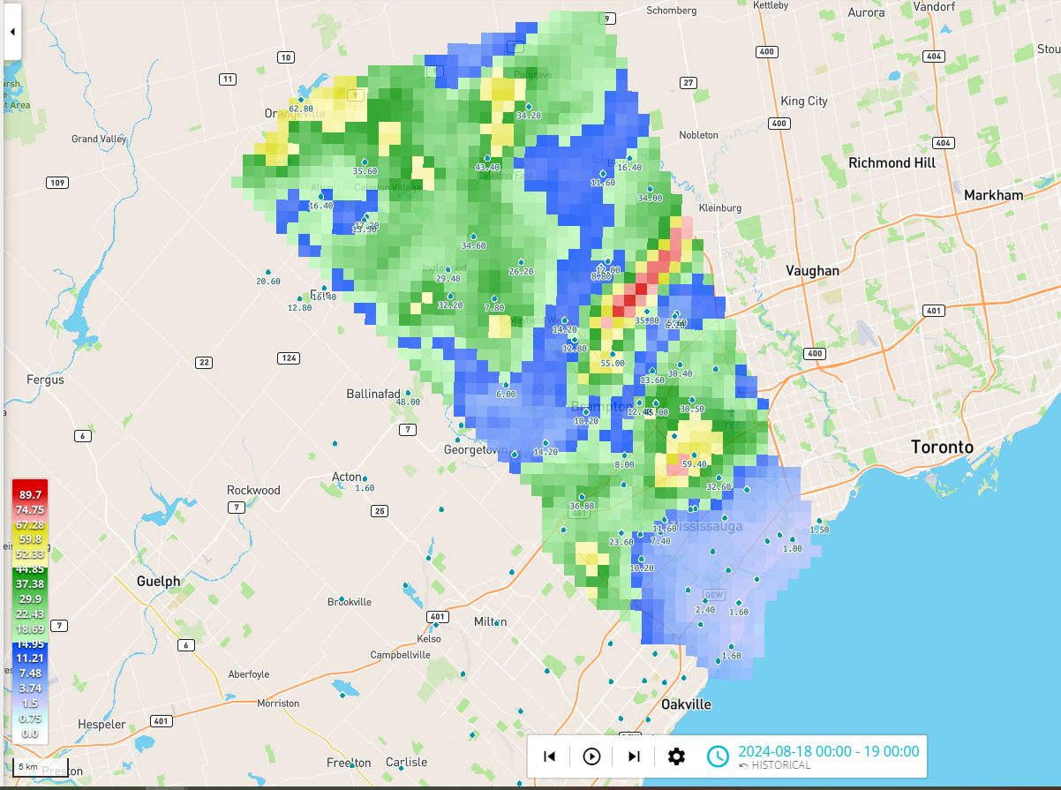
GARR product – August 18, 2024
Notes:
North end of Little Etobicoke got approximately 60mm
Very isolated and localized bands of more intense rainfall – not captured on TRCA’s rain gauge network

Slide 47
TRCA Little Etobicoke Stream Gauge Water Level Data

Slide 48
TRCA’s Role (during storms).

Slide 49
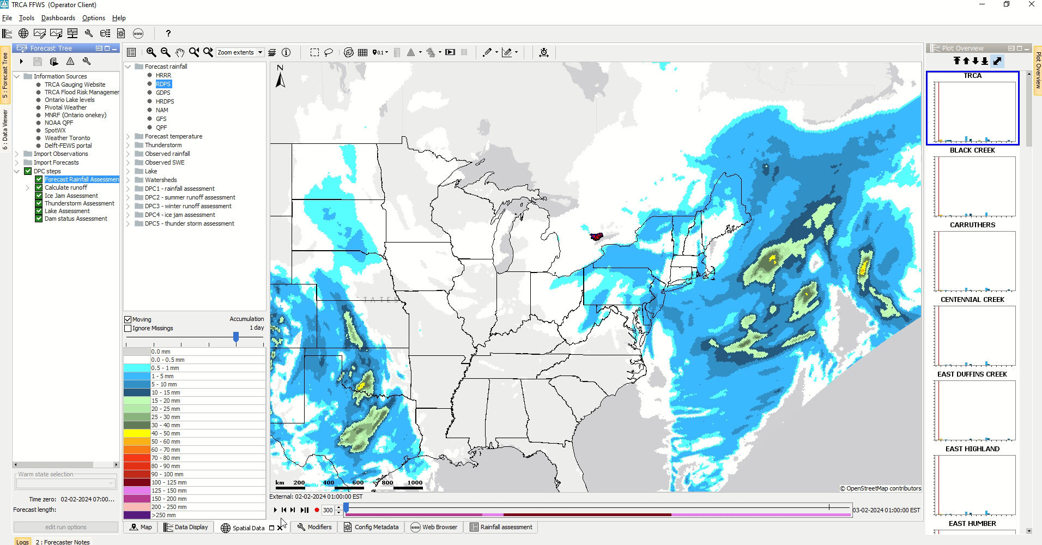
Monitors Weather & Provides Flood Messages
Notes:
I’m actually going to breakdown the first responsibility of operating a FFW system into two parts, and start with Monitoring the Weather.
TRCA has designated on-call staff as part of the Flood Warning Program, called Flood Duty Officers, or FDO’s
The FDO’s are tasked with reviewing weather forecast information and completing a daily assessment of forecasted rainfall, as well as current watershed conditions (which I will explain on the next slide).
I have an example shown here of how that information is reviewed everyday by the Flood Duty Officer in a new program we are using called Flood Early Warning System, or FEWS for short.
TRCA Flood Duty Officers review multiple different weather forecast models as well as information from publicly available weather forecasts, such as Environment Canada’s Weather Office.
We also have the ability to speak with and ask questions of the professional meteorologists at the Ontario Storm Prediction Centre, to obtain a little bit more information about incoming weather systems, when necessary.
Once the forecast weather is reviewed, we can then translate the precipitation amounts into estimated runoff volumes and what that means for water levels and flows in our river systems.
Based on this first part of the assessment, the conclusion may be that there is no flood risk for the day based on the weather forecast, or there is potential flood risk due to high runoff and a closer look at watershed conditions is necessary.
*

Slide 50

TRCA’s Role is defined by the Conservation Authorities Act.
Flood Messages follow the same format across Ontario.
Notes:
Flood Messages are to communicate and provide information for potential flood risk to municipal partners, local agencies as well as the general public.
These audiences may then proceed with some proactive measures or emergency response actions, as required.
On July 16th, TRCA issued a Flood Watch (9:35am) and a Flood Warning (11:35am)
On August 17-18th, TRCA issued a Flood Watch (2:00pm) message which was effective for August 17 and 18 and then cancelled on Monday, August 19th.

Slide 51






How to sign-up to receive TRCA flood messages through email
Be prepared
1. Go to trca.ca/floodmessages
2. Navigate down the page to the sign-up form
3. Fill in and submit the form
Once the form is submitted, the user has successfully signed up to receive flood messages from TRCA through email.
Follow us on formerly known as Twitter: @TRCA_Flood
Toronto and Region Conservation Authority
Notes:
Members of the public can sign up for TRCA Riverine Flood Messages directly from TRCA in two ways: Follow us on Twitter, and, sign up at trca.ca/floodmessages.
To sign up Go to trca.ca/floodmessages
2. Navigate down the page to the sign-up form
3. Fill in and submit the form
Once the form is submitted, the user has successfully signed up to receive flood messages from TRCA through email.

Slide 52
TRCA’s Flood Plain Mapping Program.

Slide 53



Where to find TRCA’s Flood Plain Maps
TRCA’s Flood Plain Map Viewer
Type this URL in your web browser:
trca.ca/defining-flood-risk
TRCA’s Flood Plain Map Viewer presents a digital representation of the current flood plain mapping data and allows users to explore TRCA’s jurisdiction to see the flood plain in a particular area. Access to the viewer can be found at the following URL:
trca.ca/conservation/flood-risk-management/flood-plain-map-viewer/
Navigate down the page to the modelling references section:
Continue to navigate down the page to view or download Flood Modelling Summary reports (Hydrology and Hydraulic) by Watershed.
Notes:
In addition to TRCA’s Flood Forecasting and Warning program, TRCA maintains a comprehensive flood plain mapping program. The majority of TRCA’s river and stream systems have been mapped to the Regional Storm, Hurricane Hazel, and these maps are used to support our Regulations under the CA act as well as supports municipal land use and infrastructure planning and emergency management.
TRCA has further developed a web-based viewer to help our partners and the public access our flood plain maps, which can be viewed on our Flood Risk Management website.

Slide 54
Tyndall Seniors Village 1060 Eglinton Ave E Mississauga Flood July 16, 2024 Flood August 17, 2024
Shirley Thomas-Weir, CEO-Sharon Village Care Homes
sthomasweir@svch.ca

Slide 55


Slide 56


Slide 57


Slide 58


Slide 59


Slide 60
Q/A’s

Slide 61
Contacts
Emma Calvert, Director of Infrastructure and Engineering
Telephone: 905-615-3200 ext. 4343
Email: emma.calvert@mississauga.ca
Anthony Parente, General Manager, Water/Wastewater, Region of Peel
Telephone:416-577-0597
Email: Anthony.parente@peelregion.ca
Dominic Reale, Manager of Operations and Tenancy Management, Peel Living, Region of Peel
Telephone: 905-791-7800 ext.3514
Email: dominic.reale@peelregion.ca
Lauren Crawford, Director of Transportation, Region of Peel
Telephone: 905-716-3613
Email: lauren.crawford@peelregion.ca
Nick Lorrain, Senior Manager, Flood Risk Management, Toronto and Region Conservation Authority
Telephone: 437-880-2375
Email: nick.lorrain@trca.ca
Shirley Thomas-Weir, Chief Executive Officer, Sharon Village Care Homes
Telephone: 905-975-9671
Email: sthomasweir@svch.ca

Slide 62
Thank You For Attending!
If I can be of assistance with municipal issues you are dealing with, my team and I are always here to help.
CONTACT INFO
COUNCILLOR Chris Fonseca
Mississauga Civic Centre
300 City Centre Drive, Mississauga, ON L5B 3C1
(905) 896-5300 | chris.fonseca@mississauga.ca

