Slide 1
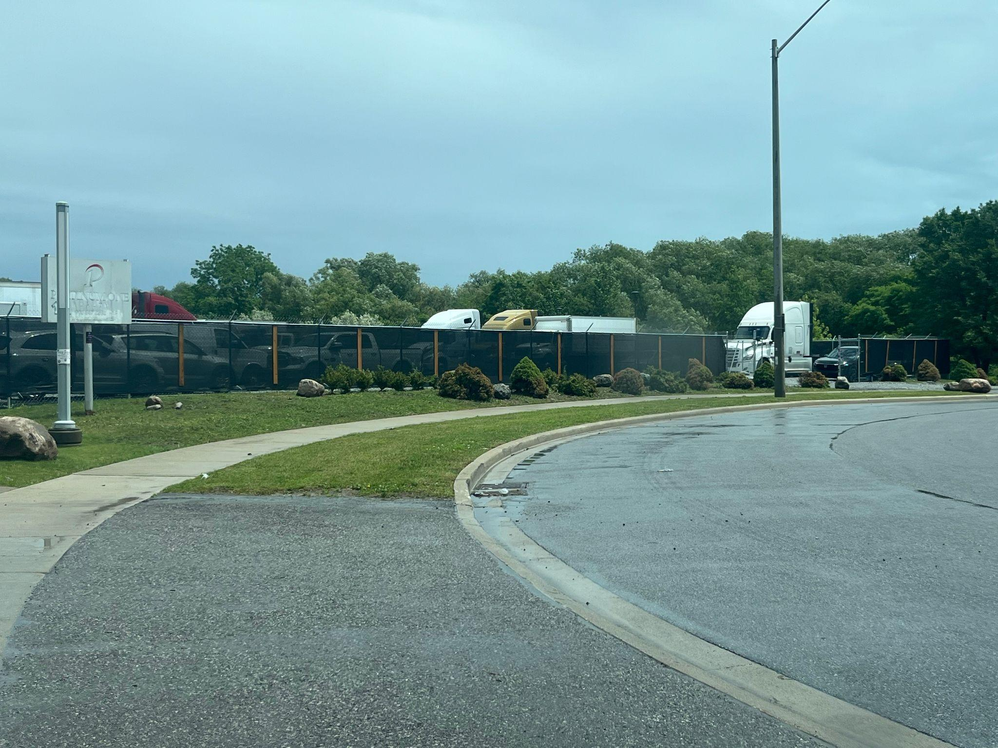
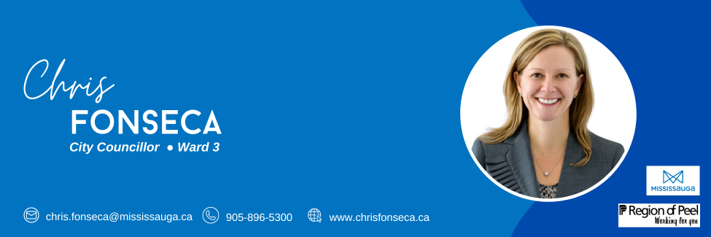
Welcome To Our
1075 CANADIAN PLACE
Community Information Meeting
Notes:
Hello,

Slide 2
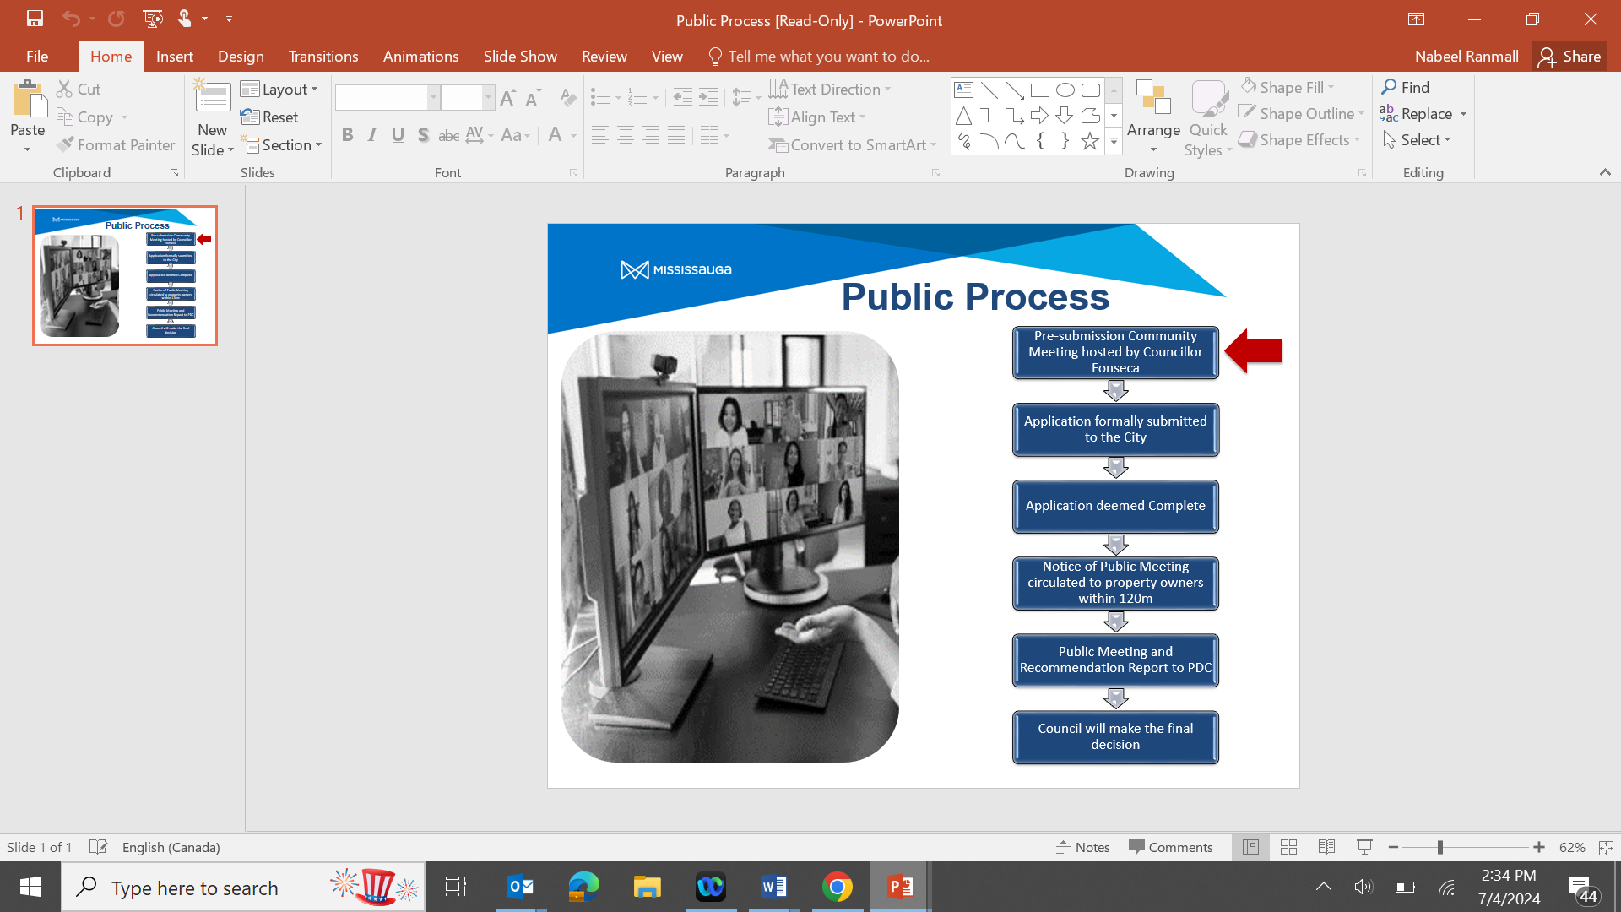

Slide 3
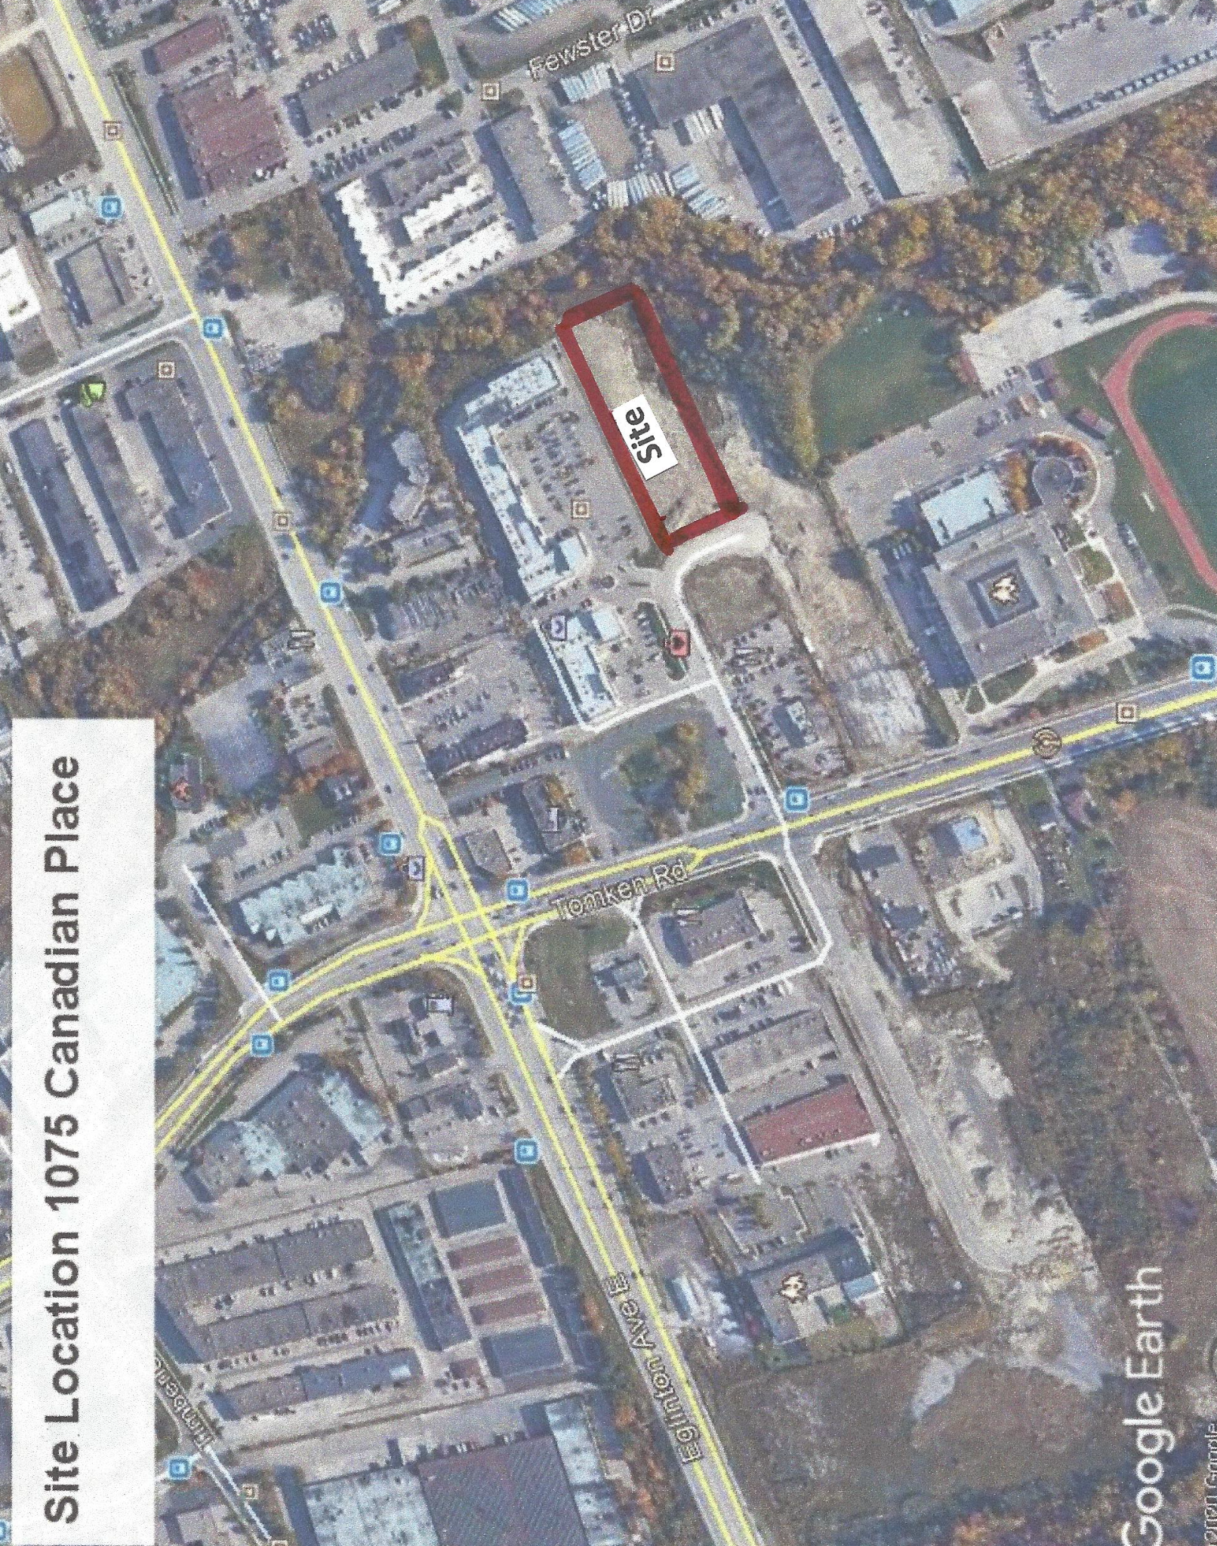
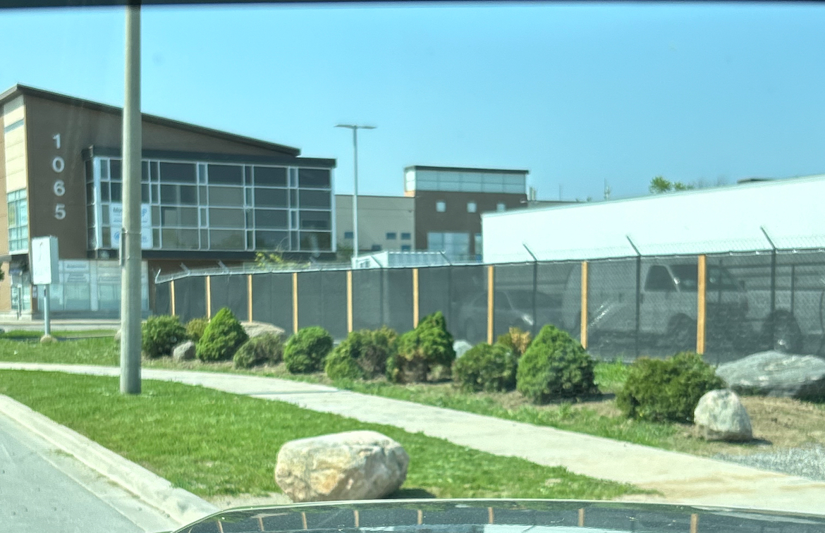
BACKGROUND OF THE EXISTING SITE
1075 Canadian Place
Site Location
The site is located within an established industrial park with industrial uses developed on all sides. Majority of the surrounding sites are zoned E2 (Employment Use).
Notes:
The subject site is currently vacant and is used for temporarily parking commercial motor vehicles. We intend to amend the zoning bylaw to facilitate a recreation and entertainment centre or similar use. The
remainder of the lot will accommodate and facilitate the proposed development such as parking and grading as required.
The subject site is located within an established industrial park with industrial uses developed on all sides. To the rear of the site is a wooded valley system associated with Etobicoke Creek. The existing access to the subject property will be used to facilitate the new use. The municipal water and sewer lines are along Canadian Place and connection will be sought through the Region of Peel.
The subject site is surrounded by commercial uses, all lands are primarily zoned E-2.

Slide 4
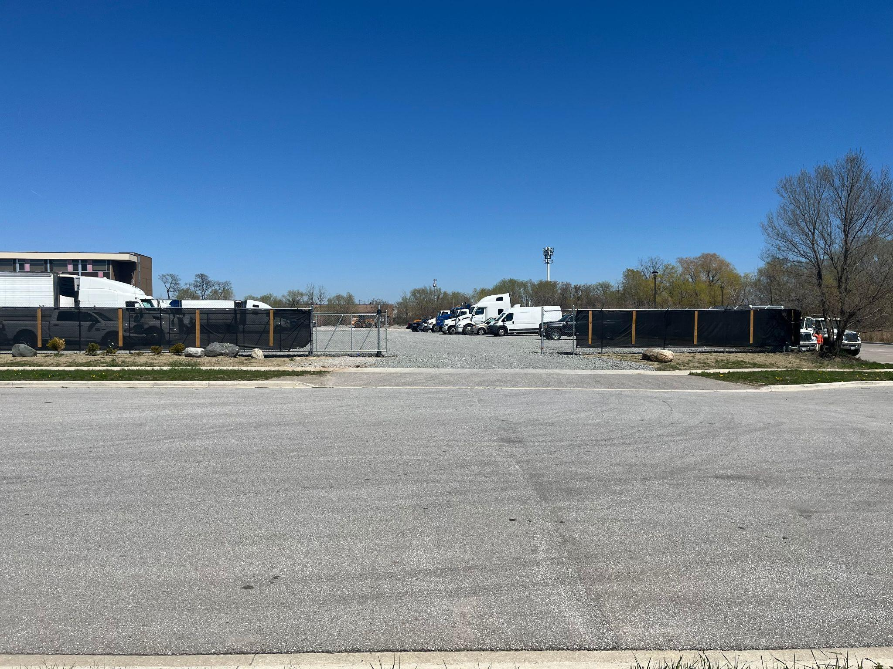
Current use of the space
Currently, the site serves as a Commercial Vehicle Parking lot
It is currently zoned as D6 for a temporary use as Trucking Facility - Commercial Vehicle Parking

Slide 5
Current Zoning Status of the Entire Lot (1075 Canadian Pl)
The subject site has been designated partly as:
Development (D) which recognizes vacant lands not yet developed, and does not permit the erection of new buildings or structures and replacements of existing structures or buildings, and as
Employment (E2)
Notes:
Read slide

Slide 6
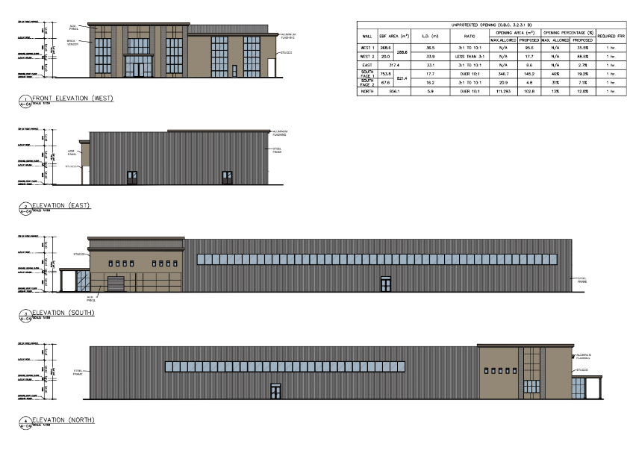

PROPOSED APPLICATION
Propose to amend the current designation of the property from a vacant lot to a 2-storey entertainment and sports building
Notes:
The proposal is to amend and rezone the property from its current designation to facilitate the various land uses permitted in the Employment Zone.
The first floor and basement will have uses core to the arena such as the office and reception area, locker rooms, equipment storage area and washrooms. The second floor will accommodate a minor restaurant use and have open rooms as well as a viewing and seating area for the arena.

Slide 7
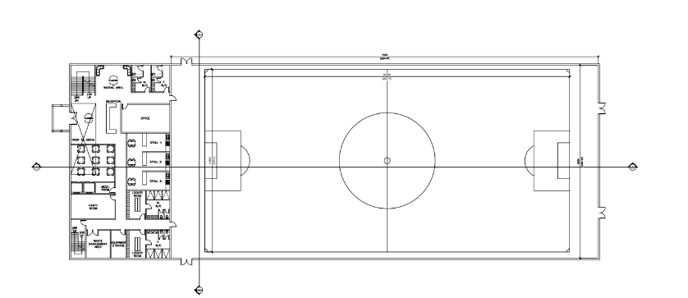
PROPOSED APPLICATION
In order to facilitate this development, we are applying for a change of the current zoning from the existing D and E2 mixed zone to E2 (Employment zone) for the entire lot

Slide 8
PROPOSED APPLICATION
The proposed change in use would permit the first built-up development on this site, therefore capable of enhancing the existing lot fabric of Canadian Place
Notes:
Currently, the subject land is zoned Development (D), which does not permit the erection of any new building or structures. The proposed change in use would allow for the site to develop, and the proposed use of the redevelopment would be a primary employment zone. Due to current market conditions, and to facilitate the review of the application an example of a recreational establishment is represented as the potential land use on the subject site. This was chosen to represent the maximum limits of development when considering the parking for the area to ensure that we can address parking deficiencies. In the City’s zoning bylaw, the recreation facility is defined as a building, structure, or part thereof, used for athletic and leisure activities and may include a fitness centre, racquet club, bowling alley, arena, curling rink, indoor facility used for golf, baseball or soccer, indoor playground or pool, and businesses such as music, martial arts, and dance schools. This use is permitted under the E2 Employment category.
The change in zoning from the existing vacant land used as a temporary truck parking can be facilitated to encourage redevelopment as a higher density of employment through the redesignation and amendment of the zoning bylaw.

Slide 9
Why a recreational facility?
Population → Increasing population at an accelerated rate in the City of Mississauga will require an increase in facilities to accommodate programming and recreation.
Target Demographic → People between the ages of 5-45.
Demand for Sports Facility → There is a scarcity of recreational sports facilities such as this and the creation of a recreational facility will accommodate the demand for field usage.
Traffic → Well connected location near highway 403 will allow people from all over the GTA to access our facility. Located near major bus connections and therefore accessible via public transit as well.
Location → Usage of the facility will peak during evening and weekend hours and would not interfere with daily traffic.
Notes:
The city of Mississauga’s population is expected to reach 930,000 people by 2051 (an increase of 21% from 2016 numbers). Based on this, there is evidence for the need for an increase in facilities such as this to accommodate programming and recreation.

Slide 10
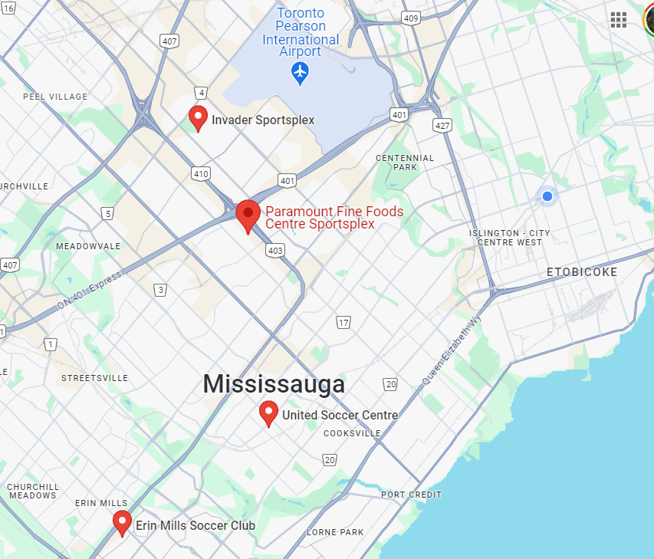
Community Benefits
Our facility will provide an option for sports and recreation for the community and will service east Mississauga and south Etobicoke where there is a lack of facilities such as this.

Slide 11
GROWTH PLAN FOR THE GREATER GOLDEN HORSESHOE
The subject site is within the built-up areas identified in the Growth Plan
The proposed application aims to increase the employment densities in employment areas as defined by the Region of Peel Official Plan and City of Mississauga Official Plan
Notes:
The subject site is within the built-up areas identified in the Growth Plan, and the proposed application aims to increase the employment densities in employment areas as defined by the Region of Peel Official Plan and City of Mississauga’s Official Plan.

Slide 12
GROWTH PLAN FOR THE GREATER GOLDEN HORSESHOE
There is a need to facilitate and direct growth to built-up areas that have the capacity to accommodate growth and promote a mix of land uses while ensuring that there are adequate water and wastewater services to support growth.
2.2.3.1 a) making more efficient use of existing employment areas and vacant and underutilized employment lands and increasing employment densities;
2.2.3.7. Municipalities will plan for all employment areas within settlement areas by: a) prohibiting residential uses and prohibiting or limiting other sensitive land uses that are not ancillary to the primary employment use;
Notes:
The Growth Plan for the Greater Golden Horseshoe builds on the policy directions contained in the Provincial Policy Statement and functions as a policy framework for achieving strong and prosperous communities by managing growth in the Greater Golden Horseshoe. It outlines that there is a need to facilitate and direct growth to built-up areas that have the capacity to accommodate growth and promote a mix of land uses while ensuring that there are adequate water and wastewater services to support growth.
It specifically references promoting efficient development patterns and encouraging economic development and competitiveness as outlined by:
2.2.3.1 a) making more efficient use of existing employment areas and vacant and underutilized employment lands and increasing employment densities;
2.2.3.7. Municipalities will plan for all employment areas within settlement areas by: a) prohibiting residential uses and prohibiting or limiting other sensitive land uses that are not ancillary to the primary employment use;

Slide 13
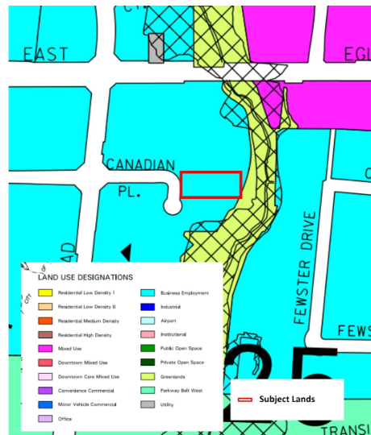
CITY OF MISSISSAUGA OFFICIAL PLAN
LAND USE DESIGNATIONS
The subject site is designated as an Employment Area under Schedule 9 and Business Employment under Schedule 10 Land Use Designations in the City of Mississauga.
SECTION 11.2.11.1 of the City’s Official Plan permits the following uses:
animal boarding establishment which may include outdoor facilities
banquet hall
conference centre
entertainment, recreation, and sports facilities
restaurant
secondary office
self-storage facility
accessory uses
Notes:
Read slide

Slide 14
CITY OF MISSISSAUGA OFFICIAL PLAN
The proposed employment use maintains and represents the uses within the City’s Official Plan.
The proposed change in use is consistent and aligns with the principles set out in the City of Mississauga’s Official Plan. The requested uses are consistent with the permitted uses for the subject site as described in the City’s Official Plan.
Notes:
The proposed employment use maintains and represents the uses within the City’s Official Plan.
The proposed change in use is consistent and aligns with the principles set out in the City of Mississauga’s Official Plan. The requested uses are consistent with the permitted uses for the subject site as described in the City’s Official Plan.

Slide 15
SUMMARY & CONCLUSIONS
The proposed development of this site intends to develop employment uses. Rezoning would provide an opportunity for the creation of jobs and employment uses in the area.
Requesting a redesignation of the site from the current mixed zoning of Development (D) and Employment (E2) to fully Employment (E2)
Proposal conforms to and promotes the policies of the Provincial Policy Statement, the Growth Plan, and the Region of Peel Official Plan by providing higher density job use and promotes the efficient use of an underutilized site
The proposed designation advances the intent of the Business Employment land use designation in the City of Mississauga Official Plan
Notes:
Read slide
Thank you to everyone here.

Slide 16
Contacts
Michal Stolarczyk – Planner, Development
City of Mississauga | Planning and Building Department
Development and Design Division
905-615-3200 ext. 5519
Michal.Stolarczyk@Mississauga.ca
Hitender Sharma – Director of Company
Hitender.Sharma@gmail.com
Mia Xue – Developer’s Agent
landbuildex@gmail.com

Slide 17
Q/A’s

Slide 18
Thank You For Attending!
If I can be of assistance with municipal issues you are dealing with, my team and I are always here to help.
CONTACT INFO
COUNCILLOR Chris Fonseca
Mississauga Civic Centre
300 City Centre Drive, Mississauga, ON L5B 3C1
(905) 896-5300 | chris.fonseca@mississauga.ca

