Slide 1
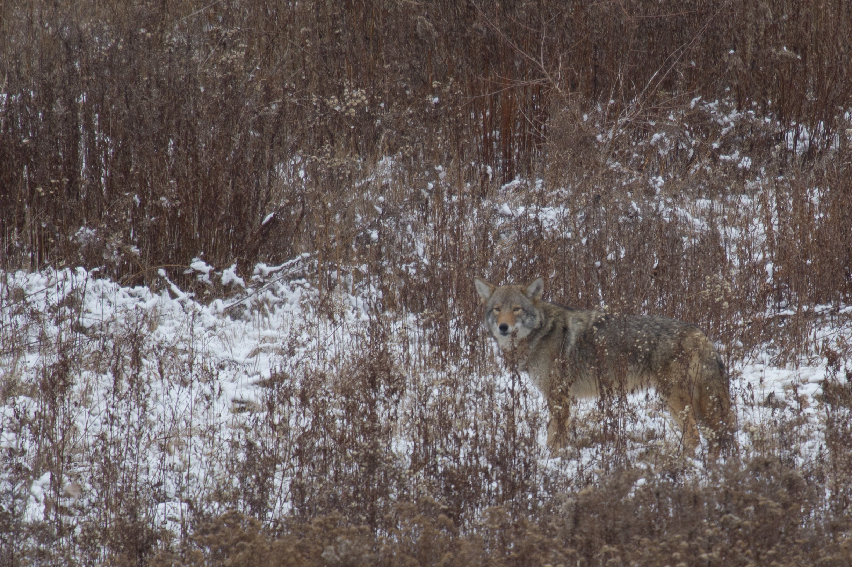
Wildlife Safety - Coyotes

Slide 2
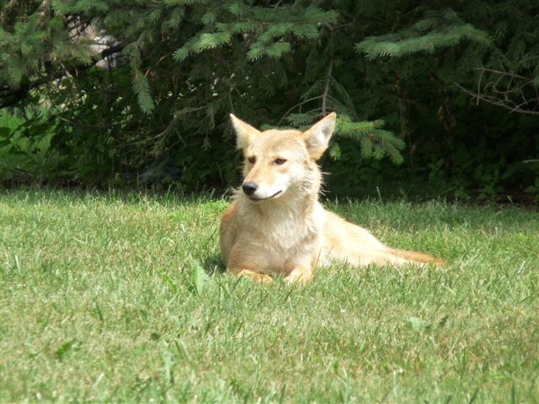
Eastern Coyotes
Eastern coyotes now inhabit most urban cities throughout southern Ontario.
Coyotes are an important part of a healthy ecosystem, aiding in the control of rodent, rabbit, and goose populations and address diseased or deceased wildlife.
Coyotes are non-confrontational and avoid humans whenever possible.
MNRF studies have indicated they can live harmoniously in densely populated urban cities and extermination or removal does not resolve conflicts or reduce populations.

Slide 3
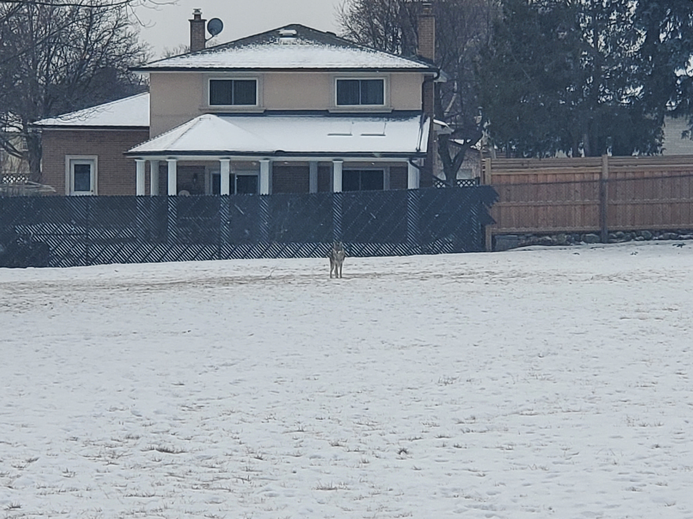
What’s happening now
Denning season occurs from March-May, coyotes will be more active and defensive around pups and den sites.
Animal Services has received a large increase in wildlife feeding concerns.
Covid 19 has not only changed human behavior but wildlife behavior as well. Wildlife may have expanded their territories. Increased feeding in neighborhoods has attracted rodents and coyotes.
During the virtual learning at schools (December-January) we had received concerns about individuals actively feeding coyotes on school properties.

Slide 4
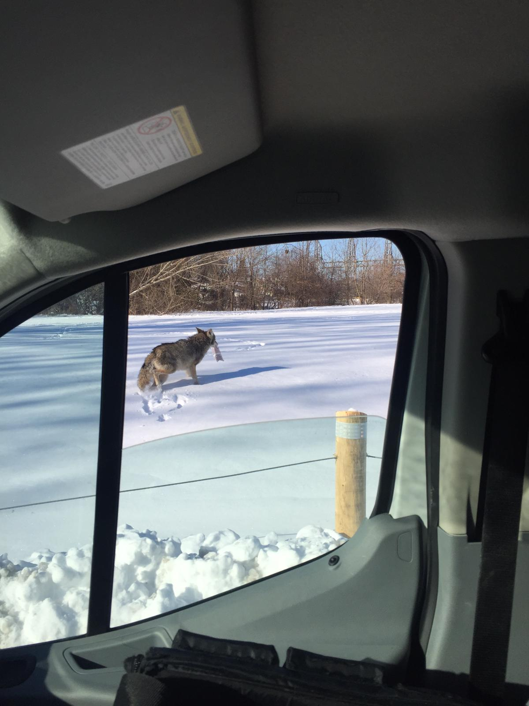
Wildlife Feeding
Feeding wildlife does more harm than help.
The feeding of wild animals and birds can become habit forming making them dependent on a food source or unwilling to forage naturally which can lead to illness, disease or injury.
The feeding of wild animals can interfere with natural instincts and behaviors and could lead to human/wildlife conflicts.
Feeding squirrels, raccoons or coyotes can cause them to become a danger to humans as they will lose their natural fear and approach humans.
An increase in rodent activity can attract larger predators like coyotes and foxes which can also prey on neighborhood pets.

Slide 5
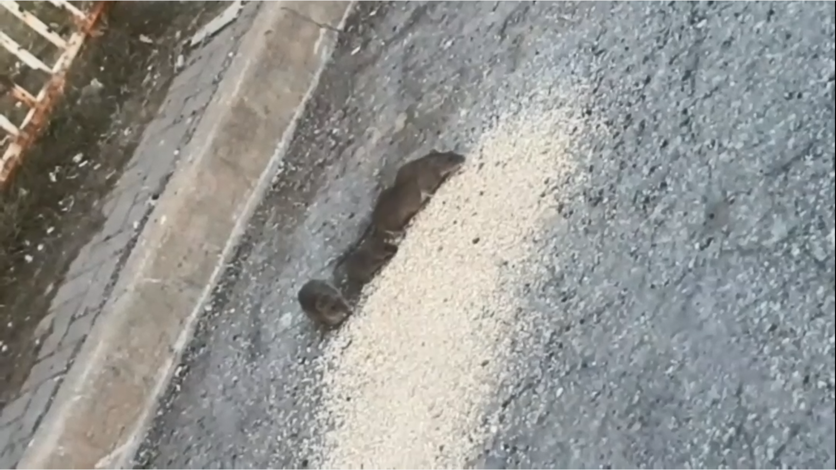

Slide 6
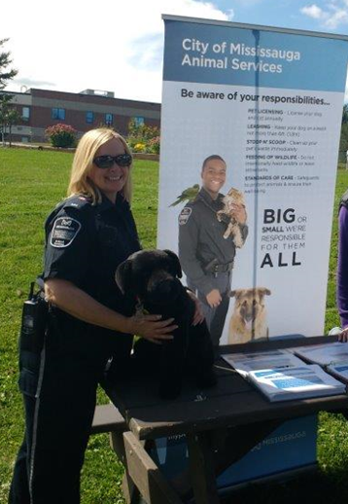
What we continue to do
Monitor coyote activity through public reporting and mapping.
Work closely with wildlife experts and authorities, Ward Councillors, schools, Communications and Parks staff to develop educational materials, programs, messaging and strategies.
Attend coyote calls to investigate: Reported unusual behaviour, environmental issues, feeding of wildlife, to rescue sick or injured, provide public education and to apply coyote aversion techniques if appropriate.
Distribute information door-to-door via the Animal Awareness and Responsibility Campaign (AARC) in identified areas.
Area schools are contacted and provided with educational
information in identified areas.
Communication, social media, news articles, web site updates and alerts

Slide 7
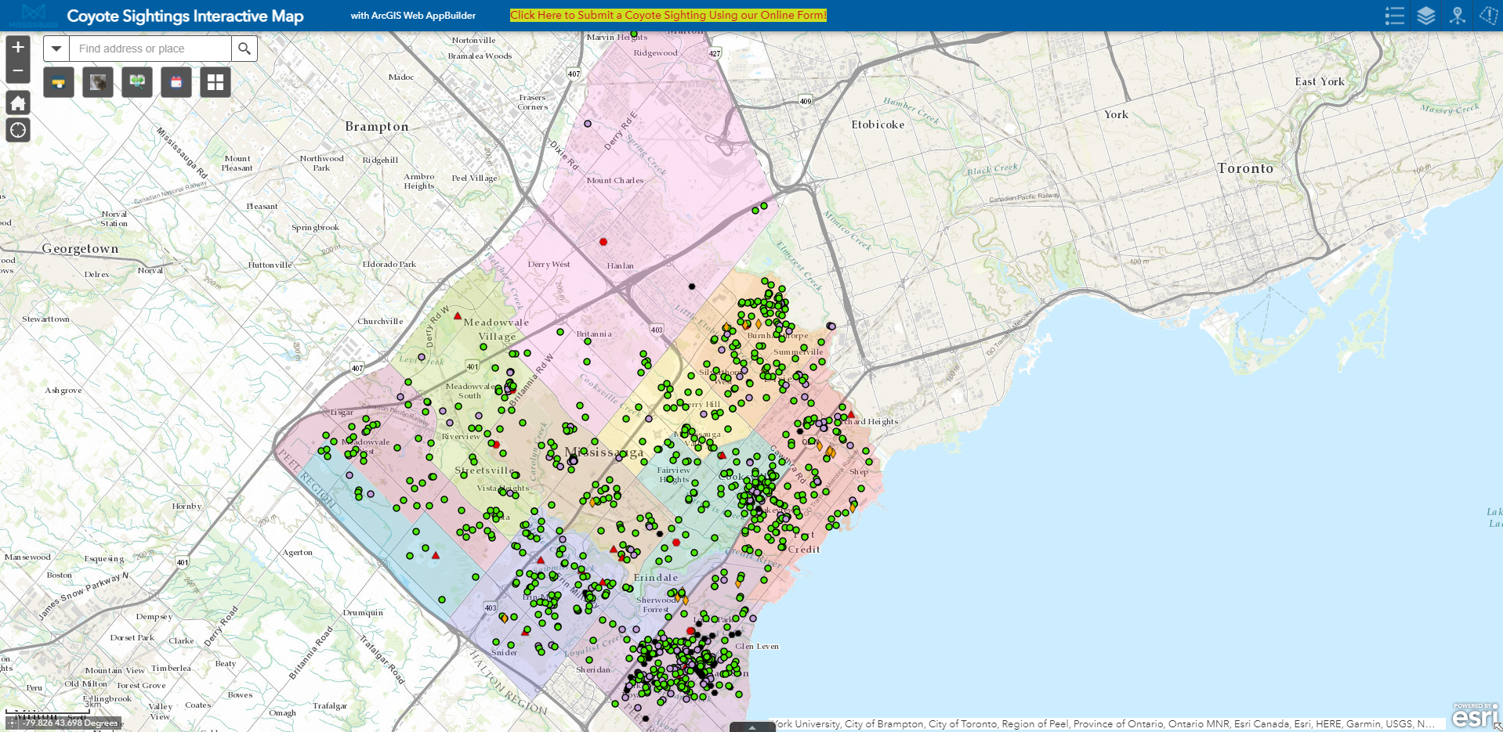
Our Online Coyote Map

Slide 8
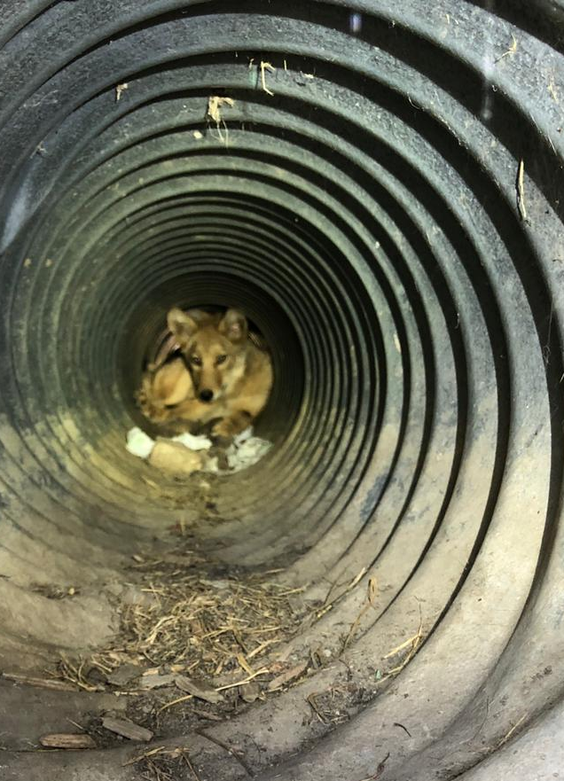
Prevent Conflicts at Home
REMOVE FOOD SOURCES – Make Coyotes Unwelcome
Clean debris/clutter from around home
Keep grass and shrubbery trimmed
Clean BBQ of grease
Pick ripened vegetables and fruit/windfalls
Close or repair openings under decks or sheds
Clean up pet waste in a timely manner
Do not feed pets outdoors
Do not feed wild animals
Eliminate the use of bird feeders.
Clean up spillage from bird feeders; place enough seed for a few hours, remove feeders if they are attracting unwanted wildlife or rodents
Install fencing/rollers/motion sensors

Slide 9
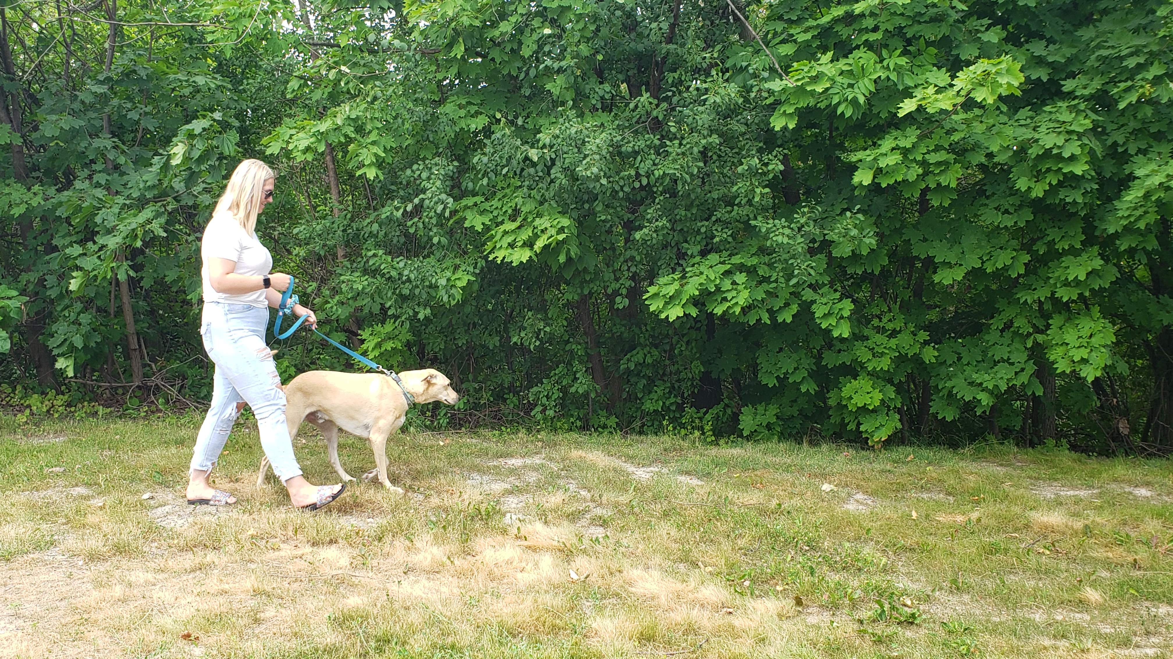
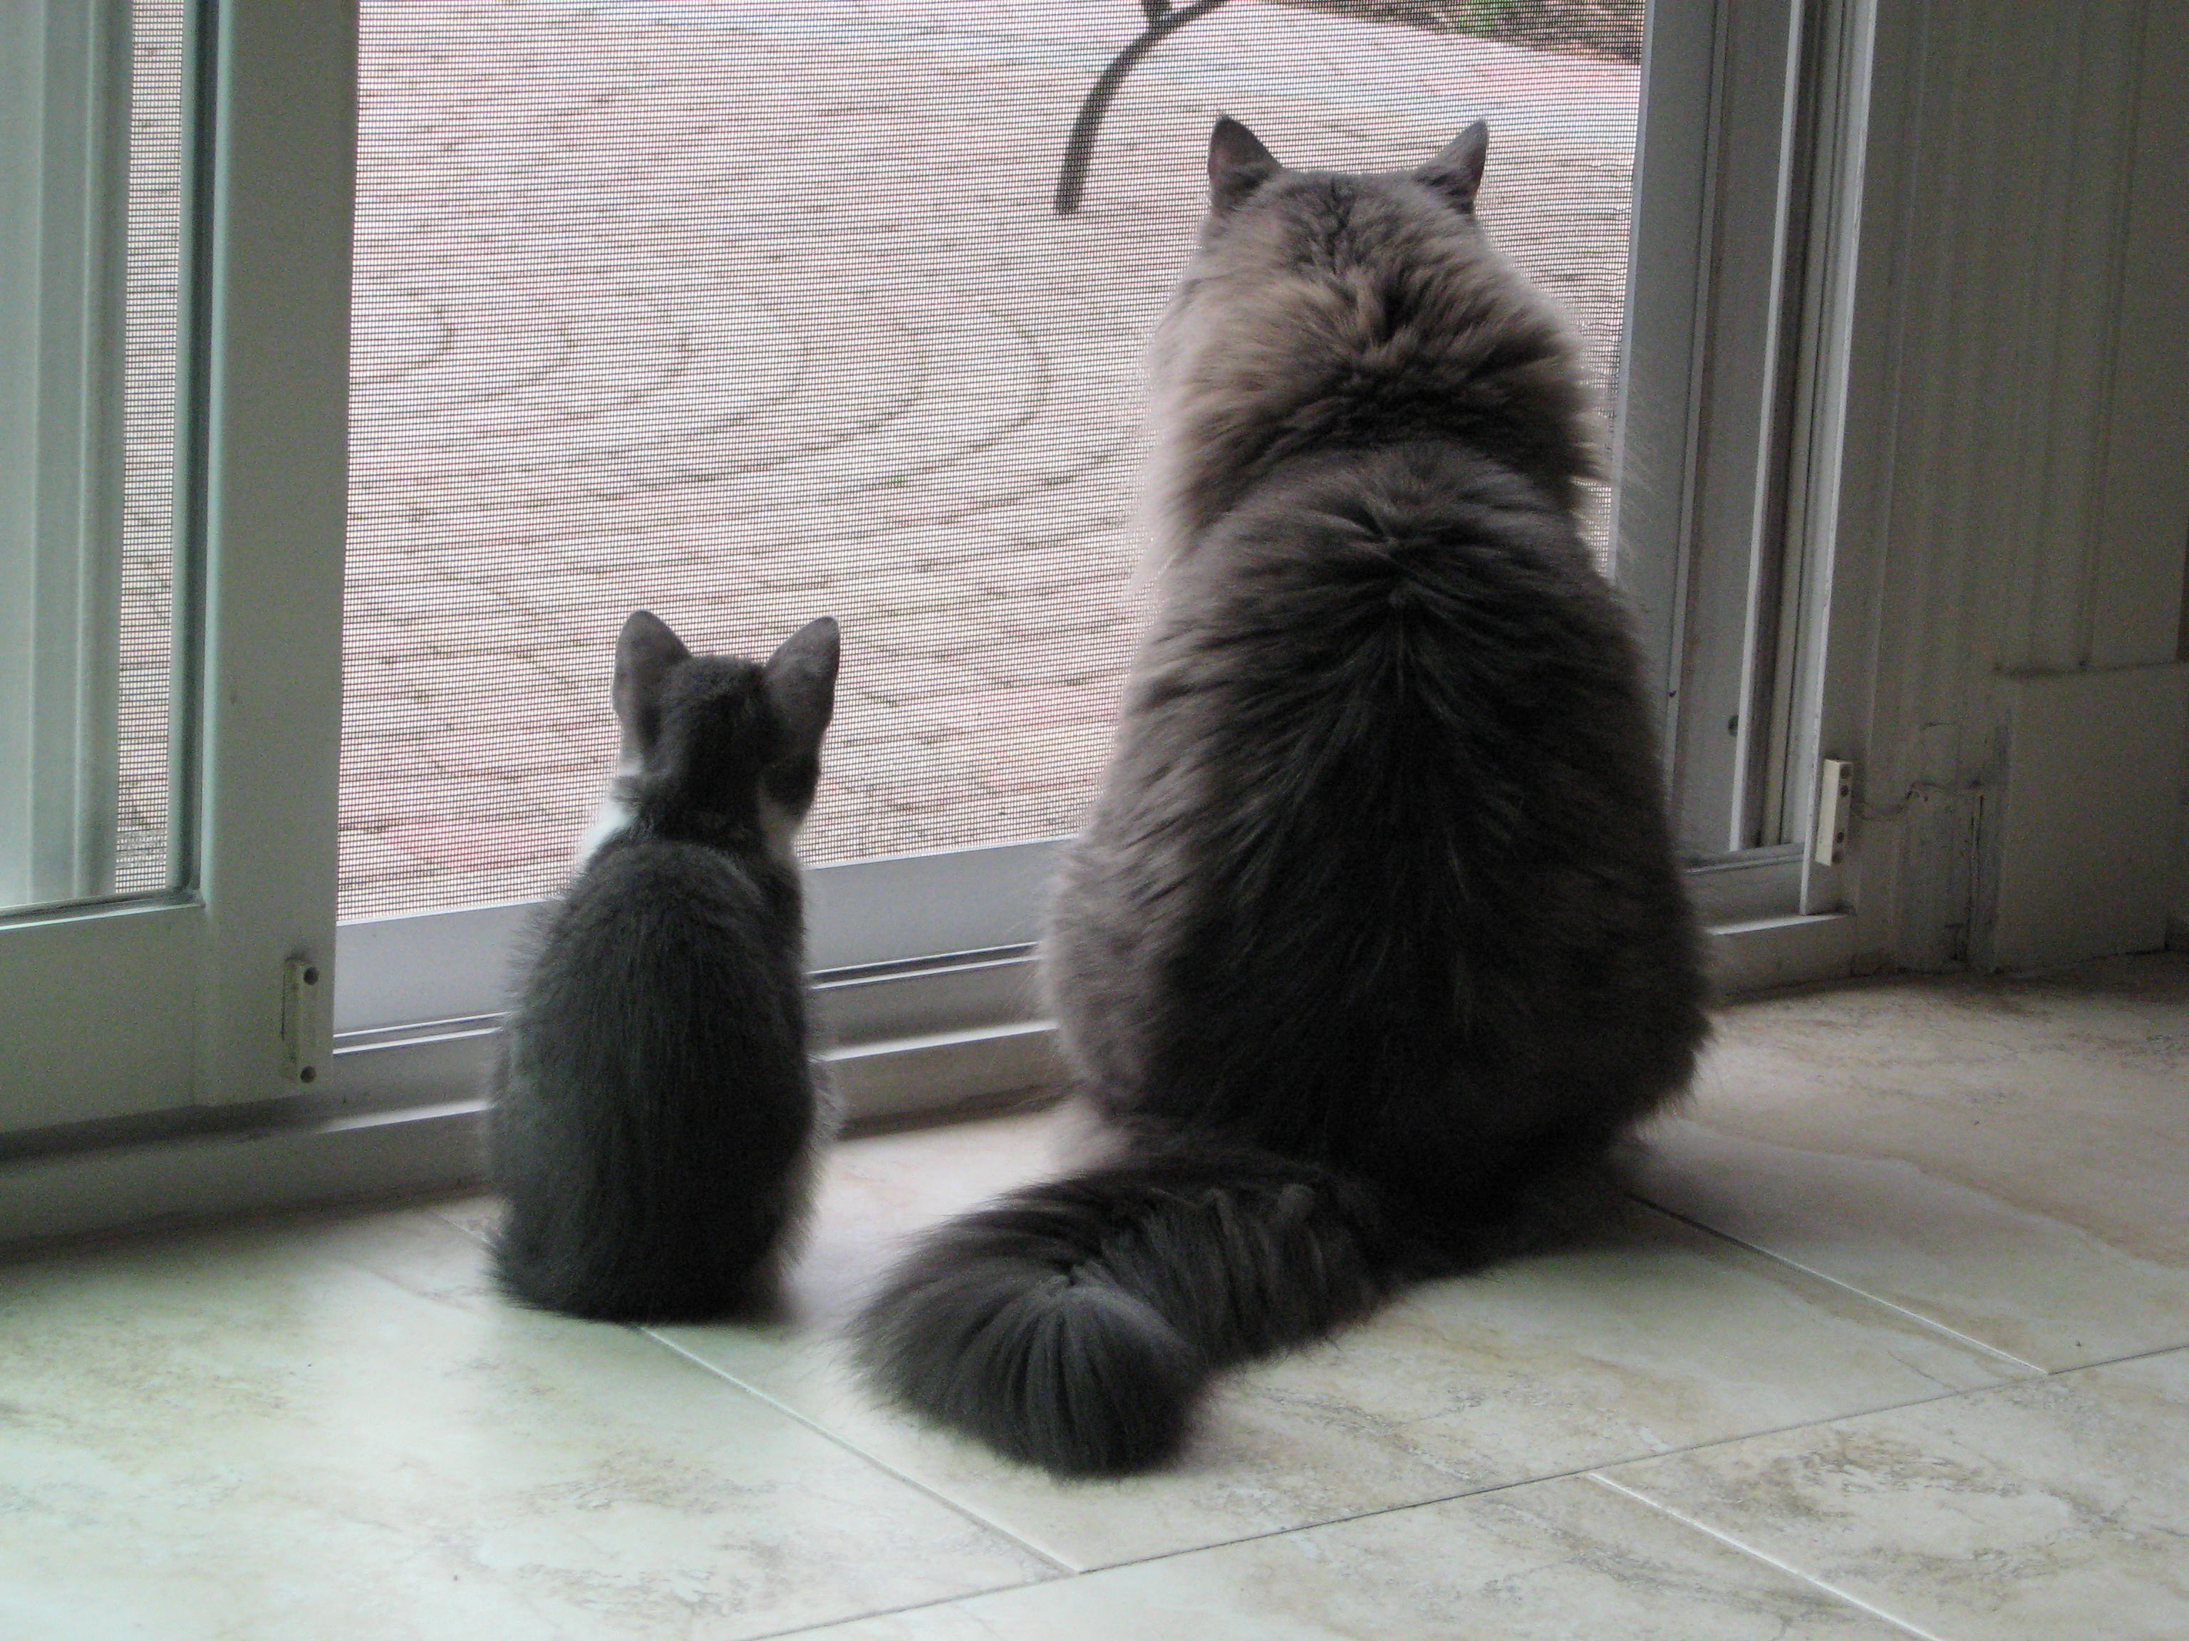
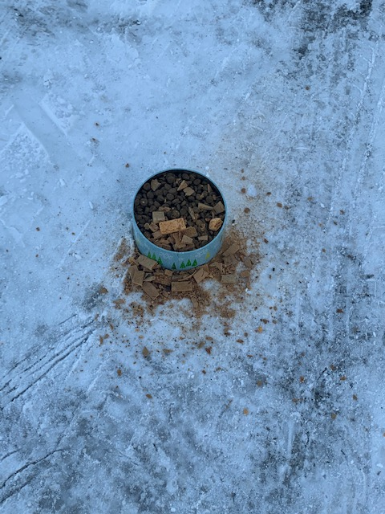
Keeping Pets Safe
Walk dog’s on 6’ leash
Supervise pets when outdoors
Keep cats indoors
Install fencing
Vaccinate pets against rabies
Spay and neuter pets
Don’t feed your pets outdoors

Slide 10
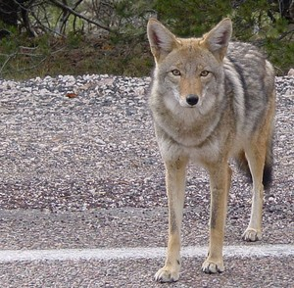
What to Do If You Encounter A Coyote
Avoid walking in isolated areas or woodlots at dusk/dawn.
Carry an audible alarm, horn, umbrella, pop can of pennies, cell phone.
Give them space and stay calm
Stand Still and face the coyote
Back away – do not run or turn your back
Keep dogs on short leash by your side
If a coyote approaches
Make yourself appear large/aggressive/wave arms/clap hands/shout
Make a sudden movement or throw something towards them
Send a strong message that they are not welcome
If you are in immediate danger - Call 911

Slide 11
Contacts
Animal Services Dispatch 24/7
905-615-3000
Animal Services Shelter
905-896-5858
Mississauga.ca/coyote

